Slide 1
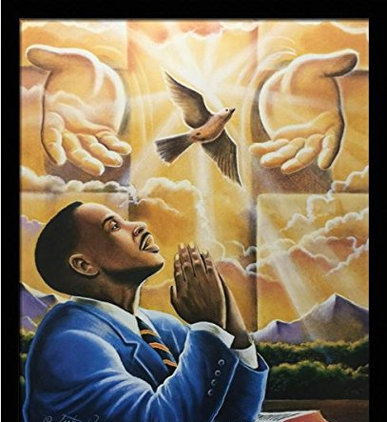
The Lords Prayer
Our Father,
who art in heaven,
hallowed be thy name;
thy kingdom come;
thy will be done
on earth as it is in heaven.
Give us this day our daily bread;
and forgive us our trespasses
as we forgive those who trespass against us;
and lead us not into temptation,
but deliver us from evil.
Amen.

