Slide 1
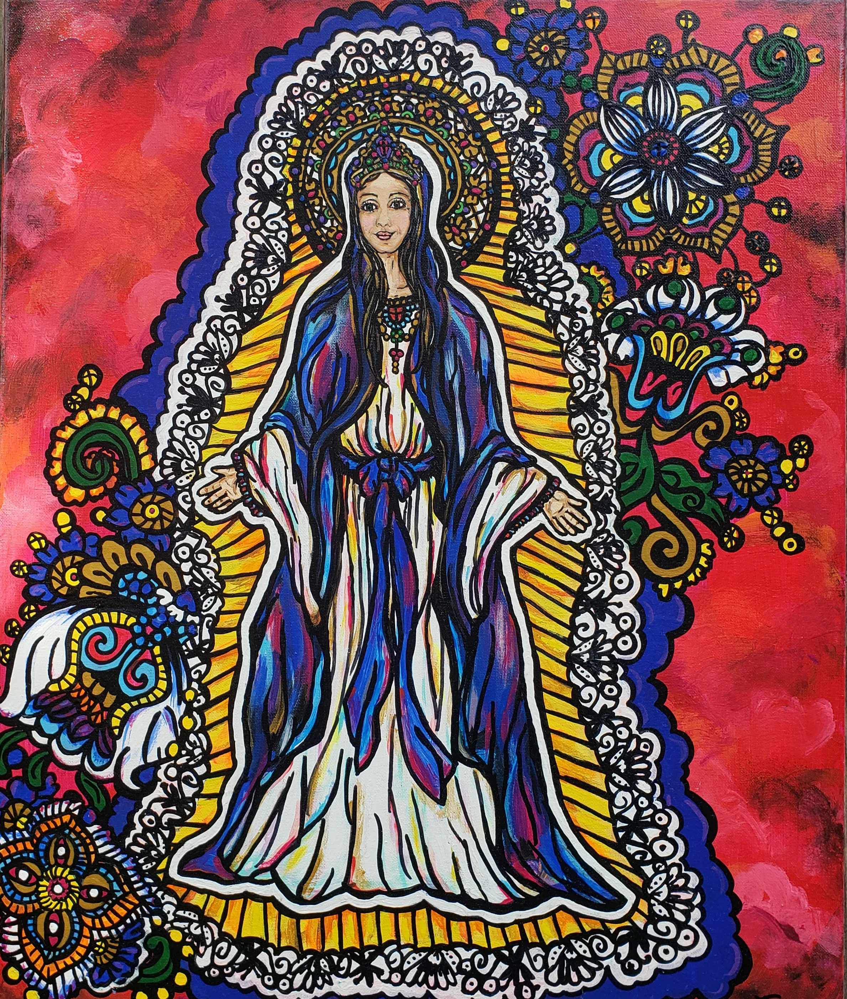
Hail Mary
Hail Mary full of Grace, the Lord is with thee.
Blessed are thou among women and blessed is the fruit of thy womb Jesus.
Holy Mary Mother of God,
pray for us sinners now and at the hour of our death
Amen.

