Slide 1

Independent Learning
Year 9
Term 1

Slide 2

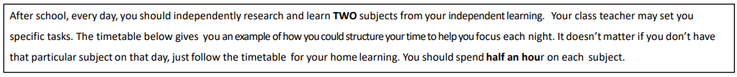
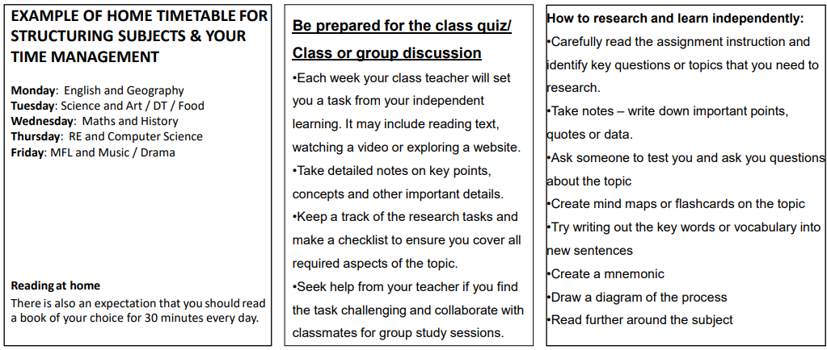

Slide 3

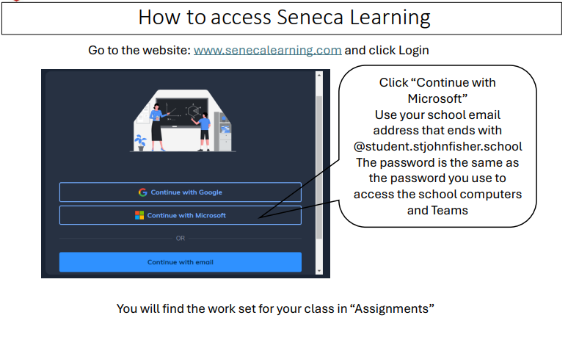

Slide 4
Mathematics Year 9 (GS)
Week 1:
No HOMEWORK
Log into Sparx Maths using the provided log in detail.
Having log in issues?
Email: e.nyantakyi@stjohnfisher.school
Week 5:
HOMEWORK
Log into Sparx Maths using the provided log in detail.
Complete the task set on: Simplifying surds, Expanding brackets with surds, Adding and subtracting surds, Multiplying and dividing surds
Having log in issues?
Email: e.nyantakyi@stjohnfisher.school
Week 2:
HOMEWORK
Log into Sparx Maths using the provided log in detail.
Complete the task set on: Counting Rule, Place value and estimation,
HCF and LCM
Having log in issues?
Email: e.nyantakyi@stjohnfisher.school
Week 6:
HOMEWORK
Log into Sparx Maths using the provided log in detail.
Complete the task set on: Expanding brackets, Solving equations with two or more steps, Changing the subjects of formulae
Having log in issues?
Email: e.nyantakyi@stjohnfisher.school
Week 3:
HOMEWORK
Log into Sparx Maths using the provided log in detail.
Complete the task set on: Index rules with positive indices and negative indices, Index rules with fraction indices, Using standard form
Having log in issues?
Email: e.nyantakyi@stjohnfisher.school
Week 7:
HOMEWORK
Log into Sparx Maths using the provided log in detail.
Complete the task set on: algebraic fractions, Substituting into algebraic formulae, Adding and subtracting algebraic fractions
Having log in issues?
Email: e.nyantakyi@stjohnfisher.school
Week 4:
HOMEWORK
Log into Sparx Maths using the provided log in detail.
Complete the task set on: Adding and subtracting numbers in standard form, Multiplying and dividing numbers in standard form
Having log in issues?
Email: e.nyantakyi@stjohnfisher.school
Week 8:
HOMEWORK
Log into Sparx Maths using the provided log in detail.
Complete the task set on: Revision of sequences
Having log in issues?
Email: e.nyantakyi@stjohnfisher.school
Key vocabulary: Indices, standard form, surds, expanding brackets, algebraic formulae, algebraic fractions

Slide 5
Mathematics Year 9 (MS)
Week 1:
No HOMEWORK
Log into Sparx Maths using the provided log in detail.
Having log in issues?
Email: e.nyantakyi@stjohnfisher.school
Week 5:
HOMEWORK
Log into Sparx Maths using the provided log in detail.
Complete the task set on: Dividing with a remainder, Calculating with roots and powers, Prime factor decomposition
Having log in issues?
Email: e.nyantakyi@stjohnfisher.school
Week 2:
HOMEWORK
Log into Sparx Maths using the provided log in detail.
Complete the task set on: Index rules with positive indices, Estimating calculations, Venn diagrams with set notation
Term-to-term rules for numerical sequences
Having log in issues?
Email: e.nyantakyi@stjohnfisher.school
Week 6:
HOMEWORK
Log into Sparx Maths using the provided log in detail.
Complete the task set on: Finding the highest common factor
Finding the lowest common multiple, Finding the HCF and LCM using prime factor decomposition
Having log in issues?
Email: e.nyantakyi@stjohnfisher.school
Week 3:
HOMEWORK
Log into Sparx Maths using the provided log in detail.
Complete the task set on: Estimating calculations, Finding factors and using divisibility tests, Using a written method to divide integers
Having log in issues?
Email: e.nyantakyi@stjohnfisher.school
Week 7:
HOMEWORK
Log into Sparx Maths using the provided log in detail.
Complete the task set on: Finding the area of rectangles, Finding the area of triangles, Finding the perimeter of rectangles and simple shapes
Having log in issues?
Email: e.nyantakyi@stjohnfisher.school
Week 4:
HOMEWORK
Log into Sparx Maths using the provided log in detail.
Complete the task set on: Multiplying and dividing with negative numbers, Ordering negative numbers, Calculating with roots and powers
Having log in issues?
Email: e.nyantakyi@stjohnfisher.school
Week 8:
HOMEWORK
Log into Sparx Maths using the provided log in detail.
Complete the task set on: Finding the area of trapeziums, Finding the area of compound shapes
Having log in issues?
Email: e.nyantakyi@stjohnfisher.school
Key vocabulary: Indices, sequences, Venn diagrams, prime factor decomposition, Trapeziums

Slide 6
English
Week 1:
Explore the socio-historic context of Gothic literature – why did it become popular when it did? (See below for your information.)
https://www.encyclopedia.com/arts/educational-magazines/gothic-literature
Week 5:
Write a paragraph for the Gothic story you planned last week – use imagery, metaphor, simile, hyperbole and personification.
Week 2:
Watch the Scooby Doo Video
https://www.youtube.com/watch?v=GsNE3dhliOk
Make a list of all the gothic aspects can you find.
Week 6 and 7:
Write the rest of your Gothic story:
Success Criteria:
Use a first-person narrator (‘I’).
Use ambitious vocabulary and varied language techniques. Can you include similes, metaphors, and personification in your retelling?
Set the scene! Describe the setting using your five senses – what can you see, hear, smell, touch and taste?
Show don’t tell! How can you show us how they’re feeling without getting them to tell us directly? For Example: Instead of writing, ‘I felt sad…’, you could write, ‘My face fell and my eyes burnt with tears. I could feel my heart breaking inside me…’
Week 3:
What character types can you identify in “Shrek” (or any other film you’ve watched/book you’ve read)?
What are the stages of the hero’s journey in any of the “Shrek” films (or any other film you’ve watched/book you’ve read)?
Week 4:
Plan your own Gothic story which involves a struggle between good and evil.
Story board your story / label with language devices.
Key Vocabulary:
Grotesque, Dolorous, Prophecy, Macabre, Gargoyle, Sinister.

Slide 7
Science
Week 1:
Settling into new school year
Week 5:
Complete Seneca Learning Assignment.
This will be marked by Seneca.
Week 2:
Settling into new school year
Week 6:
Complete Seneca Learning Assignment.
This will be marked by Seneca.
Week 3:
Complete Seneca Learning Assignment.
This will be marked by Seneca.
Week 7:
Complete Seneca Learning Assignment.
This will be marked by Seneca.
Week 4:
Complete Seneca Learning Assignment.
This will be marked by Seneca.
Key Vocabulary: digestion – mouth – stomach – small intestine – large intestine – villi – microvilli – diffusion – concentration gradient – enzyme – protein – active site – substrate – product – carbohydrate – lipid – glucose – respiration

Slide 8
Year 8 Religious Education
Week 1: Genesis
Watch the following clip: https://www.youtube.com/watch?v=9z_rllI-H4o
Create a piece of art to explain what happens in both genesis stories. This can be done by hand or on a computer with internet images. Then write a short explanation of each story.
Week 4: Gender Equality
How does the Catholic Church promote equality. Create a short presentation on how the Catholic Church promotes gender equality in the world today.
Some helpful links to get you started below:
https://cafod.org.uk/about-us/what-we-do/gender
https://www.youtube.com/watch?v=Z_-nvOg7S0o
Week 2: Imago Dei
Use the bitesize resource and answer the questions
https://www.bbc.co.uk/bitesize/guides/zg3vxfr/revision/4
What Imago Dei mean?
Outline 3 ways humans are made in the image of God (3)
What does it mean to have free will
What is sin?
Why do Catholics think that humans are predisposed to sin?
Week 5:
  Revise for the assessment.
  Use information on Teams and from class to help you prepare for the assessment.
Week 3: Human Dignity
Watch the following clip: https://www.youtube.com/watch?v=sPfx2rVtgxs and answer the questions below:
1. Summarise human dignity in your own words.
2. Do you think you treat everyone with dignity?
3. Outline 3 ways Catholics can promote the dignity of the human person. (3)
Week 6: Biography
Create a short biography about one of the following figures, focusing on how they have promoted human dignity and equality in the world.
1. Pope Francis
2. Bartolomé de las Casas
3. Franz Jägerstätter
Key vocabulary: Imago Dei, Creation, Sin, Free Will, Concupiscence, Rational, Relational, Sanctity of Life, Gender Equality, Matrimony.

Slide 9
Year 9: Term 1 Citizenship: Positive and Healthy Relationships
Week 1: Relationships
Think about the different relationships you have in your life, such as friends, family members, teachers or teammates. Write a list of five qualities that you think are important in a healthy relationship (for example, trust, kindness or respect). Choose two of your qualities and explain why they are important using full sentences. Aim to write 100–150 words.
Week 5: Solutions to social pressure on young people
Research where young people can go if they feel stressed. What charities exist? What do the charities do?
The following clip might help you: https://www.youtube.com/watch?v=Rgil2_hlbmU
Week 2: Respect in Everyday Life
Respect is an important part of healthy relationships. Think of three ways people can show respect at home, at school or online. Write a short paragraph explaining how these actions help people feel safe, valued and included. Use examples to support your ideas.
Week 6:
Create a poster explaining where young people can go if they are stressed.
Week 3: Aspects of a positive relationship?
Watch the following clip and design a poster outlining the 8 aspects of a positive relationship.
https://www.youtube.com/watch?v=sch8LPCu6s4
Week 7: Watch the news in preparation for next term’s work on the law. Write a list of news items that relate to crime. What are the issues within crime today?
Week 4: Social pressures for young people
List at least 5 pressures that young face today and explain what they are.
Key Vocabulary: Anxiety, stress, mental health, abuse, coercion

Slide 10
Computing
Week 1:
HOMEWORK
Create a Python list of 10 numbers and write code to calculate the average.
Week 5: HOMEWORK
Write a Python program that reads from a text file and counts how many times the word 'computer' appears.
Week 2: HOMEWORK
Create a nested list to represent students and their marks, then write code to find the student with the highest mark..
Week 6: HOMEWORK
Plan and outline a small project that uses lists, loops, and file handling (e.g., a simple gradebook system).
Week 3: HOMEWORK
Write a while loop that continues asking the user for input until they type 'STOP'.
Week 7: HOMEWORK
Reflect on your learning: Which Python concept this term was the hardest? How did you overcome it?
Week 4: HOMEWORK
Write a for loop that prints only the even numbers from 1 to 50.
KEY VOCABULARY
List, data type, Nested loops, Indexing, Iteration

Slide 11
French Year 9
Week 1:
No Homework
Week 5:
Writing Task
What are you going to do next weekend? 50 words.
Week 2:
Vocab Test
Week 6:
Avoir – Grammar check (Passé Composé)
Week 3:
Writing Task
What do you watch on TV? 50 words.
Week 7:
Revise for T1 Assessment.
Week 4:
Aller – Grammar check (Near future)
Key Vocabulary: Media & Technology

Slide 12
Subject: Latin Year 9
Week 1: No Homework
Week 5:
Focus: Grammar – Nominative & accusative
Tasks: Language practice from Suburani online.
Week 2:
Vocabulary Test – as set on Teams
Week 6:
Vita Romana poster / presentation
Week 3:
Focus: The Present Tense.
Tasks: Language practice from Suburani online.
Week 7 : Revision for T1 Assessment
Week 4:
Vocabulary Test – as set on Teams
Week 8:
What can you say about cases and declensions? Give a few examples.
Key Vocabulary: Rome, Subura, insula, laboro, popina, turba, vinum, amicus, forum

Slide 13
History
Week 1:
Settling in to new school year
Week 5:
This week your independent learning task will be to start to complete an information sheet on your chosen topic. This week, make a plan for your information sheet. There is a planning page in your booklet for this. Once you have made your plan, make a start on your project.
Week 2:
Settling in to the new school year
Week 6:
For this week’s independent learning task, you are required to complete your information sheet. Remember that your work must be illustrated. It must also describe in detail the topic you have chosen for your research.
Week 3:
1. Choose your research topic from the list provided.
2. In one paragraph, explain why you chose this topic to research.
3. Discover and write down three interesting facts about your chosen research topic.
Week 7:
Now that you have completed your first research project, it is time to reflect on what went well, and what you might do differently next time.
Week 4:
Your research project requires you to know when the events you are investigating occurred. This week, complete the timeline page in your independent learning book. Plot the key dates for your chosen topic.
Key Vocabulary:
Militarism, Alliances, Imperialism, Nationalism, Britain, Germany, France, Russia, Austria-Hungary, Italy, the Ottoman Empire, Schlieffen, Belgium, Trench, Artillery, Shell, Casualties

Slide 14
Geography
Week 1:
Settling into new school year
Week 5:
Work through the tasks set on Seneca investigating the biodiversity of cold environments.
The assignment will become active on Teams.
Week 2:
Work through the tasks set on Seneca investigating how cold environments are interdependent.
The assignment will become active on Teams.
Week 6:
Work through the tasks set on Seneca Investigating Alaska and Svalbard as case studies of a cold environments.
The assignment will become active on Teams.
Week 3:
Work through the tasks set on Seneca investigating how plants have adapted to cold environments.
The assignment will become active on Teams.
Week 7:
Work through the tasks set on Seneca Investigating how we can sustainably manage cold environments.
The assignment will become active on Teams.
Week 4:
Work through the tasks set on Seneca investigating how animals have adapted to cold environments.
The assignment will become active on Teams.
Key Vocabulary:
Interdependent, harsh, Arctic berry, large surface area, insulation, fur, biodiversity, extreme, fragile, exploitation and sustainable management.

Slide 15
Art and Design Year 9 Term 1
Week 1:
Create a title page design for the Human Form project.
Week 5:
Take close-up photographs of facial features and present these on a PowerPoint slide. Please include the following: eyes, nose, mouth and ears.
Week 2:
Research portraiture in art. Create a PowerPoint slide with images and information.
Week 6:
Draw a self-portrait using line and tone. Observe yourself in a reflective object e.g. a mirror, spoon or shiny kettle.
Week 3:
Create a mood board of hands in Art. Find and use examples of drawing, painting and sculpture.
Week 7:
Research the work of artist Kris Trappeniers. Create a PowerPoint slide of images of his work.
I
Week 4:
Sit in front of a mirror and create a line drawn self-portrait using pencil or pen.
Key Vocabulary:
Portraiture, facial features, proportion, pose, expression, character, continuous line drawing, wire drawing, mixed media, masks from different cultures, cubism, multiple viewpoints, perspective, human anatomy, figure drawing and painting, sculpture, charcoal.

Slide 16
Drama Year 9 Term 1
Week 1: Bertolt Brecht
This term we are studying Bertolt Brecht. Write a mini fact file about Brecht explaining where and when he was born, when he died, what his thoughts were about theatre, and five of the plays that he wrote.
Week 5: Rehearsal
Find ten minutes at the start of a break or lunchtime with your group to go over the performance so far. Focus on making sure you have covered everything that you need to be doing for your final performance.
Week 2: Gestus
Using a mirror to help you, practice a series of different Gestus. Make sure that this movement is exaggerated in order to really bring out the over the top nature that Brecht intended through his work.
Week 6: Reflection
Think over the work that you have done this term on Brecht. Write a reflection of this working, thinking about what went really well, and what needed some improvements.
Week 3: Banksy
We are using some of the work of the street artist Banksy in our lessons. Research another piece of artwork that he has done and find out what his political meaning for creating the piece is.
Week 7: Brecht Plays
As well as being a theatre practitioner, Bertolt Brecht wrote many plays. Do some research into one of them and produce for me a information pack about this play, telling me about its original production and the meaning behind it.
Week 4: Placards
Brecht liked to use placards in his work to emphasis the points that he was trying to make. Design your own placard for a cause that you believe in – that can be a large scale cause, or something more personal.
Key vocabulary: Epic theatre, Political Theatre, Gestus, Exaggeration, Placards, Freeze Frames, Tableaux

Slide 17
Year 9 Music Term 1
Week 1:
Settling in to new school year.
Week 5:
Note lengths
https://www.musictheoryacademy.com/how-to-read-sheet-music/note-lengths/
Read the information, take a few notes and be prepared to answer questions at the start of next lesson
Week 2:
What is Middle C?
https://www.musictheoryacademy.com/how-to-read-sheet-music/middle-c/
Read the information, take a few notes and be prepared to answer questions at the start of next lesson
Week 6:
Basic Rhythms
https://www.musictheoryacademy.com/how-to-read-sheet-music/reading-straight-rhythms/
Read the information, take a few notes and be prepared to answer questions at the start of next lesson
Week 3:
What is Pitch?
https://www.musictheoryacademy.com/how-to-read-sheet-music/pitch/
Read the information, take a few notes and be prepared to answer questions at the start of next lesson
Week 7:
Dynamics
https://www.musictheoryacademy.com/how-to-read-sheet-music/dynamics/
Read the information, take a few notes and be prepared to answer questions at the start of next lesson
Week 4:
The treble clef
https://www.musictheoryacademy.com/how-to-read-sheet-music/treble-clef/
Read the information, take a few notes and be prepared to answer questions at the start of next lesson
Key Vocabulary: Musical notes, pitch, clef, rhythms, note value, semibreve, crotchet, minim, semiquaver

Slide 18

Year 9 - Physical Education Term 1
Week 1: Baseline Assessment & Expectations in PE. PE Department Expectations.pptx
Revisit the rules and expectations in PE document and answer the PE Department Expectrations – Fill out form
Week 4: Activity 1 Week 3
Knowledge Focus – Muscles (lower body)
Knowledge Organiser Pages 3 & 4
Read page 3 and learn the different muscles and write them on the blank diagrams on page 4
Week 2: Activity 1 Week 1 - Teams
Knowledge Focus – Muscles (Upper Body)
Knowledge Organiser Pages 3 & 4
Read page 3 and answer the questions on page 4
Week 5 : Activity 1 Week 4
Log into ever learner and complete assignment 2 which is knowledge of the muscular system.
Complete muscular locations practice online
Everlearner Muscular Information Practice
Week 3: Activity 1 Week 2 - Everlearner
Log into ever learner and complete assignment 2 which is knowledge of the muscular system.
https://theeverlearner.com/course-166/lesson/the-muscular-system-1
Week 6: Activity 1 Revision & Assessment Week
  Read and revise knowledge Organiser Pages 2 - 7
  Quiz Yourself: Everlearner Muscular Information Practice
Click for knowledge organiser

