Slide 1

Independent Learning
Year 8
Term 1

Slide 2

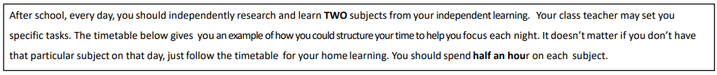
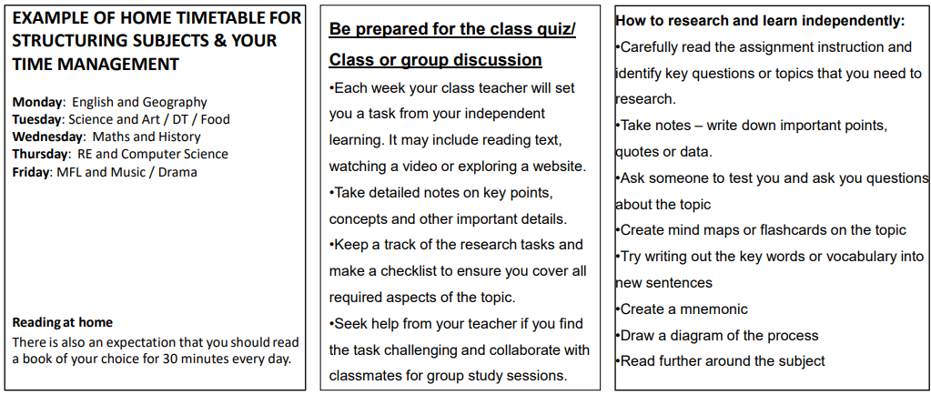

Slide 3

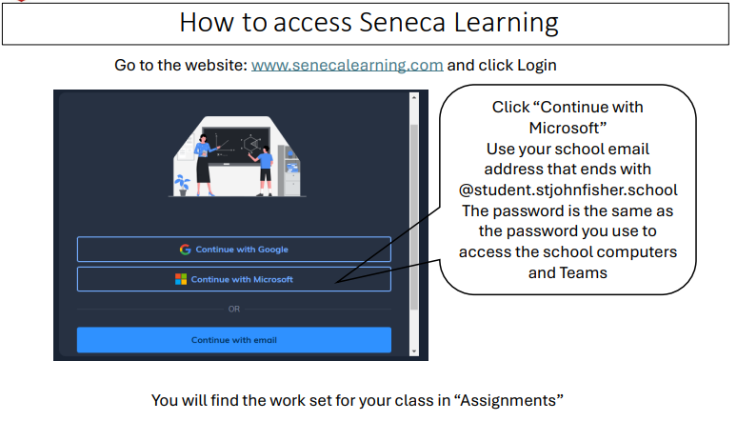

Slide 4
Mathematics Year 8 (GS)
Week 1:
No HOMEWORK
Log into Sparx Maths using the provided log in detail.
Having log in issues?
Email: e.nyantakyi@stjohnfisher.school
Week 5:
HOMEWORK
Log into Sparx Maths using the provided log in detail.
Complete the task set on: Dividing with a remainder, Calculating with roots and powers, Prime factor decomposition
Having log in issues?
Email: e.nyantakyi@stjohnfisher.school
Week 2:
HOMEWORK
Log into Sparx Maths using the provided log in detail.
Complete the task set on: Index rules with positive indices, Estimating calculations, Venn diagrams with set notation
Term-to-term rules for numerical sequences
Having log in issues?
Email: e.nyantakyi@stjohnfisher.school
Week 6:
HOMEWORK
Log into Sparx Maths using the provided log in detail.
Complete the task set on: Finding the highest common factor
Finding the lowest common multiple, Finding the HCF and LCM using prime factor decomposition
Having log in issues?
Email: e.nyantakyi@stjohnfisher.school
Week 3:
HOMEWORK
Log into Sparx Maths using the provided log in detail.
Complete the task set on: Estimating calculations, Finding factors and using divisibility tests, Using a written method to divide integers
Having log in issues?
Email: e.nyantakyi@stjohnfisher.school
Week 7:
HOMEWORK
Log into Sparx Maths using the provided log in detail.
Complete the task set on: Finding the area of rectangles, Finding the area of triangles, Finding the perimeter of rectangles and simple shapes
Having log in issues?
Email: e.nyantakyi@stjohnfisher.school
Week 4:
HOMEWORK
Log into Sparx Maths using the provided log in detail.
Complete the task set on: Multiplying and dividing with negative numbers, Ordering negative numbers, Calculating with roots and powers
Having log in issues?
Email: e.nyantakyi@stjohnfisher.school
Week 8:
HOMEWORK
Log into Sparx Maths using the provided log in detail.
Complete the task set on: Finding the area of trapeziums, Finding the area of compound shapes
Having log in issues?
Email: e.nyantakyi@stjohnfisher.school
Key vocabulary: Indices, sequences, Venn diagrams, prime factor decomposition, Trapeziums

Slide 5
Mathematics Year 8 (MS)
Week 1:
NO HOMEWORK
Week 5:
HOMEWORK
Log into Sparx Maths using the provided log in detail.
Complete the task set on: Area of triangle
Having log in issues?
Email: e.nyantakyi@stjohnfisher.school
Week 2:
HOMEWORK
Log into Sparx Maths using the provided log in detail.
Complete the task set on: Divisibility and division
Having log in issues?
Email: e.nyantakyi@stjohnfisher.school
Week 6:
HOMEWORK
Log into Sparx Maths using the provided log in detail.
Complete the task set on:Area of parallelogram and trapezium
Having log in issues?
Email: e.nyantakyi@stjohnfisher.school
Week 3:
HOMEWORK
Log into Sparx Maths using the provided log in detail.
Complete the task set on: Square numbers and square roots
Having log in issues?
Email: e.nyantakyi@stjohnfisher.school
Week 7:
HOMEWORK
Log into Sparx Maths using the provided log in detail.
Complete the task set on: Volume of cube and cuboids
Having log in issues?
Email: e.nyantakyi@stjohnfisher.school
Week 4:
HOMEWORK
Log into Sparx Maths using the provided log in detail.
Complete the task set on: Factors, multiples and primes
Having log in issues?
Email: e.nyantakyi@stjohnfisher.school
Week 8:
HOMEWORK
Log into Sparx Maths using the provided log in detail.
Complete the task set on: Surface area of cube and cuboids
Having log in issues?
Email: e.nyantakyi@stjohnfisher.school
Key vocabulary: Division, Divisibility, Square roots, Primes, Area, Volume, Parallelogram, Cuboids

Slide 6
English
Week 1:
Watch the myth of Pandora’s Box on you tube by Iseult Gillespie – What lesson do you think is learned?
https://www.youtube.com/watch?v=pMdJxVjZMRI
Week 5:
Research what figurative language is and write a description of yourself using figurative language..
Week 2:
Choose a Greek myth from this list: King Midas, Theseus and the Minotaur, Odysseus and the Cyclops
Read the myth. Make a list of the themes and ideas within the myth. Is there are lesson or moral in the myth? Why? What is it?
Week 6 and 7:
Choose a myth, legend, or fairy tale and retell it from the perspective of one character. For example: Retell ‘Red Riding Hood’ from the perspective of the wolf; or ‘Odysseus’ from the perspective of the Cyclops.
Success Criteria:
Use a first-person narrator (‘I’).
Use ambitious vocabulary and varied language techniques. Can you include similes, metaphors, and personification in your retelling?
Set the scene! Describe the setting using your five senses – what can you see, hear, smell, touch and taste?
Show don’t tell! How can you show us how they’re feeling without getting them to tell us directly? For Example: Instead of writing, ‘I felt sad…’, you could write, ‘My face fell and my eyes burnt with tears. I could feel my heart breaking inside me…’
Week 3:
Research a famous legend (not myth) – YouTube has loads..
Describe the main character’s personality and character traits.
Can you think of any similarities with characters from other legends? Which ones? Comment on why these characters might have similarities.
Week 4:
Think of a traditional fairy tale and then give it a modern twist by writing down what changes you would make to the structure to show modern values and ideas. Consider:
Setting (where it is); plot (what happens); character(s) (who is in it); magical object/animals (how the plot develops); the moral or lesson (why).
Key Vocabulary:
Theme, Hamartia, Hubris, Immortals/mortals, Freytag’s Pyramid, Foreshadows.

Slide 7
Science
Week 1:
Settling into new school year
Week 5:
Complete Seneca Learning Assignment.
This will be marked by Seneca.
Week 2:
Settling into new school year
Week 6:
Complete Seneca Learning Assignment.
This will be marked by Seneca.
Week 3:
Complete Seneca Learning Assignment.
This will be marked by Seneca.
Week 7:
Complete Seneca Learning Assignment.
This will be marked by Seneca.
Week 4:
Complete Seneca Learning Assignment.
This will be marked by Seneca.
Key Vocabulary: digestion – mouth – stomach – small intestine – large intestine – villi – microvilli – diffusion – concentration gradient – enzyme – protein – active site – substrate – product – carbohydrate – lipid – glucose – respiration

Slide 8
Religious Education
Week 1:
Settling in to new school year
Week 5: Research Desmond Doss. Use the following link to help you:
https://www.youtube.com/watch?v=R8ZoRgz2Xk8
You will be tested, in class, on 5 key facts from this link.
Week 2:.
Settling into new school year
Week 6: Revise for the assessment.
Use information on Teams and from class to help you prepare for the assessment.
Week 3: Research the Fall of Humanity.
Use the following link to help you:
https://www.youtube.com/watch?v=POpB_s9V8Ak
You will be tested, in class, on 5 key facts from this link
Week 7: Research Sophie Scholl and the White Rose Movement. Use the following link to help you complete the knowledge organizer.
https://www.youtube.com/watch?v=ZtOKRsF6Rr0
You will be tested, in class, on 5 key facts from this link.
Week 4: Research conscientious objector. Use the following link to help you:
https://www.youtube.com/watch?v=PKiJhGmI6Rs
You will be tested, in class, on 5 key facts from this link.
Key Vocabulary: The Fall, Original Sin, omnibenevolent, decalogue, conscience, baptism, and concupiscence.

Slide 9
Citizenship Year 08 - Term 1
Week 1: What Are Human Rights?
Find out what human rights are and explain them in your own words. Write a short paragraph explaining why human rights are important. Include three examples of human rights and explain why each one matters. Finish by explaining which right you think is the most important and why.
Week 4: Human Rights Around the World
Choose one country and find out about a human rights issue there. Write three facts about the issue and explain who is affected. Identify one UDHR article linked to the problem. Finish by suggesting one realistic improvement that could help people in that country.
Week 2: Rights or Responsibilities?
Make a table with two columns labelled "Rights" and "Responsibilities." List at least six human rights and match each one with a responsibility that helps protect it. Write a short paragraph explaining why rights and responsibilities should work together. Give one real-life example.
Week 5: Trafficking Awareness Poster
Create a simple poster warning people about human trafficking. Include three warning signs, two facts and one place people could go for help. Add a clear slogan such as "Know the signs, protect people." Write two sentences explaining why public awareness is important.
Week 3: True or False Challenge
Create 10 statements about human rights, child labour and trafficking. Make five true and five false. Ask someone at home to answer them, then mark their score. Write three sentences explaining which question was hardest and why.
Week 6: Be a Campaigner
Write a short speech (8–10 sentences) persuading people to take action against child labour or trafficking. Use at least three facts from your lessons. Explain why the issue matters and what ordinary people can do to help. End with a strong call to action.
Key vocabulary: rights, campaign, trafficking

Slide 10
Computing
Week 1:
HOMEWORK
Research and explain 3 major milestones in the history of computer systems. Include dates and why they were significant.
Week 5:
HOMEWORK
Explain in detail one modern application of AI, including benefits and risks.
Week 2:
HOMEWORK
Describe the function of 5 key hardware components and explain how they work together inside a computer.
Week 6:
HOMEWORK
Discuss the advantages and disadvantages of open-source vs. proprietary software with examples.
Week 3:
HOMEWORK
Compare and contrast two different operating systems, highlighting their advantages and disadvantages.
Week 7:
HOMEWORK
Write 5 challenging exam-style questions (with answers) based on this term’s learning.
Week 4:
HOMEWORK
Draw the AND, OR, NOT gate symbols and give truth tables for each.
KEY VOCABULARY
Computer system, Machine learning, Logic gates

Slide 11
Geography
Week 1:
Settling in to new school year
Week 5:
Work through the tasks set on Seneca Investigating the Savannah and Tropical Rain Forest environments.
The assignment will become active on Teams.
Week 2:
Watch the following you tube clip. Make notes on some of the key facts about Africa.
https://www.youtube.com/watch?v=KcNVNsvyFfA
Be prepared to complete a quiz on this in lesson.
Week 6:
Work through the tasks set on Seneca Investigating colonialization and population of Africa.
The assignment will become active on Teams.
Week 3:
Watch the following you tube clip. Make notes on the key points that are made.
https://www.youtube.com/watch?v=jbkSRLYSojo
Week 7:
Work through the tasks set on Seneca Investigating resources and the physical features of Africa.
The assignment will become active on Teams.
Week 4:
Work through the tasks set on Seneca Investigating Desert and semi-desert environments.
The assignment will become active on Teams.
Key Vocabulary:
Physical features, human features, colonialism, tourism, arid environments, dry season, wet season, slave trade, resources and wealth.

Slide 12
History
Week 1:
Settling in to new school year
Week 5:
This week your independent learning task will be to start to complete an information sheet on your chosen topic. This week, make a plan for your information sheet. There is a planning page in your booklet for this. Once you have made your plan, make a start on your project.
Week 2:
Settling in to the new school year
Week 6:
For this week’s independent learning task, you are required to complete your information sheet. Remember that your work must be illustrated. It must also describe in detail the topic you have chosen for your research.
Week 3:
1. Choose your research topic from the list provided.
2. In one paragraph, explain why you chose this topic to research.
3. Discover and write down three interesting facts about your chosen research topic.
Week 7:
Now that you have completed your first research project, it is time to reflect on what went well, and what you might do differently next time.
Week 4:
Your research project requires you to know when the events you are investigating occurred. This week, complete the timeline page in your independent learning book. Plot the key dates for your chosen topic.
Key Vocabulary:
Industry, Industrial, Steam Engine, Factory, Revolution, Urban, Rural, Agricultural, Coal, Iron, Canal, Railway

Slide 13
Year 8- French
Week 1:
No Homework
Week 5: learn the vocab which will be set on teams in French
Week 2: write a 40-word paragraph about your ‘look’ in French.
Week 6: Revision topics:
Describing clothes in French +opinions
How often you do activities in French
Hobbies
The weather
Week 3: learn the vocab for different types of weather in French.
Il fait du vent= It is windy 7. il y a du soleil= it is sunny
Il fait froid= it is cold 8. il neige= it is snowy
3. Il fait chaud= it is hot
4. Il pleut= it is raining
5. Il géle= it is freezy
6. Il y a du l’orage= it is stormy
Week 7: learn the vocab on teams for the next topic in French.
Week 4: write a paragraph about what you do on the weekend. Include about your favourite hobbies, how often you do it and with whom you do it. Write up to 40 words.
Key Vocabulary: Clothes, colours, the weather in French, hobbies and activities in French.

Slide 14
Subject: Latin Year 8
Week 1: No Homework
Week 5: Copy and learn 10 new Latin words: Caecilius, Metella, servus, canis, in, est, laborat, sedet, dormit, tablinum.
Translate:Senes sedent, iuvenes currunt. Feminae clamorem audiunt.
Change the sentences so the subjects are singular or plural correctly.
Week 2: Focus: Nominative & accusative cases.
Tasks:
Writing: Who is Caecilius? Write a short story about him.
Learn 10 words: leo, navis, forum, vinum, et, sed, non, videt, portat, clamat.
Translate:Caecilius leonem videt. Mercator in foro stat.
Identify the subject and object in each sentence above.
Week 6:
Translate: Caecilius in tablino scribit. Metella in atrio sedet.
Write 3 simple Latin sentences about a family (use in + noun).
Week 3: - Negotium in Foro
Focus: The accusative case & present tense revision.
Tasks :Learn 8 words: argentarius, pecunia, poeta, signum, vocat, reddit, agit, quaerit.
Translate:Poeta signum videt et pecuniam quaerit.
Write 2 Latin sentences using mercator and argentarius.
Week 7 : Revision for T1 Assessment
Week 8: What can you say about cases and declensions? Give a few examples.
Week 4: Learn 8 words: iuvenis, senex, femina, clamor, turba, currit, venit, audit.
Key Vocabulary: vita romana, villa / villam, servus / servum, Metella / Metellam

Slide 15
Art and Design Year 8 Term 1
Week 1:
Create a design for the Flora and Fauna title page
Week 5:
Make a careful drawing of one of the animals from your mood board that you completed last week.
Week 2:
On a PowerPoint slide, create a mood board of images from Rainforests
Week 6:
Create a mood board of images of lots of colourful insects
Week 3:
Research the paintings of Henri Rousseau. Create a PowerPoint slide of images of his work.
Week 7:
Draw two of the insects from last week’s mood board
I
Week 4:
Create a mood board of images of jungle animals.
Key Vocabulary:
Organic forms, tropical plants, pen and wash, mixed media, template, structure, shape, silhouette, flora, fauna, textured surface, repeating pattern

Slide 16
Drama- Year 8
Week 1:
Settling into new school year
Week 5: What makes an effective soundscape?
Using your knowledge acquired from the lesson, write a paragraph on what makes an effective soundscape. Bring this to next lesson.
Week 2:
N/A
Week 6: What sort of costume will Ernie have?
Now that we have started to read Ernie’s Incredible Illucinations, using what you have learnt about costume design, design a costume for the main character Ernie. He is approximately 11 years old.
Week 3: What skills and qualities should a lighting designer possess?
Type in to Google ‘working in the theatre: lighting design’ and watch the first 10 minutes of the video. From what you have seen, answer the question:
What skills and qualities should a lighting designer possess? Aim for 3 skills and 3 qualities. Tell me your answers in our next lesson.
Week 7: How can I prepare for my assessment?
Revise for your assessment next week by typing in to Google ‘GCSE Drama AQA BBC Bitesize.’
Scroll down until you see ‘theatre design’ and work your way through each element.
Week 4: Can you create you set design from Ernie’s Incredible Illucinations?
In lesson, you designed a setting for the opening scene in Ernie’s Incredible Illucinations. Can you now create this setting using any materials you have at home? Bring this in next lesson and I will give you 10 praise points.
Key Vocabulary:
Technical theatre, lighting design, set design, sound design, costume design

Slide 17
Year 8 Music Term 1
Week 1:
Settling in to new school year.
Week 5:
Find 2 different recordings of the song Blue Suede Shoes. You can use YouTube or Spotify to find good quality tracks
How are they the same? How are they different?
Week 2:
Watch the clips and read the information about Gershwin's Rhapsody in Blue
https://www.bbc.co.uk/teach/ten-pieces/articles/zkcy6v4
Be prepared to share your thoughts and ideas at the start of the next lesson
Week 6:
Watch the following clip – Classical Gas
https://www.youtube.com/watch?v=0vXtywOlayc
Challenge: Find another piece of music featuring a classical guitar. How is the playing technique different to pop and rock songs?
Week 3:
Watch the clips and read the information about Marianne von Martínez - Overture
https://www.bbc.co.uk/teach/ten-pieces/articles/z6n3qyc
Be prepared to share your thoughts and ideas at the start of the next lesson
Week 7:
Watch the following clip of The Eve of the War from War of the Worlds.
https://www.youtube.com/watch?v=6YwFvmnbj3E
Listen carefully and be prepared to share your thoughts and ideas about the piece next lesson.
Week 4:
Watch the clips and read the information about Gabriel Prokofiev - Concerto for Turntables and Orchestra
https://www.bbc.co.uk/teach/ten-pieces/articles/z6vs2sg
Be prepared to share your thoughts and ideas at the start of the next lesson
Key Vocabulary: a capella, rock & roll, orchestra, vocals, timbre, jazz, concerto, overture, synthesizer

Slide 18
Year 8 - Physical Education
Week 1: Baseline Assessment & Expectations in PE. PE Department Expectations.pptx
Revisit the rules and expectations in PE document and answer the PE Department Expectrations – Fill out form
Week 4: Activity 1 Week 3
Knowledge Focus – Muscles (lower body)
Knowledge Organiser Pages 3 & 4
Read page 3 and learn the different muscles and write them on the blank diagrams on page 4
Week 2: Activity 1 Week 1 - Teams
Knowledge Focus – Muscles (Upper Body)
Knowledge Organiser Pages 3 & 4
Read page 3 and answer the questions on page 4
Week 5 : Activity 1 Week 4
Log into ever learner and complete assignment 2 which is knowledge of the muscular system.
Complete muscular locations practice online
Everlearner Muscular Information Practice
Week 3: Activity 1 Week 2 - Everlearner
Log into ever learner and complete assignment 2 which is knowledge of the muscular system.
Week 6: Activity 1 Revision & Assessment Week
  Read and revide knowledge Organiser Pages 2 - 7
  Quiz Yourself: Everlearner Muscular Information Practice

