Slide 1

Independent Learning
Year 7
Term 1

Slide 2

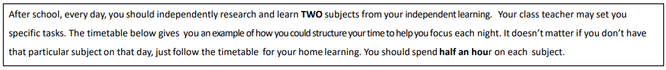
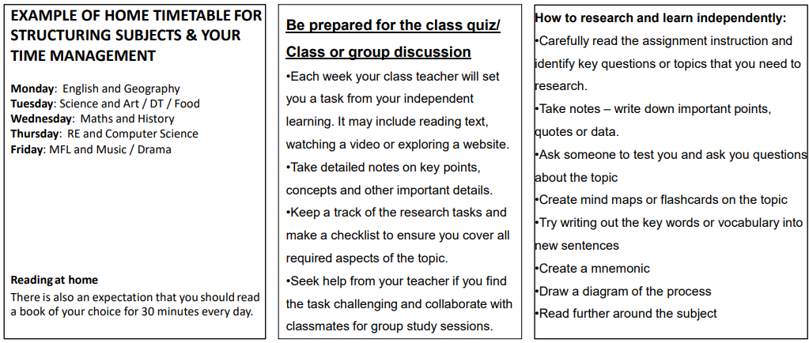

Slide 3

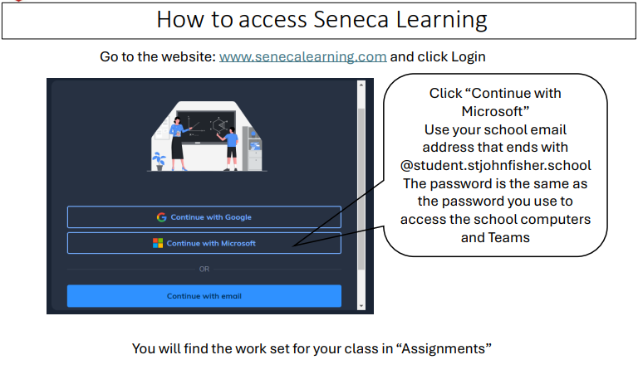

Slide 4
Mathematics Year 7 (GS)
Week 1:
NO HOMEWORK
Week 5:
HOMEWORK
Log into Sparx Maths using the provided log in detail.
Complete the task set on: Area of triangle
Having log in issues?
Email: e.nyantakyi@stjohnfisher.school
Week 2:
HOMEWORK
Log into Sparx Maths using the provided log in detail.
Complete the task set on: Divisibility and division
Having log in issues?
Email: e.nyantakyi@stjohnfisher.school
Week 6:
HOMEWORK
Log into Sparx Maths using the provided log in detail.
Complete the task set on:Area of parallelogram and trapezium
Having log in issues?
Email: e.nyantakyi@stjohnfisher.school
Week 3:
HOMEWORK
Log into Sparx Maths using the provided log in detail.
Complete the task set on: Square numbers and square roots
Having log in issues?
Email: e.nyantakyi@stjohnfisher.school
Week 7:
HOMEWORK
Log into Sparx Maths using the provided log in detail.
Complete the task set on: Volume of cube and cuboids
Having log in issues?
Email: e.nyantakyi@stjohnfisher.school
Week 4:
HOMEWORK
Log into Sparx Maths using the provided log in detail.
Complete the task set on: Factors, multiples and primes
Having log in issues?
Email: e.nyantakyi@stjohnfisher.school
Week 8:
HOMEWORK
Log into Sparx Maths using the provided log in detail.
Complete the task set on: Surface area of cube and cuboids
Having log in issues?
Email: e.nyantakyi@stjohnfisher.school
Key vocabulary: Division, Divisibility, Square roots, Primes, Area, Volume, Parallelogram, Cuboids

Slide 5
Mathematics Year 7 (MS)
Week 1:
NO HOMEWORK
Week 5:
HOMEWORK
Log into Sparx Maths using the provided log in detail.
Complete the task set on: FACTORS AND MULTIPLES
Having log in issues?
Email: e.nyantakyi@stjohnfisher.school
Week 2:
HOMEWORK
Log into Sparx Maths using the provided log in detail.
Complete the task set on: CALCULATIONS USING 4 OPERATIONS
Having log in issues?
Email: e.nyantakyi@stjohnfisher.school
Week 6:
HOMEWORK
Log into Sparx Maths using the provided log in detail.
Complete the task set on: Pie charts
Having log in issues?
Email: e.nyantakyi@stjohnfisher.school
Week 3:
HOMEWORK
Log into Sparx Maths using the provided log in detail.
Complete the task set on: MONEY AND TIME
Having log in issues?
Email: e.nyantakyi@stjohnfisher.school
Week 7:
HOMEWORK
Log into Sparx Maths using the provided log in detail.
Complete the task set on: Stem and leaf diagram
Having log in issues?
Email: e.nyantakyi@stjohnfisher.school
Week 4:
HOMEWORK
Log into Sparx Maths using the provided log in detail.
Complete the task set on: NEGATIVE NUMBERS
Having log in issues?
Email: e.nyantakyi@stjohnfisher.school
Week 8:
HOMEWORK
Log into Sparx Maths using the provided log in detail.
Complete the task set on: Scatter graphs
Having log in issues?
Email: e.nyantakyi@stjohnfisher.school
Key vocabulary: Operations, Negative, Positive, Factors, Multiples, Pie chart, Stem and leaf diagram, Scatter graphs

Slide 6
Year 7: Term 1
Week 1:
Look online at the front-page story of a Broadsheet and Tabloid – look at the differences – list them and be prepared to discuss these in the classroom with your teacher and classmates.
Week 5:
Choose a topic for a speech and then think of three ways to begin your speech.
Evaluate which is the best technique to open your speech – which will engage the reader more.
Week 2:
Find a newspaper. This could be online or in print.
Print or cut out the front cover. On a piece of paper, make notes on:
The different features of a newspaper front cover. What pictures are included? How is it laid out? What information is provided
Week 6:
Watch the you tube link below
https://www.youtube.com/watch?v=93VBdWgPpMw
Make notes on the most important things to remember about article writing in this video
Week 3:
Choose something that you have an opinion on. It could be a book, a film, a TV programme, a YouTube video.
Plan a review of whatever you choose. What was good about it? What could be improved? Would you recommend it to others? Why? Why not?
Week 7:
Create a poster describing the most important things you have learned over the course of this module.
Week 4:
An entrepreneur is considering opening a shop in your home-town.
Write a list providing them with advice on what they should consider before opening their business.
Key Vocabulary:
Purpose, Audience, Language techniques, Impact, Structure, Persuade, Argue, Inform, Advise.

Slide 7
Science
Week 1:
Settling into new school
Week 5:
Complete Seneca Learning Assignment.
This will be marked by Seneca.
Week 2:
Settling into new school
Week 6:
Complete Seneca Learning Assignment.
This will be marked by Seneca.
Week 3:
Complete Seneca Learning Assignment.
This will be marked by Seneca.
Week 7:
Complete Seneca Learning Assignment.
This will be marked by Seneca.
Week 4:
Complete Seneca Learning Assignment.
This will be marked by Seneca.
Key Vocabulary: Nucleus – cell membrane – cell wall – vacuole – chloroplast – mitochondria – ribosome – cytoplasm – plant cell – animal cell – cell – tissue – organ – organ system – organism

Slide 8
Religious Education
Week 1:
Settling in to new school year
Week 5: Research Dorothy Stang. You can use the following link:
https://www.youtube.com/watch?v=fLVH4vp0QkA
You will be tested on 5 key facts from this link.
Week 2: Find and learn the meanings of these words
1. Big Bang Theory
2. Creationism
3 Evolution
4. Creatio-ex-nihilo
5. Imago Dei
Week 6: Revise for the termly assessment on Creation to Covenant.
Use resources from class and Teams to support you.
Week 3: Find and learn the meaning of the following key terms:
Bible – Covenant – God – Gospel - Literary forms - Literary sense – Mass - Revelation
You will be tested on 5 of these words
Week 7: Research Dorothy Stang. Us the Dorothy Stang document found in your Teams class materials folder.
Use the following link to help you complete the task:
https://www.sndohio.org/sister-dorothy
You will be asked to peer assess a classmates’ work.
Week 4: Research the Creation Story from Genesis. You can use the following link:
https://www.youtube.com/watch?v=0CcR2PILQUE
You will be tested on 5 key facts from this link.
Key Vocabulary: Bible, Covenant, God, Gospel, Literary forms, Literary sense, creationism, scientism and revelation.

Slide 9
Term One Citizenship: Active Citizens
Week 1: Starting Secondary School Watch the clip below. Be prepared to discuss what problems the students face. Did you face the same things? What advice could you give?
https://www.youtube.com/watch?v=kFpVOIpeksk
Design a poster helping students settle in to secondary school
Week 5: Fairness
Find a news story or ask an adult about an event where people were treated fairly or unfairly. Write four or five sentences explaining what happened. Explain whether you think the outcome was fair. Give one reason for your opinion.
Week 2: What is Citizenship?
Draw a mind map with the word "Citizenship" in the middle. Add at least six words or pictures that show what citizenship means to you. Write one sentence explaining three of your ideas. Make your work colourful and easy to read.
Week 6: Democratic Community
Design a simple poster encouraging people to vote in a school election. Include a catchy title, three reasons why voting is important and one picture or symbol. Write two sentences explaining your design choices. Make your poster neat and colourful.
Week 3: Active Citizenship
Interview an adult at home by asking, "What does being an active citizen mean to you?" Write down three things they say. Compare their answers with what you have learned in class. Write two sentences explaining whether you agree with them and why.
Week 7: Getting Involved
Make a list of five different ways young people can help their school or community. Choose one idea and explain how it would make a positive difference. Describe one skill you would need to take part. Finish by saying whether you would enjoy doing it.
Week 4: Rules and Laws
Create a two-column table labelled Rules and Laws. List at least five examples in each column. Write two sentences explaining the difference between rules and laws. Add one sentence about why both are needed.
Key Vocabulary: Identity, Citizenship, Community

Slide 10
History
Week 1:
Settling in to new school year
Week 5:
This week your independent learning task will be to start to complete an information sheet on your chosen topic. This week, make a plan for your information sheet. There is a planning page in your booklet for this. Once you have made your plan, make a start on your project.
Week 2:
Settling in to the new school year
Week 6:
For this week’s independent learning task, you are required to complete your information sheet. Remember that your work must be illustrated. It must also describe in detail the topic you have chosen for your research.
Week 3:
1. Choose your research topic from the list provided.
2. In one paragraph, explain why you chose this topic to research.
3. Discover and write down three interesting facts about your chosen research topic.
Week 7:
Now that you have completed your first research project, it is time to reflect on what went well, and what you might do differently next time.
Week 4:
Your research project requires you to know when the events you are investigating occurred. This week, complete the timeline page in your independent learning book. Plot the key dates for your chosen topic.
Key Vocabulary:
History, Historian, Evidence, Analysis, Evaluation, Source, Primary, Secondary, Change, Continuity, Cause, Consequence, Similarity, Difference, Significance, Judgement, Context, Research, Visual, Textual

Slide 11
Year 7 Geography
Week 1:
Settling in to new school year
Week 5:
Complete the Term 1 map skills assignment on Seneca Learning.
  This will be marked automatically by Seneca Learning
Week 2:
Complete the Term 1 map skills assignment on Seneca Learning.
  This will be marked automatically by Seneca Learning
Week 6:
Complete the Term 1 map skills assignment on Seneca Learning.
  This will be marked automatically by Seneca Learning
Week3:
Complete the Term 1 map skills assignment on Seneca Learning.
  This will be marked automatically by Seneca Learning
Week 7:
Complete the Term 1 map skills assignment on Seneca Learning.
  This will be marked automatically by Seneca Learning
Week 4:
Complete the Term 1 map skills assignment on Seneca Learning.
  This will be marked automatically by Seneca Learning
Key Vocabulary:
Map, direction, compass, OS maps, contour lines, symbol, scale, distance, aerial, satellite.

Slide 12
Computing
Week 1:
HOMEWORK
Write 5 rules you should follow when messaging online.
Week 5:
HOMEWORK
Review a poster online or at school – list 2 strengths and 2 improvements.
Week 2:
HOMEWORK
Create a short 'About Me' plan (bullet points only) for a presentation.
Week 6:
HOMEWORK
Sketch or describe your idea for a poster on staying safe online.
Week 3:
HOMEWORK
Draft 3 professional design tips you would use in a PowerPoint.
Week 7:
HOMEWORK
Write 3 sentences on what you learned about designing and presenting information.
Week 4:
HOMEWORK
Write a sample email to your teacher, using proper etiquette.
KEY VOCABULARY
Online safety, Digital footprint, Netiquette, Designing

Slide 13
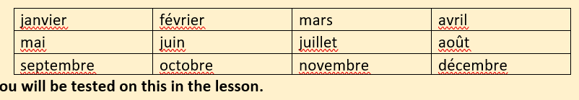
Year 7-French
Week 1:
  Collect learning booklet from class.
  No homework.
Week 4: Voici ma famille
Create a family tree of your home/your family. Please do not use photos of your family, just drawings. Write their names and the words for the family members in French. E.g. soeur (sister) etc.
Week 2:
  Quel age-as tu?
  Learn the numbers vocab from 1-31 which will be on teams.
Week 5:
Written task. Write a 50 word to describe your physical description, your family and your pets in French.
Week 3: Quelle est la date de ton anniversaire? Vocab test. Learn the months in French. You’ll be tested on this in class
Week 6: Presentation homework. Choose a celebrity.
Describe: Their height, Their size (are they big, slim…), Their hair &Their eyes. You’ll be presenting this in class. You can choose to work individually or separately
Key vocabulary: greetings, birthdays, months, numbers, family members and physical description.

Slide 14
Art and Design Year 7 Term 1
Week 1:
IResearch the Rhinoceros woodcut by Albrecht Durer. This is a print of an Indian Rhinoceros. Watch the following video to find out more:
https://www.youtube.com/watch?v=IPthhO4YU28
Week 5:
Research the work of Helen Wells. Create a PowerPoint slide of examples of her work.
Week 2:
Draw an animal using different mark-making techniques like those seen on Albrecht Durer’s rhinoceros.
Week 6:
Research life in coral reefs. Create an A4 page of images or a PowerPoint slide.
Week 3:
Research the work of artist Susannah Blaxill. Collect images of her black and white drawings of fruit and vegetables. Present on a PowerPoint slide with some information about the artist.
Week 7:
In your project this term we are investigating the use of the Formal Elements of Art and Design.
TASK: Learn the following spellings: Line, Colour, Tone, Pattern, Texture, Shape
Week 4:
Create a drawing of a piece of fruit using line and tone (shading) in the style of Susannah Blaxill.
Key Vocabulary:
Line, Tone, Pattern, Colour, Shape, Texture, Composition, Artist, Linear drawing, Tonal drawing, Coral Reef, Sea Forms

Slide 15
Drama – Year 7 – Term 1
Week 1:
Settling into the new school year.
Week 5: How can I create an effective jetpack lift?
Revise over how to create an effective jetpack lift from last lesson
Week 2:
Watch a piece of drama (TV show or movie) that you really enjoy. Identify what the actors do that makes their performance effective. Think about facial expressions, body language and vocal performance.
Week 6: How can I rehearse effectively?
Meet with your group for the first 10 minutes of one break or lunch time to rehearse your Living House performance.
Decide on a date and time that all your group members can make
Decide where you will rehearse (playground, classroom, drama room)
Be punctual to your rehearsal and don’t waste time messing around
If a group member does not turn up, don’t worry! Rehearse your part without them.
Week 3: Who are Frantic Assembly?
Google the theatre company Frantic Assembly and find the answers to the questions below. Hand your work in to me on paper next week:
Who is the artistic director?
When was the company formed?
What methods do they use in their work?
Name a past production of theirs and explain what it was about.
Why is their work so engaging?
Week 7: What does it mean to be funny?
Type into Google ‘master clown Phillippe Gaulier’ and watch the documentary. As you watch, write the answers to the questions on paper and hand it to me next week:
Who is Phillippe Gaulier?
How do people describe him?
Name a famous actor who has trained at his school.
Explain how Gaulier provides feedback to his clown trainees.
How do you discover your ‘clown?’
Does everybody have an ‘inner clown?’
Week 4: What are the key skills in Drama?
Use your yellow and blue skills sheet to revise over the key skills in Drama. When creating and performing characters, you must use these skills to create believable characters. This is what gets you good marks in your assessments. It is therefore important your know them
Key Vocabulary: Physical Theatre, Ensemble, Essence Machines, Clowning, Mime, Improvisation, Performance, Lift, Frantic Assembley

Slide 16
Music Year 7 Term 1
Week 1:
Settling in to new school year
Week 5:
Watch the following clip about the instruments of the string section in an orchestra.
https://www.youtube.com/watch?v=MP2_6OLummA
Challenge: Find a piece of music with only a string quartet.
You will be quizzed on these instruments at the start of your next music lesson
Week 2:
Watch the following clip of Japanese Taiko Drumming
https://www.youtube.com/watch?v=rWxhMwmW2QM&t=9s
How do the drummers communicate?
Week 6:
Watch the clips and read the information about Bach's Toccata and Fugue in D minor
https://www.bbc.co.uk/teach/ten-pieces/articles/znvn7nb
Be prepared to share your thoughts and ideas at the start of the next lesson!
Week 3:
Watch the following clip about the instruments of a percussion section in an orchestra.
https://www.youtube.com/watch?v=xGKpngesISI
Challenge: Find another piece of music where the percussion section is important.
You will be quizzed on these instruments at the start of your next music lesson.
Week 7:
Watch and listen to the following clip of the piece Hedwig’s Theme (from Harry Potter and the Philosopher’s Stone) by John Williams.
https://www.youtube.com/watch?v=GTXBLyp7_Dw
List 10 instruments you can hear.
Week 4:
Watch the following clip about the instruments of the brass section in an orchestra.
https://www.youtube.com/watch?v=yE0aSxziNdY
Challenge: Find a piece of music with only brass instruments.
You will be quizzed on these instruments in your next music lesson.
Key Vocabulary: percussion, woodwind, brass, orchestra, plucked, bowed, soprano, alto, tenor, bass, timbre, sound quality, technique

Slide 17
Year 7 - Physical Education
Week 1: Baseline Assessment & Expectations in PE. PE Department Expectations.pptx
Revisit the rules and expectations in PE document and answer the PE Department Expectrations – Fill out form
Login to Ever learner and open assignment 1 for year 7.
Week 4: Activity 1 Week 3 What is Social Health
Knowledge Organiser Page 8-9 - How does sport help us socially?
Read the information on page 8 and complete the tasks on page 9.
Week 5 : Activity 1 Week 4
Review the knowledge organiser pages 4-9
Mock questions in preparation for your test in week 6.
Year 7 PE Health Quiz Knowledge Practice 1 – Fill out form
Week 2: Activity 1 Week 1 – What is Physical Health
Knowledge Organiser Page 4-5 - What is health read the information and complete the questions.
Login to Ever learner and complete assignment 1 for year 7.
Week 6:
Activity 1 Revision & Assessment Week
Use Page 10 to create a mind map on everything that you have leant in PE about Health.
Week 3: Activity 1 Week 2 – What is Mental/Emotional Health
Knowledge Organiser Page 6-7 - What is emotional health read the information and complete the tasks
Read the information on page 6 and complete the tasks on page 7.
Week 7:
Activity 2 Week 1
Login to Ever learner and complete assignment 2 for year 7
Engage in the lesson on “Effects of Exercise on Health”

