Slide 1

Independent Learning
Year 11
Term 1

Slide 2

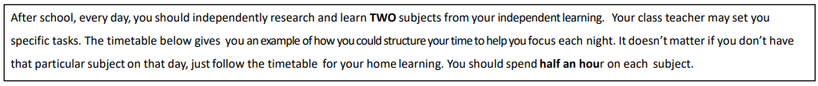
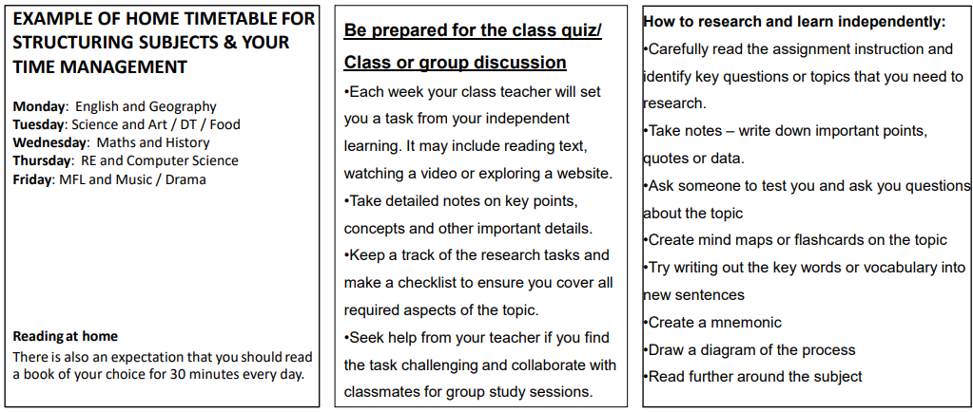

Slide 3

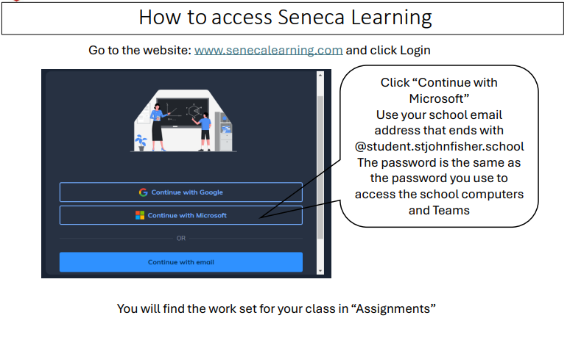

Slide 4
Mathematics Year 11 Foundation
Week 1:
No HOMEWORK
Log into Sparx Maths using the provided log in detail.
Having log in issues?
Email: e.nyantakyi@stjohnfisher.school
Week 5:
HOMEWORK
Log into Sparx Maths using the provided log in detail.
Complete the task set on: Volume and surface area of cuboids
Having log in issues?
Email: e.nyantakyi@stjohnfisher.school
Week 2:
HOMEWORK
Log into Sparx Maths using the provided log in detail.
Complete the task set on: Circumferences
Having log in issues?
Email: e.nyantakyi@stjohnfisher.school
Week 6:
HOMEWORK
Log into Sparx Maths using the provided log in detail.
Complete the task set on: Volume and surface area of prisms
Having log in issues?
Email: e.nyantakyi@stjohnfisher.school
Week 3:
HOMEWORK
Log into Sparx Maths using the provided log in detail.
Complete the task set on: Area of circles
Having log in issues?
Email: e.nyantakyi@stjohnfisher.school
Week 7:
HOMEWORK
Log into Sparx Maths using the provided log in detail.
Complete the task set on: Volume and surface area of Cylinders
Having log in issues?
Email: e.nyantakyi@stjohnfisher.school
Week 4:
HOMEWORK
Log into Sparx Maths using the provided log in detail.
Complete the task set on: Sectors
Having log in issues?
Email: e.nyantakyi@stjohnfisher.school
Week 8:
HOMEWORK
Log into Sparx Maths using the provided log in detail.
Complete the task set on: Revision of area and volumes
Having log in issues?
Email: e.nyantakyi@stjohnfisher.school
Key vocabulary: Circumferences, Sectors, Cuboids, Prisms, Cylinders, Cone, Surface area, volumes

Slide 5
Mathematics Year 11 Higher
Week 1:
No HOMEWORK
Log into Sparx Maths using the provided log in detail.
Having log in issues?
Email: e.nyantakyi@stjohnfisher.school
Week 5:
HOMEWORK
Log into Sparx Maths using the provided log in detail.
Complete the task set on: Quadratic inequalities
Having log in issues?
Email: e.nyantakyi@stjohnfisher.school
Week 2:
HOMEWORK
Log into Sparx Maths using the provided log in detail.
Complete the task set on: Quadratics equations
Having log in issues?
Email: e.nyantakyi@stjohnfisher.school
Week 6:
HOMEWORK
Log into Sparx Maths using the provided log in detail.
Complete the task set on: Iterations
Having log in issues?
Email: e.nyantakyi@stjohnfisher.school
Week 3:
HOMEWORK
Log into Sparx Maths using the provided log in detail.
Complete the task set on: Quadratics graphs
Having log in issues?
Email: e.nyantakyi@stjohnfisher.school
Week 7:
HOMEWORK
Log into Sparx Maths using the provided log in detail.
Complete the task set on: Circle theorem I
Having log in issues?
Email: e.nyantakyi@stjohnfisher.school
Week 4:
HOMEWORK
Log into Sparx Maths using the provided log in detail.
Complete the task set on: Inequality and Regions
Having log in issues?
Email: e.nyantakyi@stjohnfisher.school
Week 8:
HOMEWORK
Log into Sparx Maths using the provided log in detail.
Complete the task set on: Circle theorem II
Having log in issues?
Email: e.nyantakyi@stjohnfisher.school
Key vocabulary: Quadratics equations, Quadratics inequalities, Iteration, Circle Theorems

Slide 6
English (Sets 2-7)
Week 1:
Create a poster informing your audience of the focus of each of the questions in the English language paper 1
Week 5:
Take notes and write down important points and quotations from ‘A Christmas Carol’
https://www.youtube.com/watch?v=qm02uJ099RI
Week 2:
English Language GCSE Paper 1 Q5 – make notes on the following: What the question is asking you to do? What you should include in your answer? Common mistakes to avoid? Watch the link below to help answer the questions:
https://www.youtube.com/watch?v=iBHeQgrF9-w
Week 6:
Take notes and write down important points and quotations from ‘A Christmas Carol’
https://www.youtube.com/watch?v=E2iW7csTUeQ
Week 3:
Take notes and write down important points and quotations from ‘A Christmas Carol’
https://www.youtube.com/watch?v=VLgJtYtHY9k
Week 7:
Link the following words to a character/quote
/analysis in ‘A Christmas Carol’.
Fear
Spontaneous
Extravagance
Sympathetic
Jovial
Week 4:
Take notes and write down important points and quotations from ‘A Christmas Carol’
https://www.youtube.com/watch?v=YzauH45rUlg
Key Vocabulary:
Misanthropic, Repentant, Spectral, Destitute, Allegorical Novel, Didactic

Slide 7
English (Grammar Stream)
Week 1:
Complete the quotation learning task as assigned by your teacher. This knowledge will be tested in next week’s lesson and peer marked.
Week 5:
Complete the quotation learning task as assigned by your teacher. This knowledge will be tested in next week’s lesson and peer marked.
Complete the practice exam question assigned by your teacher. This will be marked by your teacher, and you will receive personal feedback.
Week 2:
Complete the quotation learning task as assigned by your teacher. This knowledge will be tested in next week’s lesson and peer marked.
Complete the practice exam question assigned by your teacher. This will be marked by your teacher, and you will receive personal feedback.
Week 6:
Complete the quotation learning task as assigned by your teacher. This knowledge will be tested in next week’s lesson and peer marked.
Complete the practice exam question assigned by your teacher. This will be marked by your teacher, and you will receive personal feedback.
Week 3:
Complete the quotation learning task as assigned by your teacher. This knowledge will be tested in next week’s lesson and peer marked.
Complete the practice exam question assigned by your teacher. This will be marked by your teacher, and you will receive personal feedback.
Week 7:
Complete the quotation learning task as assigned by your teacher. This knowledge will be tested in next week’s lesson and peer marked.
Complete the practice exam question assigned by your teacher. This will be marked by your teacher, and you will receive personal feedback.
Week 4:
Complete the quotation learning task as assigned by your teacher. This knowledge will be tested in next week’s lesson and peer marked.
Complete the practice exam question assigned by your teacher. This will be marked by your teacher, and you will receive personal feedback.
Key Vocabulary:
Misanthropic, Repentant, Spectral, Destitute, Allegorical Novel, Didactic

Slide 8
Science
Week 1:
Settling into new school year
Week 5:
Complete Seneca Learning Assignment.
This will be marked by Seneca.
Week 2:
Settling into new school year
Week 6:
Complete Seneca Learning Assignment.
This will be marked by Seneca.
Week 3:
Complete Seneca Learning Assignment.
This will be marked by Seneca.
Week 7:
Complete Seneca Learning Assignment.
This will be marked by Seneca.
Week 4:
Complete Seneca Learning Assignment.
This will be marked by Seneca.
Key Vocabulary: solid – liquid – gas – condensation – boiling – evaporation – freezing – melting – particle arrangement – particle movement – mole – concentration – density – pathogen – infection – antibiotic – virus – antibody – antigen – vaccine – white blood cell

Slide 9
Religious Education
Week 1:
Settling in to new school year
Week 5: Access the article in the link below. Read and explain in your own words Paragraphs 14 and 17:
https://www.vatican.va/content/paul-vi/en/encyclicals/documents/hf_p-vi_enc_25071968_humanae-vitae.html
This will inform your knowledge about contraception in a Catholic context for this week’s lesson.
.
Week 2: Watch the clip below on the topic of Catholic marriage and answer the questions below:
https://www.youtube.com/watch?v=qcnBS9JNXH4
Questions:
1 – What is the difference between a marriage and a Catholic marriage. 2 – What do catholic marriages mean for the Catholic family.
Week 6: Access Seneca learning on the following link:
https://app.senecalearning.com/classroom/course/06a0580f-8405-499a-8bd3-b986c7efddd0/section/a88007fa-6698-4a73-b7da-06a50bf4253d/session
Complete sections 1.2.1 and 1.2.2 on Marriage and the family.
Week 3: Read the quotes from different Christian traditions about Sexual Relationships.
https://www.bbc.co.uk/bitesize/guides/zfwp47h/revision/5
What are the differences and similarities?
Week 7: Revision of Paper 1 topics.
Use your revision guide, kerboodle, class notes and resources on Teams to prepare for the PPE.
Topics will be posted on Teams
Week 4: Research how the Catholic Church supports Catholic families with the following methods:
Counselling
Sunday school
Marriage Preparation classes.
Write a short summary of each.
Key Vocabulary: Procreation – Marriage – Marriage preparation – Contraception - Cohabitation

Slide 10
Citizenship
Week 1: Create a key terms list for Theme A using the glossary from your teacher
Week 5: 10m practice question.
‘We should welcome anyone who is escaping war, persecution or disaster’. Write 2 paragraphs, 1 explaining why someone might agree with this and another why someone else might disagree with it.
Week 2: Put your key terms into categories relating to each theme:
Theme A: Community
Theme B: Democracy
Theme C: The Law
Week 6: 10m practice question.
‘People should look after themselves rather than being protected by declarations and conventions’.
Week 3: Watch the following clip and note down areas that you feel you need help to revise:
https://www.youtube.com/watch?v=MEYIGpzR1pI
Week 7: 10m practice question.
‘People should never have rights without responsibilities.’
Week 4: Revision for Theme A. Use Theme A revision booklet to create a list of key terms and their definitions for the whole of Theme A. The booklet can be found on TEAMS or in student shared area.
Key Vocabulary: Refugee, migrant, integration, identity, racism, human rights, duty

Slide 11
Computing
Week 1: HOMEWORK
Describe the role of the ALU, CU, and registers in the CPU. Apply your knowledge by explaining what happens to the registers during a simple calculation such as 5 + 3.
Week 5: HOMEWORK
Research and explain how encryption is used in online banking to secure data. Then, evaluate: What might happen if encryption methods were not used in online transactions?
Week 2: HOMEWORK
Explain the Fetch-Decode-Execute cycle in detail. In your answer, illustrate what happens when the CPU is asked to load a program stored in RAM and then execute an instruction.
Week 6: HOMEWORK
Construct truth tables for the expression: (A AND B) OR (NOT C). Apply this to a real-life example (e.g., a security system that activates an alarm if a door sensor AND a motion sensor are triggered, OR if the system is manually set to active).
Week 3: HOMEWORK
Construct truth tables for AND, OR, NOT gates. Then, apply your knowledge: Design a logic circuit that could control a security light that switches on only when it is dark OR when motion is detected.
Week 7: HOMEWORK
Evaluate the importance of the CPU compared to other computer components such as RAM, cache, and secondary storage. Justify your answer with examples.
Week 4: HOMEWORK
Explain the purpose of TCP/IP protocols. Apply your answer to an example: A student is sending an email with an attachment. Describe how TCP/IP ensures that the message is correctly transmitted and received
KEY VOCABULARY
Boolean Logic, Logic gates, Truth tables, Registers

Slide 12
Geography
Week 1:
Settling into new school year
Week 5:
Work through the tasks set on Seneca reviewing content from year 10. OR complete the exam practise handed out in class.
The assignment will become active on Teams.
Week 2:
Work through the tasks set on Seneca reviewing urban challenges. This content is focused on the AQA specification. OR complete the exam practise handed out in class.
The assignment will become active on Teams.
Week 6:
Work through the tasks set on Seneca reviewing content from year 10. OR complete the exam practise handed out in class.
The assignment will become active on Teams.
Week 3:
Work through the tasks set on Seneca reviewing urban challenges. OR complete the exam practise handed out in class.
The assignment will become active on Teams.
Week 7:
Work through the tasks set on Seneca reviewing content from year 10. OR complete the exam practise handed out in class.
The assignment will become active on Teams.
Week 4:
Work through the tasks set on Seneca reviewing content from year 10. OR complete the exam practise handed out in class.
The assignment will become active on Teams.
Key Vocabulary:
Ecosystem, producer, primary consumer, secondary consumer, small scale ecosystem, humid, adaptation, biodiversity, buttress roots, prehensile tail, deforestation, mineral extraction, sustainable tourism, ecotourism, clear felling and logging.

Slide 13
History
Week 1:
Settling in to new school year
Week 5:
Complete your information sheet and prepare to discuss this in class.
Use your information sheet to attempt the challenge question.
Week 2:
Choose a topic and key question from the independent learning booklet.
Research the factors which will help you answer the key question.
Use these factors to attempt the challenge question.
Week 6:
Complete the “source usefulness” section of the booklet.
Ensure that you use the paragraph structure provided.
Week3
Research your chosen topic and prepare your information sheet.
Ensure you link your chosen topic to the key question.
Week 7
:Complete the “review” section of the booklet.
Set a target for next term.
Week 4:
Research your chosen topic and prepare your information sheet.
Ensure you link your chosen topic to the key question.
Key Vocabulary:
Medicine, Diagnosis, Prevention, Treatment, Four Humours, Miasma, Supernatural, Rational, Scientific Method, Hospital, Surgery, Physician, Apothecary

Slide 14
French Year 11
Week 1:
Summer Homework
Week 5:
Writing Task
Improve Module 6 Answers
Week 2:
Vocab Test
Week 6:
Vocab Test
Week 3:
Writing Task – My environment
Module 6 – Speaking Exam Questions
Week 7:
Grammar Check – Complex structures
Week 4:
Grammar check – 5 Tenses
Key Vocabulary: Notre planète – My neighbourhood, environmental problems

Slide 15
Latin Year 11
Week 1:
Summer Homework
Week 5:
Focus: Component 3B, Slavery
Tasks: Create a sketch of a Roman “familia” and label.
What is the word for “property” in Latin?
Week 2:
Focus: Latin Language
Tasks: Write out the 5 Latin cases and write a sentence for each as example.
Week 3:
Focus: Latin Language: Come dine with me.
Tasks: What are declensions? How can you easily recognize the 1st and 2nd declensions? Do you find it difficulty recognizing them? Why?
Week 6:
Focus: Latin Language
Tasks: Write out 10 figures of speech with examples in English and Latin.
Week 4:
Focus: Literature Component 3B, Slavery,
Tasks: What would be your definition of the word “slavery”? What is the difference between your definition and that of the Roman empire?
Week 7:
Focus: Latin Language
Tasks: Write one sentence for each of the following tenses:
Present, Perfect, Imperfect, Pluperfect.
Key Vocabulary: Come, dine with me / Slavery

Slide 16
Art and Design Fine Art Year 11 Term 1
Week 1:
Review of progress made on independent project. What have you achieved so far? What are your next steps?
Week 5:
Complete the critical study you started last week.
Week 2:
Improve any incomplete work in your sketchbook on the current project. Ensure there are no gaps.
Week 6:
Start a visual response to the work of your new artist. This may be using the same techniques, compositional style, subject matter etc.
Week 3:
Find a new artist that you can introduce to your independent project. Collect images and information and present on a PowerPoint slide.
Week 7:
Complete the visual response to your artist that you started last week.
I
Week 4:
Start a double page critical study for your new artist. Include images, information, your own opinions of the work and visual responses to their work.
Key Vocabulary:
,Line, tone, pattern, texture, form, shape, composition, graphite, charcoal, pen and wash, watercolour, drawing ink, acrylic paint, scale, composition, subject matter, mark-making, meaning, content, process, mood.

Slide 17
Business Studies (Year 11) – Term 1
Week 1: Understanding Cash and Cash Flow
Importance of Cash and Cashflow to a business
Major components of the cash flow
The opening and closing balance
Cash inflow
Cash outflow
Net cashflow
Relationship between cashflow, profit and loss
Watch Video link: Cash Flow Explained
Week 5: Sources of Finance Essay
Refer to Activity 32 Aman scenario in study Power Point slide on Teams:
Write an essay that clearly compares the options Aman is considering and then support this with justified recommendations of which he should choose for this burger restaurant expansion.
Answers will form group class debate on best source of finance.
Week 2: The cash flow Forecast and statement
Understanding the cashflow statement and forecast
Difference between the cashflow forecast and statement
Preparing the cashflow statement
Use and importance of the cashflow statement forecast
Advantages and disadvantages of the cashflow forecast
Study activities 26 and 27 (Slides 129 and 130) on TwoTeachers lecture slides.
Week 6: Starting Up a Business
The options for start-up and small businesses
Concept of liability
Types of liability
Relationship between liability and ownership
Watch video: https://youtu.be/H0ddna58suE
Week 7: Types of Business ownership for start-ups
  Understanding business ownership structures
  - Key characteristics
  Advantages and disadvantages
  Liability structure of ownership types
  Complete activity on eRevision
Week 3: Sources of Business Finance
- What is meant by ‘source of Finance’?
- Explain 4 roles and importance of finance to a business.
- What are the six major stages that businesses require finance?
- Discuss 4 sources of finance to a business
- What is the difference between short- and long-term finance?
Complete activity on eRevision
Week 4: Types of Business Finance
Types and difference between short- and long-term business finance
Major forms of short-term business finance
Major forms of long-term business finance
Advantages and disadvantages of short- and long-term business finance.
Complete activity on eRevision
Key Vocabulary:
Cash flow, Opening balance, inflow, outflow, net cashflow, cash flow forecast, source of finance, short-term finance, long-term finance, start-up, limited liability, unlimited liability, sole trader, partnership, private limited liability company, public limited liability company

Slide 18
Sociology Year 11 Term 1 Research Methods Practice
Week 1:
Settling in to new school year
Week 5:
Complete past exam question 1 and 2 (pgs. 64 – 65) of Research Methods Booklet
Week 2:
Research Methods Revision (Issued Week 2)
Complete past exam question 1 and 2 (pgs. 58 – 59) of Research Methods Booklet
Week 6:
Revision for assessment on Research Methods
Week 3:
Complete past exam question 1 and 2 (pgs. 60 – 61) of Research Methods Booklet
Week 7:
Assessment in class on Research Methods
Week 4:
Complete past exam question 1 and 2 (pgs. 62 – 63) of Research Methods Booklet
Key Vocabulary:
Strength/ Weakness / Limitation / Participant observation/Questionnaires Roles/Interviews/Longitudinal studies/Group Interviews/ Ethical Issues

Slide 19
Physical Education – GCSE
Week 1: SENECA task –
Complete the assignments on:
Aerobic and Anaerobic Respiration/Recovering after exercise/Treatments after recovery/Diagnostic misconceptions
Week 4: SENECA task –
Complete the assignments on:
Types of Data
Week 5: SENECA task –
Complete the assignments on:
Long term effects of exercise
Week 2: SENECA task –
Complete the assignments on:
Optimising training/Altitude and Seasonal Training/Warming-up/Cooling Down/End of Topic Test – Principles of Training/Exam-style questions
Week 6: SENECA task –
Complete the assignments on:
The Cardiovascular System
Week 3: SENECA task –
Complete the assignments on:
Short term effects of exercise
Week 7: SENECA task –
Complete the assignments on:
The Respiratory System
Key vocabulary:, Aerobic, Anaerobic, Warm-up, Cool-down, Heart, Arteries, Capillaries, Veins, Vascular Shunting, Vasodilation, Vasoconstriction, Trachea, Lungs, Bronchi, Bronchioles, Alveoli, Inspiration, Expiration, Pectoral, Sternocleidomastoid, Abdominal muscles, Tidal Volume, Inspiratory Reserve volume, Expiratory reserve volume, Residual Volume, Lactic acid, Oxygen Debt, EPOC, DOMS, Cramp, Rehydration, Ice Baths, Cardiac Hypertrophy, Hypertrophy

Slide 20
CoPE
Week 1:
Choose a book to read. This could be a story, facts-based book on a topic you find interesting.
This can be a book at home, or one from the school/ local library
Read 10 pages. We will discuss what you have read in class
Week 5:
Continue with your book.
Read the next 10 pages of your book.
You will be giving an update on what is happening to your partner/ class
Week 2:
Continue with your book.
Read the next 10 pages of your book.
You will be giving an update on what is happening to your partner/ class
Week 6:
Continue with your book.
Read the next 10 pages of your book.
You will be giving an update on what is happening to your partner/ class
Week 3:
Continue with your book.
Read the next 10 pages of your book.
You will be giving an update on what is happening to your partner/ class
Week 7:
Prepare a 5-minute verbal presentation.
The presentation is on the book you have read.
The presentation should include:
What you enjoyed about the book.
What you didn’t enjoy.
If there was another book to be written what do you think would happen in the story
Week 4:
Continue with your book.
Read the next 10 pages of your book.
You will be giving an update on what is happening to your partner/ class
Key Vocabulary: Phonics – Comprehension – Prediction – Inference – Context – Theme – Conflict – Plot – Protagonist – Point of view -

Slide 21
Drama
Week 1 & 2:
Settling into new school year
Week 5: Context- costume design
Read page 54 of the AQA GCSE Drama workbook and complete task 3 on paper. Then read page 56 and complete task 5. Bring this in next week and stick it in your exercise book. You will receive 5 praise points.
Week 6: Context-lighting design
Read pages 70 & 71 of the AQA GCSE Drama workbook and then complete task 21 on paper. Bring this in next week and stick it in your exercise book. You will receive 5 praise points.
Week 3: Context- different households, set design
Read pages 51, 52 and 53 of the AQA GCSE Drama workbook then complete task 2 on paper. Then read page 55 and complete task 4. Bring this in next week and stick it in your exercise book. You will receive 5 praise points.
Week 7: Context-sound design
Read page 72 of the AQA GCSE Drama workbook and then complete task 23 on paper. Bring this in next week and stick it in your exercise book. You will receive 5 praise points.
Week 4: Context- set design
On paper, complete tasks 16, 17 & 18 on pages 67 and 68 of the AQA GCSE Drama workbook. Bring this in next week and stick it in your exercise book. You will receive 5 praise points.
Key Vocabulary:
Context, set design, costume design, lighting design, sound design.

Slide 22
Hospitality and Catering
Week 1 –Section 1.1.1 Hospitality providers
Compare 15 hospitality providers – this can be done in a table or as a written report. What are their main features? The providers can be commercial or non-commercial.
Stretch – for extra points – research an international provider – 10 bullet points
Hand the work in on Teams
Week 5: Produce an information leaflet about different types of contracts and working hours in hospitality. Give the advantages and disadvantages of each.
Include information about split shifts and pro rata pay.
Work to be handed in on Teams
Week 2: Section 1.1.1 Hospitality Providers
Produce a poster to show the different restaurant rating systems used in the UK.
Work to be handed in on Teams
Week 6:
Environmental impacts
Produce a poster with 10 key points to learn for revision of environmental factors and their impacts within the hospitality and catering industry.
Work to be handed in on Teams
Week 3: 1.1.2 Employment roles
Create a careers booklet – for a Kitchen Brigade
Describe their responsibilities
Work to be handed in on Teams
Week 7: Technology in the hospitality and careering industry
Produce an annotated think map about how technology is used in the hospitality and catering industry, give examples and advantages and disadvantages of each.
Work to be handed in on Teams
Week 4: Write a report about personal attributes that are sought after by employers in hospitality. Give examples of job roles and personal attitudes that are important for each.
Work to be handed in on Teams.
Key Vocabulary: B&B, Airbnb, Table service, Personal attributes, fixed cost, competitive advantage, VAT

Slide 23
Year 10 Music Term 1
Week 1:
Settling in to new school year.
Week 5:
Practice on your chosen instrument for fifteen minutes three times this week.
This week’s rehearsal focus: Expression – think about the feeling of your piece and how you want to express mood through your playing.
Week 2:
Practice on your chosen instrument for fifteen minutes three times this week.
This week’s rehearsal focus: Note accuracy – try to match each note completely at pitch.
Week 6:
Practice on your chosen instrument for fifteen minutes three times this week.
This week’s rehearsal focus: Tempo – practice a piece with a tempo change in it and make the difference as smooth as possible.
Week 3:
Practice on your chosen instrument for fifteen minutes three times this week.
This week’s rehearsal focus: Rhythm accuracy – try to make sure that each note duration is exactly correct.
Week 7:
Practice on your chosen instrument for fifteen minutes three times this week.
This week’s rehearsal focus: Push yourself – try a piece that is technically challenging to you.
Week 4:
Practice on your chosen instrument for fifteen minutes three times this week.
This week’s rehearsal focus: Scales – practice going through each of your scales to familiarise yourself with them.
Key Vocabulary: Pitch, Tempo, Rhythm, Scales, Note Value, Piano, Forte, Mezzo Piano, Mezo Forte, Diminuendo

