Slide 1

Independent Learning
Year 10
Term 1

Slide 2

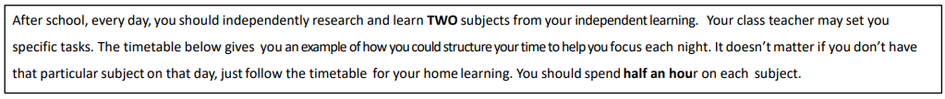
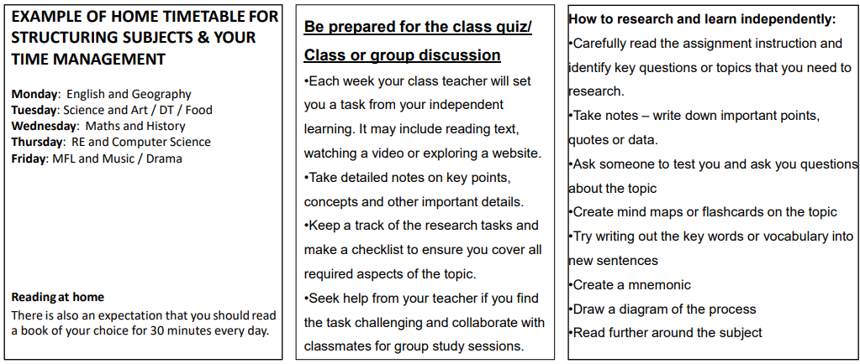

Slide 3

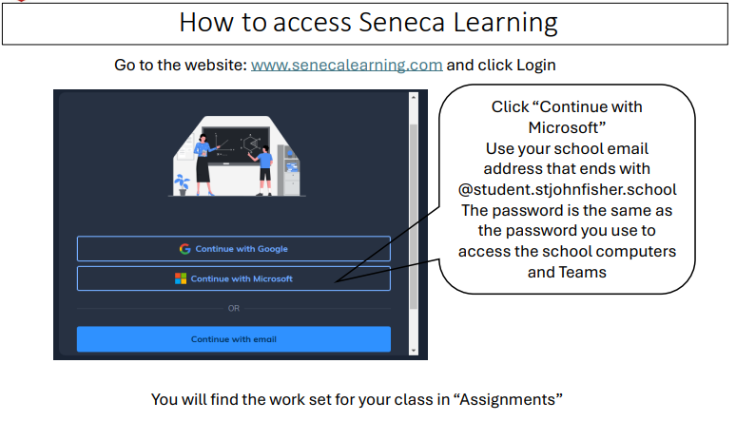

Slide 4
Mathematics Year 10 Foundation
Week 1:
No HOMEWORK
Log into Sparx Maths using the provided log in detail.
Having log in issues?
Email: e.nyantakyi@stjohnfisher.school
Week 5:
HOMEWORK
Log into Sparx Maths using the provided log in detail.
Complete the task set on: SURFACE AREA OF 3D SOLIDS
Having log in issues?
Email: e.nyantakyi@stjohnfisher.school
Week 2:
HOMEWORK
Log into Sparx Maths using the provided log in detail.
Complete the task set on: RECTANGLES, PARALLELOGRAMS & TRIANGLES Having log in issues?
Email: e.nyantakyi@stjohnfisher.school
Week 6:
HOMEWORK
Log into Sparx Maths using the provided log in detail.
Complete the task set on: VOLUME OF PRISMS
Having log in issues?
Email: e.nyantakyi@stjohnfisher.school
Week 3:
HOMEWORK
Log into Sparx Maths using the provided log in detail.
Complete the task set on: TRAPEZIUM & CHANGING UNITS
Having log in issues?
Email: e.nyantakyi@stjohnfisher.school
Week 7:
HOMEWORK
Log into Sparx Maths using the provided log in detail.
Complete the task set on: MORE VOLUMES AND SURFACE AREA
Having log in issues?
Email: e.nyantakyi@stjohnfisher.school
Week 4:
HOMEWORK
Log into Sparx Maths using the provided log in detail.
Complete the task set on: AREA OF COMPOUNDING SHAPES
Having log in issues?
Email: e.nyantakyi@stjohnfisher.school
Week 8:
HOMEWORK
Log into Sparx Maths using the provided log in detail.
Complete the task set on: Revision of Area and volumes
Having log in issues?
Email: e.nyantakyi@stjohnfisher.school
Key vocabulary: Parallelograms, Trapeziums, compounding shapes, prisms, surface area

Slide 5
Mathematics Year 10 Higher
Week 1:
No HOMEWORK
Log into Sparx Maths using the provided log in detail.
Having log in issues?
Email: e.nyantakyi@stjohnfisher.school
Week 5:
HOMEWORK
Log into Sparx Maths using the provided log in detail.
Complete the task set on: Volume and surface area of prisms
Having log in issues?
Email: e.nyantakyi@stjohnfisher.school
Week 2:
HOMEWORK
Log into Sparx Maths using the provided log in detail.
Complete the task set on: Circumferences
Having log in issues?
Email: e.nyantakyi@stjohnfisher.school
Week 6:
HOMEWORK
Log into Sparx Maths using the provided log in detail.
Complete the task set on: Volume and surface area of Cylinders
Having log in issues?
Email: e.nyantakyi@stjohnfisher.school
Week 3:
HOMEWORK
Log into Sparx Maths using the provided log in detail.
Complete the task set on: Area of circles
Having log in issues?
Email: e.nyantakyi@stjohnfisher.school
Week 7:
HOMEWORK
Log into Sparx Maths using the provided log in detail.
Complete the task set on: Volume and surface area of Cone
Having log in issues?
Email: e.nyantakyi@stjohnfisher.school
Week 4:
HOMEWORK
Log into Sparx Maths using the provided log in detail.
Complete the task set on: Sectors
Having log in issues?
Email: e.nyantakyi@stjohnfisher.school
Week 8:
HOMEWORK
Log into Sparx Maths using the provided log in detail.
Complete the task set on: Volume and surface area of pyramids
Having log in issues?
Email: e.nyantakyi@stjohnfisher.school
Key vocabulary: Circumferences, Sectors, Prisms, Cylinders, Cone, Pyramids, Surface area, volumes

Slide 6
English
Week 1:
Watch the following YouTube video and take notes on the following:
class, capitalism, socialism pre-WW1 and post-WW2.
https://www.youtube.com/watch?v=hLspHecezFU
Week 5:
Think about Priestley’s themes or ‘big ideas’ that he explores in the play. Make a list of these and design an icon to represent each theme – explain your reasoning.
Week 2:
Study the revision page for Mr. Birling using the link below:
https://www.bbc.co.uk/bitesize/guides/zwscxsg/revision/2
Learn the quotes relevant to this character and make sure you are able to analyse the language devices within the quotes.
Week 6:
Create a mind-map with symbols where you map out the theme of gender in ‘An Inspector Calls’.
The link below will help you – be creative as possible.
https://www.youtube.com/watch?v=W1rW_wRyhM0
Week 3:
Focus on the character of Sheila –
https://www.bbc.co.uk/bitesize/guides/zwscxsg/revision/4
Learn the quotes relevant to this character and make sure you are able to analyse the language devices within the quotes.
Week 7:
Using your mind-map, write a PEACE paragraph exploring the theme of gender in ‘An Inspector Calls’.
Week 4:
Complete the following multiple choice quiz for Act 2 of ‘An Inspector Calls’.
https://quizizz.com/admin/quiz/605ceaf60a9edc001bfcb5ed/an-inspector-calls-act-2-quiz
Key Vocabulary:
Follow the link for key words for each character:
https://stjosephsenglishblog.wordpress.com/2018/11/19/key-vocabulary-for-each-character-aic/

Slide 7
Science
Week 1:
Settling into new school year
Week 5:
Complete Seneca Learning Assignment.
This will be marked by Seneca.
Week 2:
Settling into new school year
Week 6:
Complete Seneca Learning Assignment.
This will be marked by Seneca.
Week 3:
Complete Seneca Learning Assignment.
This will be marked by Seneca.
Week 7:
Complete Seneca Learning Assignment.
This will be marked by Seneca.
Week 4:
Complete Seneca Learning Assignment.
This will be marked by Seneca.
Key Vocabulary: current – potential difference – ammeter – voltmeter – series circuit – parallel circuit – electron – wire – lamp – resistance – attraction – repulsion – pole

Slide 8
Religious Education
Week 1:
Settling into the new school year
Week 5: Complete 2 Judaism sections on SENECA learning on the link below:
On the tab at the left of the page, scroll down to Judaism and complete:
a) 4.2.3 – Ritual
b) 4.2.3 – Synagogue
You are revising the topics we have already covered. Test your knowledge and make adjustments where necessary.
Week 2: Watch the clip on the link below and create a small paragraph summary. You are learning about the Jewish Place of worship: The Synagogue
https://www.youtube.com/watch?v=ZgFxp8TfXl8
You are learning this because it is important to understand the place of worship of the religions you are studying, it can also be an exam
Week 6: Revision create a report on your Judaism learning so far. From Secure – Not yet Secure – I don’t understand, evaluate your knowledge of the following topics, writing 3 lines of information about each topic:
The Synagogue, public worship, birth, brit milah, marriage and mourning.
You will be assessed on these topics for your end of term assessment. It is important that you understand where your strengths and weaknesses are.
Week 3: Read the information on the link provided. You are learning about Jewish rituals and rites of passage.
Read Bar and Bat Mitzvah sections: https://www.bbc.co.uk/bitesize/guides/zv626yc/revision/7
Read Brit Milah and Marriage: https://www.bbc.co.uk/bitesize/guides/zv626yc/revision/5
This will give you a deeper understanding of the lessons this week.
Week 7: Create a poster no bigger than an A4 sheet about the Jewish Synagogue OR Jewish Marriage. It must include:
1. Key terms
2. Relevant images
3. Key information
4. Colour
Week 4: Using your research skills, find out how Jews mourn their dead. On no more than one A4 size sheet, create a fact file about Jewish mourning rituals.
Some links to help you:
https://www.youtube.com/watch?v=Zz0QZXMkrsg
https://www.bbc.co.uk/bitesize/guides/zv626yc/revision/6
You will be quizzed on Jewish mourning rituals by your teacher this week.
Key Vocabulary: Synagogue, Mitzvot, Shema, Rosh Hashanah, Yom Kippur, Pesach, Mezuzah, tallit, tefillin, Torah, Tenakh, Shavuot, Sukkot, Amidah, Bar Mitzvah, Brit Milah

Slide 9
Citizenship
Week 1: What is a Community?
List different communities that you belong to.
Give points for and against:
‘It is easier to feel part of a community if you live in a village or a small town’ 10m
Week 5: List the positive impacts of migration to the UK. Give at least 5 reasons. Which reason is the most important and why?
Week 2: Where are your roots:
Carry out research into your family history. Where do you come from? List the cities and or countries. How does this affect who you are today?
Week 6: List 5 possible negative impacts of migration to the UK. Why do you think people have different views?
Week 3: Religious understanding: Tolerance
Watch the clip below and write down what religious tolerance is and why Locke thought it was so important? Do you think religious tolerance exists in the UK today? Give reasons and examples.
https://www.youtube.com/watch?v=HrVrrEzN8jA
Week 7:’The world belongs to everyone, we should all be allowed to move around it freely’ List reasons for and against this view.
Week 4: Migration Carry out research on migration in the UK using the link below. What are the trends/patterns? https://www.migrationpolicy.org/article/united-kingdom-shift-immigration-interrupted-brexit-pandemic?gad_source=1&gad_campaignid=46884364&gbraid=0AAAAAD8CHmpwcM91cTams8JKu6I-rerTK&gclid=EAIaIQobChMImPPflufLjwMVV41QBh1C3hkFEAAYASAAEgKAtPD_BwE
Key Vocabulary: Tolerance, migration, economic, push and pull factors, migration, emigration, census, community

Slide 10
French Year 10
Week 1:
No Homework
Week 5:
Writing Task
Improve Module 4 Answers
Week 2:
Vocab Test
Week 6:
Vocab Test
Week 3:
Writing Task
Module 4 – Speaking Exam Questions
Week 7:
Grammar Check – Modal verbs
Week 4:
Grammar check – 3 Tenses
Key Vocabulary: Lifestyle & wellbeing

Slide 11
Geography
Week 1:
Settling in to new school year
Week 5:
Work through the tasks set on Seneca Investigating the biodiversity of Tropical Rain Forest environments. OR complete the exam practise handed out in class.
The assignment will become active on Teams.
Week 2:
Work through the tasks set on Seneca reviewing ecosystems. This content is focused on the AQA specification. OR complete the exam practise handed out in class.
The assignment will become active on Teams.
Week 6:
Work through the tasks set on Seneca Investigating the causes and impacts of deforestation. OR complete the exam practise handed out in class.
The assignment will become active on Teams.
Week 3:
Work through the tasks set on Seneca Introducing Tropical rainforests and investigating interdependence. OR complete the exam practise handed out in class.
The assignment will become active on Teams.
Week 7:
Work through the tasks set on Seneca Investigating why and how Tropical Rain Forests can be managed. OR complete the exam practise handed out in class.
The assignment will become active on Teams.
Week 4:
Work through the tasks set on Seneca reviewing plant and animal adaptations in tropical rainforests. OR complete the exam practise handed out in class.
The assignment will become active on Teams.
Key Vocabulary:
Ecosystem, producer, primary consumer, secondary consumer, small scale ecosystem, humid, adaptation, biodiversity, buttress roots, prehensile tail, deforestation, mineral extraction, sustainable tourism, ecotourism, clear felling and logging.

Slide 12
History
Week 1:
Settling in to new school year
Week 5:
Complete your information sheet and prepare to discuss this in class.
Use your information sheet to attempt the challenge question.
Week 2:
Choose a topic and key question from the independent learning booklet.
Research the factors which will help you answer the key question.
Use these factors to attempt the challenge question.
Week 6:
Complete the “source usefulness” section of the booklet.
Ensure that you use the paragraph structure provided.
Week3
Research your chosen topic and prepare your information sheet.
Ensure you link your chosen topic to the key question.
Week 7
:Complete the “review” section of the booklet.
Set a target for next term.
Week 4:
Research your chosen topic and prepare your information sheet.
Ensure you link your chosen topic to the key question.
Key Vocabulary:
Medicine, Diagnosis, Prevention, Treatment, Four Humours, Miasma, Supernatural, Rational, Scientific Method, Hospital, Surgery, Physician, Apothecary

Slide 13
Computing
Week 1:
HOMEWORK
Write a step-by-step algorithm for making a sandwich, using sequencing, selection, and iteration.
Week 5:
HOMEWORK
Compare the differences between RAM, ROM, and Cache memory in terms of speed, volatility, and use.
Week 2:
HOMEWORK
Convert the algorithm you completed on week 1 into a flowchart using correct symbols..
Week 6:
HOMEWORK
Draw a labelled diagram of the memory hierarchy including registers, cache, RAM, and secondary storage.
Week 3:
HOMEWORK
Explain with examples the difference between syntax, logic, and runtime errors.
Week 7:
HOMEWORK
Create 5 exam-style short-answer questions with answers covering computational thinking concepts.
Week 4:
HOMEWORK
Write pseudocode for a program that asks a user for 5 numbers and outputs the largest number.
KEY VOCABULARY
Algorithm, Pseudocode, Storage, Memory

Slide 14
Art and Design (Fine Art) Year 10 Term 1
Week 1:
Create a title page design for the project Organic Forms.
Week 5:
Complete the Ernst Haeckel critical study ensuring you have written your own opinions of his work as well as information about him.
Week 2:
Make a careful observation drawing of a piece of fruit:
Whole fruit or vegetable
Cut pieces of fruit or vegetable
Week 6:
Collect images of different types of shells and fossils and present on a PowerPoint slide.
Week 3:
Research the sea life images produced by Ernst Haeckel. Collect images and information and present on a PowerPoint slide.
Week 7:
Create a page of drawings from the photographs of shells and fossils you collected last week.
Week 4:
Start a double page critical study of the work of Ernst Haeckel. Consider presentation and use of appropriate text. You should include images, information and drawings of parts of his work.
Key Vocabulary:
Natural, organic, critical study, monochrome, composition, linear, structure, stippling, texture, pattern, tonal, contrast.

Slide 15
Art and Design (Three-dimensional Design) Year 10 Term 1
Week 1:
Create a title page design for the project Organic Forms.
Week 5:
Complete the Dale Chihuly critical study ensuring you have written your own opinions of his work as well as information about him.
Week 2:
Make a careful observation drawing of a piece of fruit:
Whole fruit or vegetable
Cut pieces of fruit or vegetable
Week 6:
Collect images of different types of sea forms and present on a PowerPoint slide.
Week 3:
Research the work of glass artist Dale Chihuly. Collect images and information and present on a PowerPoint slide.
Week 7:
Create a page of drawings from the photographs of sea forms you collected last week.
Week 4:
Start a double page critical study of the work of Dale Chihuly. Consider presentation and use of appropriate text. You should include images, information and drawings of parts of his work.
Key Vocabulary:
Natural, organic, critical study, colour, composition, linear, structure, form, shape, texture, pattern, installation, glass forms, transparent, opaque.

Slide 16
Health and Social Care
Week 1: Draw out a poster to show the life stages and one bullet point for each of the PIES at each stage. This can be hand draw or produced on a computer.
Hand in in class for display.
Week 5: Draw out a think map to give examples of Gross and Fine motor skills in infancy.
Hand this work in on Teams
Week 2: Work set on Erevision
Topic A1 Definitions of health and wellbeing
Categorise
Week 6: Write 10 bullet points for revision about puberty in boys and girls, include the main differences and hormones involved.
Hand this work in on Teams
Week 3: : Work set on Erevision
Topic A1 Definitions of health and wellbeing
Pindrop
Week 7: produce 15 questions and answers to test your partner this week in school ready for our end of topic test on Infancy, early childhood and adolescence.
Bring your question and answers on cards to class to show your teacher.
Week 4: : Work set on Erevision
Topic A1 Definitions of health and wellbeing
Type it
Key Vocabulary: Infancy, early childhood, adolescence , life stages, gross motor skills, Hormones, testosterone, oestrogen, menstruation

Slide 17
Year 10 – GCSE Physical Education Term 1
Week 1: Baseline Assessment & Expectations in PE. PE Department Expectations.pptx
Revisit the rules and expectations in PE document and answer the PE Department Expectrations – Fill out form
Week 4: Term 1 Focus – Components of Fitness
Listen to Everlearner - Components of Fitness Testing Limitations
2) Quiz Practice: Quiz Practice - Fitness
Week 2: Term 1 Focus – Components of Fitness
1) Listen to TheEverLearner - Health and Fitness Top Up Lesson
2) Quiz Practice: Quiz Practice - Fitness
Week 5 : Term 1 Focus – Fitness Testing Types
Listen to Everlearner - Components of Fitness Testing Types
2) Quiz Practice: Quiz Practice - Fitness
Week 3: Term 1 Focus – Components of Fitness
Listen to Everlearner - Components of Fitness Top up Lesson
2) Quiz Practice: Quiz Practice - Fitness
Week 6: Term 1 Focus – Components of Fitness
Listen to Everlearner - Components of Fitness Top up Lesson
2) Quiz Practice: Quiz Practice - Fitness

Slide 18
CoPE
Week 1:
Choose a book to read. This could be a story, facts-based book on a topic you find interesting.
This can be a book at home, or one from the school/ local library
Read 10 pages. We will discuss what you have read in class
Week 5:
Continue with your book.
Read the next 10 pages of your book.
You will be giving an update on what is happening to your partner/ class
Week 2:
Continue with your book.
Read the next 10 pages of your book.
You will be giving an update on what is happening to your partner/ class
Week 6:
Continue with your book.
Read the next 10 pages of your book.
You will be giving an update on what is happening to your partner/ class
Week 3:
Continue with your book.
Read the next 10 pages of your book.
You will be giving an update on what is happening to your partner/ class
Week 7:
Prepare a 5-minute verbal presentation.
The presentation is on the book you have read.
The presentation should include:
What you enjoyed about the book.
What you didn’t enjoy.
If there was another book to be written what do you think would happen in the story
Week 4:
Continue with your book.
Read the next 10 pages of your book.
You will be giving an update on what is happening to your partner/ class
Key Vocabulary: Phonics – Comprehension – Prediction – Inference – Context – Theme – Conflict – Plot – Protagonist – Point of view -

Slide 19
Drama Year 10 Term 1
Week 1:
Settling in to new school year.
Week 2:
Watch an episode of your favourite programme or movie, and focus on one actor that you really enjoy their performance. Make a note of what they do in terms of face, body, voice and space to make their performance effective.
Week 5:
Line learning for your monologue. It is helpful to work with another person for this – get them to stop you and correct you if you have made a mistake.
Week 3:
Meet up with your group for your performance this week at a break or lunch time. You can speak to me if you need to organize a space. Rehearse your piece to be performed in class at the start of next week.
Week 6:
Read a script. This can be for any play that you have enjoyed. There are a selection in the library if you need to borrow one. You will have homework based on this next week, so make sure you read it properly.
Week 4:
Using the work we have done in class, research the context of the play that we have studied. Remember to look at the key elements.
Social
Historical
Political
Economic
Week 7:
Pick out one character from the play that you read last week. Design a character sheet for them, including how they feel and their costume.
Key Vocabulary: Designer, facial expressions, Body language, vocal skills, FBVS, character sheet, blocking, rehearsal

Slide 20
Year 10 Music Term 1
Week 1:
Settling in to new school year.
Week 5:
Practice on your chosen instrument for fifteen minutes three times this week.
This week’s rehearsal focus: Expression – think about the feeling of your piece and how you want to express mood through your playing.
Week 2:
Practice on your chosen instrument for fifteen minutes three times this week.
This week’s rehearsal focus: Note accuracy – try to match each note completely at pitch.
Week 6:
Practice on your chosen instrument for fifteen minutes three times this week.
This week’s rehearsal focus: Tempo – practice a piece with a tempo change in it and make the difference as smooth as possible.
Week 3:
Practice on your chosen instrument for fifteen minutes three times this week.
This week’s rehearsal focus: Rhythm accuracy – try to make sure that each note duration is exactly correct.
Week 7:
Practice on your chosen instrument for fifteen minutes three times this week.
This week’s rehearsal focus: Push yourself – try a piece that is technically challenging to you.
Week 4:
Practice on your chosen instrument for fifteen minutes three times this week.
This week’s rehearsal focus: Scales – practice going through each of your scales to familiarise yourself with them.
Key Vocabulary: Pitch, Tempo, Rhythm, Scales, Note Value, Piano, Forte, Mezzo Piano, Mezo Forte, Diminuendo

Slide 21
Sociology GCSE Year 10
Week 1:
Learn the definitions of the following key concepts– making sure you are able to give an example –
Social Structures – social Processes – Social Issues - Culture – Norms- Values -
Week 5
Design a Fact File on Functionalism : include the following information
What is Functionalism?
When did the movement begin?
What are the functionalist key ideas?
Who are some key functionalists' figures?
Any other interesting facts
Week 2
Learn the spelling and definitions of the following key concepts– making sure you are able to give an example –
Socialisation- Primary socialisation – Secondary socialisation
Week 6
Design a Fact File on Max Weber : include the following information
Born- Died- Place of Birth- Key Ideas- Any other
interesting facts
Week 3:
Through the following groups identify how they can help to socialise you
Peer groups- Schools- Workplaces- Religions- Mass Media
Week 7:
Design a Fact File on Feminism : include the following information
What is feminism?
When did the movement begin?
What does feminism aim to achieve?
Who are some key feminist figures?
Any other interesting facts
Week 4:
Design a Fact File on Karl Mark: include the following information
Born- Died- Place of Birth- Key Ideas(social classes) - Any other
interesting facts
Key Vocabulary
Social Structures – social Processes – Social Issues - Culture – Norms- Values
Socialisation- Primary socialisation – Secondary socialisation – Peer groups- Mass Media – Religion-
Karl Mark- Functionalism- Max Weber – Feminism

