Slide 1

Independent Learning
Year 9
Term 6

Slide 2

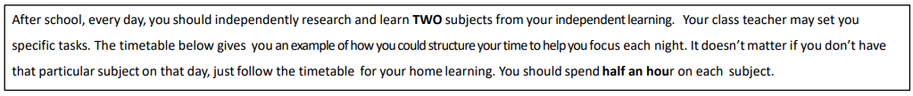
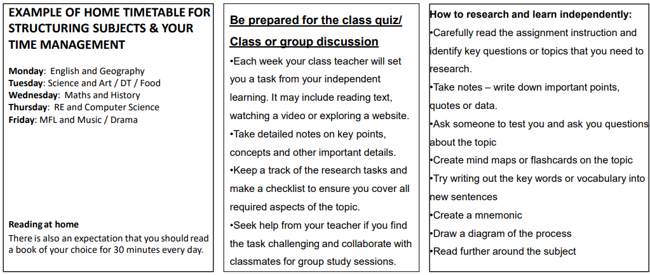

Slide 3

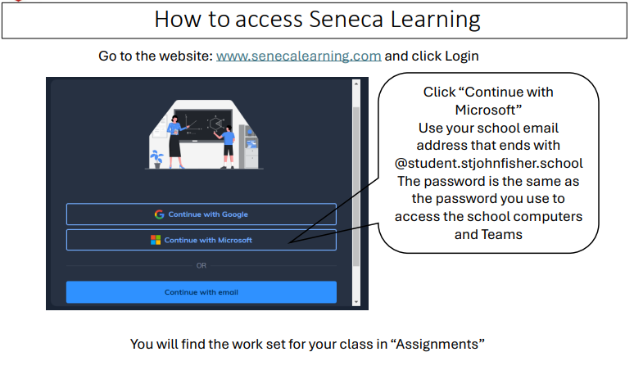

Slide 4
Mathematics Year 9 (MS)
Week 1:
HOMEWORK
Log into Sparx Maths using the provided log in detail.
Complete the task set on: Congruent shapes
Having log in issues?
Email:e.nyantakyi@stjohnfisher.school
Week 5:
HOMEWORK
Log into Sparx Maths using the provided log in detail.
Complete the task set on: Cosine ratio
Having log in issues?
Email: e.nyantakyi@stjohnfisher.school
Week 2:
HOMEWORK
Log into Sparx Maths using the provided log in detail.
Complete the task set on: Similar shapes
Having log in issues?
Email:e.nyantakyi@stjohnfisher.school
Week 6:
HOMEWORK
Log into Sparx Maths using the provided log in detail.
Complete the task set on: Revision I
Having log in issues?
Email: e.nyantakyi@stjohnfisher.school
Week 3:
HOMEWORK
Log into Sparx Maths using the provided log in detail.
Complete the task set on: Tangent ratio
Having log in issues?
Email:e.nyantakyi@stjohnfisher.school
Week 7:
HOMEWORK
Log into Sparx Maths using the provided log in detail.
Complete the task set on: Revision II
Having log in issues?
Email: e.nyantakyi@stjohnfisher.school
Week 4:
HOMEWORK
Log into Sparx Maths using the provided log in detail.
Complete the task set on: Sine ratio
Having log in issues?
Email: e.nyantakyi@stjohnfisher.school
Key Vocabulary: Congruency, Similar, tangent, sine, cosine, trigonometry ratio

Slide 5
Mathematics Year 9 (GS)
Week 1:
HOMEWORK
Log into Sparx Maths using the provided log in detail.
Complete the task set on: Linear graph
Having log in issues?
Email:e.nyantakyi@stjohnfisher.school
Week 5:
HOMEWORK
Log into Sparx Maths using the provided log in detail.
Complete the task set on: Quadratic graphs
Having log in issues?
Email: e.nyantakyi@stjohnfisher.school
Week 2:
HOMEWORK
Log into Sparx Maths using the provided log in detail.
Complete the task set on: Graphing rate of changes
Having log in issues?
Email:e.nyantakyi@stjohnfisher.school
Week 6:
HOMEWORK
Log into Sparx Maths using the provided log in detail.
Complete the task set on: Revision I
Having log in issues?
Email: e.nyantakyi@stjohnfisher.school
Week 3:
HOMEWORK
Log into Sparx Maths using the provided log in detail.
Complete the task set on: Real-life graphs
Having log in issues?
Email:e.nyantakyi@stjohnfisher.school
Week 7:
HOMEWORK
Log into Sparx Maths using the provided log in detail.
Complete the task set on: Revision II
Having log in issues?
Email: e.nyantakyi@stjohnfisher.school
Week 4:
HOMEWORK
Log into Sparx Maths using the provided log in detail.
Complete the task set on: Line segment
Having log in issues?
Email: e.nyantakyi@stjohnfisher.school
Key Vocabulary: Linear graphs, Rate of change, Real-life graphs, Line Segment, Quadratic graphs

Slide 6
ENGLISH:Year 9
Week 1:
  Complete the “Exploring Advertising and Sales Techniques” assignment on Seneca Learning.
  This will be marked automatically by Seneca Learning.
Week 5:
  Complete the “Mastering Persuasive Techniques in Advertising” assignment on Seneca Learning.
  This will be marked automatically by Seneca Learning.
Week 2:
  Complete the “Advertising and Marketing Terms” assignment on Seneca Learning.
  This will be marked automatically by Seneca Learning.
Week 6:
  Complete the “Mastering the Art of Advertising” assignment on Seneca Learning.
  This will be marked automatically by Seneca Learning.
Week 3:
  Complete the “Exploring Stereotypes in Advertising” assignment on Seneca Learning.
  This will be marked automatically by Seneca Learning.
Week 7:
  Complete the “Mastering Persuasive Writing: The Apprentice Challenge” assignment on Seneca Learning.
  This will be marked automatically by Seneca Learning.
Week 4:
  Complete the “The Art and Science of Advertising” assignment on Seneca Learning.
  This will be marked automatically by Seneca Learning.
Key Vocabulary:
CAMPAIGN / COMMERCIAL / BILLBOARD / COPYWRITER / ANALYTICS / TARGET AUDIENCE

Slide 7
Science
Week 1:
Complete Seneca Learning Assignment.
This will be marked by Seneca.
Week 5:
Complete Seneca Learning Assignment.
This will be marked by Seneca.
Week 2:
Complete Seneca Learning Assignment.
This will be marked by Seneca.
Week 6:
Complete Seneca Learning Assignment.
This will be marked by Seneca.
Week 3:
Complete Seneca Learning Assignment.
This will be marked by Seneca.
Week 7:
Complete Seneca Learning Assignment.
This will be marked by Seneca.
Week 4:
Complete Seneca Learning Assignment.
This will be marked by Seneca.
Key Vocabulary: Energy store – energy pathway – kinetic – thermal – chemical – gravitational potential – elastic potential – by heating – by radiation – mechanical working – electrical working – mass – extension – velocity

Slide 8
Citizenship- Year 09
Week 1:
Think about a problem in your local community, such as littering, anti-social behaviour, or lack of activities for young people. Explain why the problem matters and who it affects. Suggest at least two ways local people could help improve the situation.
Week 5:
Find out what your local council does for the community. Describe at least three services it provides, such as rubbish collection, parks, or libraries. Explain why these services are important for local people. Finish by suggesting one new idea that could improve your local are
Week 2:
Write about what identity means and what makes people different from each other. Describe how diversity can benefit schools and communities. Explain why respect and tolerance are important in modern Britain. Finish by giving one example of how people can challenge discrimination or unfair treatment.
Week 6:
Describe the main purpose of laws and courts in the UK. Explain the roles of the police, magistrates, and judges. Write about why it is important for everyone to be treated fairly under the law. Finish by explaining what could happen if laws were not enforced properly.
Week 3
Write about why schools need rules and what could happen if there were no rules. Explain at least two school rules that you think are important and why they matter. Describe how rules help students and teachers feel safe and respected. Give one example of a rule you would improve and explain your reason.
Week 7:
Choose one human right from the Human Rights Act or the United Nations Convention on the Rights of the Child. Explain what the right means and why it is important. Research one country or situation where this right has been challenged. Describe how charities or organisations try to protect people’s rights.
Week 4:
Choose three rights that young people have in the UK. Explain what each right means and why it is important. Then describe one responsibility that matches each right. Finish by explaining why rights and responsibilities should work together in society.
Key Vocabulary: identity, commumity, democracy

Slide 9
Religious Education
Week 1: Meeting God in strangers
Watch the following video and write a brief explanation of what happens and what Christians should do.
God's Story: The Good Samaritan
Week 5: CAFOD
Create a CAFOD campaign peace poster. Use the following link to choose a campaign
Campaign
Week 2: Common Good
Create a poster with images and words that explains the Catholic Social Teaching theme for the common good.
Week 6: Revision
Use your notes and Teams to prepare for assessment
Week 3: Research CSAN respond to the following:
What does CSAN stand for?
What is the main aim of the Catholic Social Action Network?
Who does CSAN try to help in society?
Give one example of an issue CSAN works on (e.g. poverty, migration, justice).
How does CSAN show Catholic beliefs through action?
Week 7:
Create a poster of all your learning this term. It must include information, quotes and pictures.
Week 4: Research Saint Vincent de Paul
Create a ppt/leaflet or poster that tells of the work and history of SVP.
Key Vocabulary:
Intercultural dialogue common good respect for the person
Social well being development of society Peace and security
World view

Slide 10
Computing
Week 1: What is the difference of backend and front end in web development and their key differences. Explain how they would work together to make the website interact. Provide the different front end languages and the back end languages that could be used in web development.
Week 4: Create a 5 page website of a topic of your choice using Wix.com. Register yourself on the website and then start by creating a site design and adding/editing new pages. Review on Hierarchical Structure in Week 3 for planning the website.
Week 2: Similarities between Python and C++ and which is better to use especially with creating a website. Which language would be harder to learn. Which programming language is considered the number 1 coding language in the world and why?
Week 5: What is a URL link and its key components. Provide examples of its breakdown and then provide the 4 key types of URL's?
Week 3: Define an Hierarchical Structure and its key components in a website, and then create one of your choice using shapes in Word or PowerPoint . An example would be three generations of your family tree. Consider an Hierarchical Structure to be the main pages in a website called - Root and Branches.
Week 6: What is a domain and an IP Address. How does a domain link to an IP address in a website?
Key vocabulary: backend , frontend, web, Python, C++, Hierarchical, URL, Domain, IP Address

Slide 11
French Year 9
Week 1:
Revision for Term 6 reading Assessment -
Module 3 (School)
Week 5:
Cultural project – create a poster / presentation
La Francophonie
Week 2:
Vocab Test to be set on Teams
Week 6:
Cultural project – create a poster / presentation
La Francophonie
Week 3:
Writing HW to be set on Teams
Week 7:
Cultural project – create a poster / presentation
La Francophonie
Week 4:
Vocabulary Test to be set on Teams
Key Vocabulary: la Francophonie, le monde francophone, les pays francophones, la langue, les traditions

Slide 12
Latin - Year 9 – Term 5
Week 1 – Revision of Stages 9 and 10
Week 4 – Translation
Nos Romani sumus callidi
Nos Romanis sumus callidiores quam vos Graeci
Week 5 – Vocabulary Test
Week 2 - Vocabulary Tes: THERMAEt(Roman Bath)
: .: Page 128, CLC. Copy in your book and revise.
Navem = ship ingens= huge conspexit = took sight of
Vero = true postulavit = asked inimmici - ennemies
Invenit = found delevit = destroyed verberabant = bea
WEEKS 6 & 8:7: CULTURAL PROJECTt
Week 3 : Roman life Poster – SCHOOL: Page 144. Copy and learn for Vocab test. .
Key vocabulary: palaestra, thermae, taberna, apodyterio, controversia

Slide 13
History
Week 1: Term 5 and 6
Week 1:Topics to choose from: Life in Nazi Germany, The Holocaust, The Dunkirk evacuations, end of WWII
Begin your independent research homework. This is a Term Five and six task. Make sure your work is detailed and well presented.
Challenge yourself by completing the extra reading task.
Week 5:
Revise for PPE
Week 2:
Continue with your independent research homework. This is a Term Five and six task. Make sure your work is detailed and well presented .Challenge yourself by completing the extra reading task.
Week 6:
Continue with your independent research homework. This is a Term Five task. Make sure your work is detailed and well presented.
Challenge yourself by completing the extra reading task.
Week 3:
Continue with your independent research homework. This is a Term Five task. Make sure your work is detailed and well presented.
Challenge yourself by completing the extra reading task.
Week 7:
Hand in your H/W.
Be prepared for an in class discussion about your research
Revise for PPE
Key Vocabulary: Secret police, Gestapo, fear, propaganda, anti semitism, Ghetto, discrimination, concentration camp, Prime Minister, Navy, Fleet, Community spirit, evacuation. Cold war, atom bomb, Dresden, War crimes, USSR

Slide 14
Geography
Week 1:
Complete set tasks on SENECA
This will be marked online
Week 4:
Complete set tasks on SENECA
This will be marked online
Week 2:
Complete set tasks on SENECA
This will be marked online
Week 5:
Complete set tasks on SENECA
This will be marked online
Week 3:
Complete set tasks on SENECA
This will be marked online
Key vocabulary: India, NEE, renewable, non-renewable, development, natural resources,
Accessibility,

Slide 15
Art and Design Year 9 Term 6
Week 1:
Create a mind map about everyday objects. This could include objects you have in your home, items that you wear, things you use in school e.g. the contents of your pencil case. Present in an interesting way.
Week 5:
Research the work of artist Gordon Smedt. Collect images and information and present this on a PowerPoint slide.
Week 2:
Create a mood board of everyday objects. Collect images and present them on a PowerPoint slide.
Week 6:
Take photographs of collections of shoes that you have at home. Present these on a PowerPoint slide.
Week 3:
Research the biro drawings of artist Andrea Joseph. Collect images and information and present on a PowerPoint slide.
Week 7:
Make a careful drawing of one of your pairs of shoes.
Week 4:
Create a biro drawing of an everyday object inspired by Andrea Joseph’s drawings. Use plenty of mark making.
Key Vocabulary:
Line, tone, pattern, texture, form, shape, composition, graphite, everyday objects, mark making, brush marks

Slide 16
Drama Year 9 Term 6
Week 1:
Placards
Brecht liked to use placards in his work to emphasis the points that he was trying to make. Design your own placard for a cause that you believe in – that can be a large scale cause, or something more personal.
Week 5:
Epic Theatre - Summary
We have now reached the end of your work on Epic Theatre. Write out a summary of what you have learned on this topic, and what you think was particularly impressive about your own work.
Week 2:
Rehearsal
Find ten minutes at the start of a break or lunchtime with your group to go over the performance so far. Focus on making sure you have covered everything that you need to be doing for your final performance.
Week 6:
Make a list of ten different things that you think you now know about Drama based on all of the work that you have done so far at school. This can be theory based or practical based.
Week 3:
Reflection
Think over the work that you have done this term on Brecht. Write a reflection of this working, thinking about what went really well, and what needed some improvements.
Week 7:
Make a list of ten things that you would like to know more about with regards to Drama. Are there any specific areas you would like to build upon or to know more about?
Week 4:Brecht Plays
As well as being a theatre practitioner, Bertolt Brecht wrote many plays. Do some research into one of them and produce for me a information pack about this play, telling me about its original production and the meaning behind it.
Key vocabulary: Epic theatre, Political Theatre, Gestus, Exaggeration, Placards, Freeze Frames, Tableaux

Slide 17
Term 6 Music
Week 1: Choose a song for keyboard that will challenge your skills
Week 4: Add in the chords and left hand accompaniment to your song
Week 2: Practise a major scale eg C or G using the correct fingerings learnt in class
C D E F G A B C
1 2 3 1 2 3 4 5 and down the same way
Week 5: Play with both hands lead sheet style
Week 3: Practise playing your chosen song 10 minutes on at least 3 days of the week
Week 6: Prepare for a performance adding in backing beats, dynamics and expression . Evaluate the progress you have made.
Key vocabulary: correct fingers practice chords lead sheet dynamics expression

Slide 18
Physical Education –Term 6 - Homework Tasks
Week 1: Bowling and Skeleton (Part 1)
Hands (Practical) Watch the following video on how to perform a bowl correctly
Video: Practice your bowling at home with a ball (Rounders)
Video: How to bowl in cricket (Practice @ Home) (Cricket
Head (Mastery) – Bones in the Axial Skeleton
Week 4: Umpiring and Joints
Watch the following video on umpiring
How to Officiate - Rounders (Watch both videos)
How to Umpire in Cricket
Head (Theory Mastery) - Skeletal Joints
Week 2: Wicket Keeper/Backstop and Skeletal Functions
Watch the following video on the shot-put throwing technique
Hands (Practical) Video: Practice Bowling at the Batter (Rounders)
Video: Practice Bowling at the Batter (Cricket)
Head (Mastery) – Seneca Link Week 2 - Functions of the Skeleton
Week 5:Developing Tactics
Developing Team Tactics in Cricket
Developing Tactics in Rounders
Head (Theory Mastery) - Skeletal Joints
Week 3: Matchplay
Watch the following video on how to play the game
Howto play Pairs Cricket
Rules of Roudners
Week 6:
Watch the following footage of a Rounders/Cricket game and identify
Areas of Strength and Weakness for 1 of the teams.
Rounders Match
Cricket Match
Keywords: Hand-eye coordination, Timing, Shot selection, Accuracy, Power, Bat control, Reaction speed, Decision-making, Concentration, Technique

