Slide 1

Independent Learning
Year 8
Term 6

Slide 2

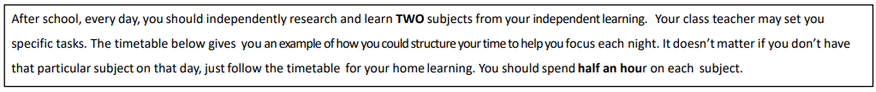
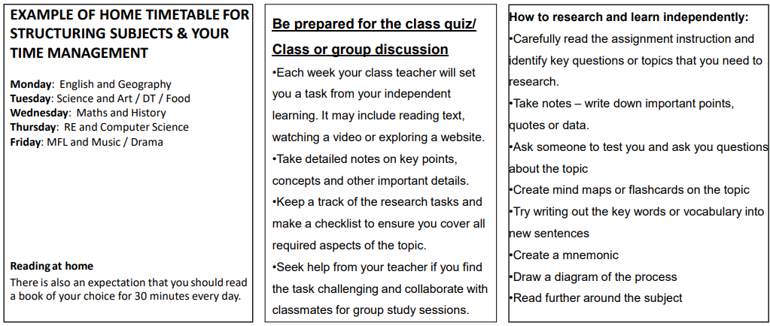

Slide 3

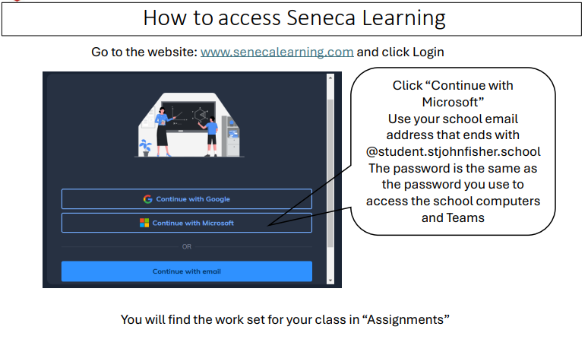

Slide 4
Mathematics Year 8 (MS)
Week 1:
HOMEWORK
Log into Sparx Maths using the provided log in detail.
Complete the task set on: Fractions and decimals
Having log in issues?
Email:e.nyantakyi@stjohnfisher.school
Week 5:
HOMEWORK
Log into Sparx Maths using the provided log in detail.
Complete the task set on: Revision on Percentages
Having log in issues?
Email: e.nyantakyi@stjohnfisher.school
Week 2:
HOMEWORK
Log into Sparx Maths using the provided log in detail.
Complete the task set on: Equivalent proportions
Having log in issues?
Email:e.nyantakyi@stjohnfisher.school
Week 6:
HOMEWORK
Log into Sparx Maths using the provided log in detail.
Complete the task set on: Revision I
Having log in issues?
Email: e.nyantakyi@stjohnfisher.school
Week 3:
HOMEWORK
Log into Sparx Maths using the provided log in detail.
Complete the task set on: Writing percentages
Having log in issues?
Email:e.nyantakyi@stjohnfisher.school
Week 7:
HOMEWORK
Log into Sparx Maths using the provided log in detail.
Complete the task set on: Revision II
Having log in issues?
Email: e.nyantakyi@stjohnfisher.school
Week 4:
HOMEWORK
Log into Sparx Maths using the provided log in detail.
Complete the task set on: Increased or Decreased Percentages
Having log in issues?
Email: e.nyantakyi@stjohnfisher.school
Key Vocabulary: Fractions, Decimals, Equivalent proportions, Percentages, Multiplier, Increased, Decreased

Slide 5
Mathematics Year 8 (GS)
Week 1:
HOMEWORK
Log into Sparx Maths using the provided log in detail.
Complete the task set on: Congruent and similar shapes
Having log in issues?
Email:e.nyantakyi@stjohnfisher.school
Week 5:
HOMEWORK
Log into Sparx Maths using the provided log in detail.
Complete the task set on: Cosine ratio
Having log in issues?
Email: e.nyantakyi@stjohnfisher.school
Week 2:
HOMEWORK
Log into Sparx Maths using the provided log in detail.
Complete the task set on: Ratios in triangles
Having log in issues?
Email:e.nyantakyi@stjohnfisher.school
Week 6:
HOMEWORK
Log into Sparx Maths using the provided log in detail.
Complete the task set on: Revision I
Having log in issues?
Email: e.nyantakyi@stjohnfisher.school
Week 3:
HOMEWORK
Log into Sparx Maths using the provided log in detail.
Complete the task set on: Tangent ratio
Having log in issues?
Email:e.nyantakyi@stjohnfisher.school
Week 7:
HOMEWORK
Log into Sparx Maths using the provided log in detail.
Complete the task set on: Revision II
Having log in issues?
Email: e.nyantakyi@stjohnfisher.school
Week 4:
HOMEWORK
Log into Sparx Maths using the provided log in detail.
Complete the task set on: Sine ratio
Having log in issues?
Email: e.nyantakyi@stjohnfisher.school
Key Vocabulary: Congruent, similar shapes, Ratio, Tangent, Sine, Cosine, Trigonometry

Slide 6
ENGLISH:Year 8
Week 1:
  Complete the “Exploring Conflict in War Poetry” assignment on Seneca Learning.
  This will be marked automatically by Seneca Learning.
Week 5:
  Complete the “Exploring the Emotional Impact of War Poetry” assignment on Seneca Learning.
  This will be marked automatically by Seneca Learning.
Week 2:
  Complete the “War Poetry: Voices from the Battlefield” assignment on Seneca Learning.
  This will be marked automatically by Seneca Learning.
Week 6:
  Complete the “The Psychological and Moral Impact of War in Poetry” assignment on Seneca Learning.
  This will be marked automatically by Seneca Learning.
Week 3:
  Complete the “Essential Vocabulary for War Poetry and Literature Studies” assignment on Seneca Learning.
  This will be marked automatically by Seneca Learning.
Week 7:
  Complete the “Exploring Conflict and Memory in Poetry” assignment on Seneca Learning.
  This will be marked automatically by Seneca Learning.
Week 4:
  Complete the “The Structure and Verse of War Poetry” assignment on Seneca Learning.
  This will be marked automatically by Seneca Learning.
Key Vocabulary:
FUTILITY / PATRIOTISM / PROPAGANDA / DISILLUSIONMENT / VOLTA / ENJAMBMENT

Slide 7
Science
Week 1:
Complete Seneca Learning Assignment.
This will be marked by Seneca.
Week 5:
Complete Seneca Learning Assignment.
This will be marked by Seneca.
Week 2:
Complete Seneca Learning Assignment.
This will be marked by Seneca.
Week 6:
Complete Seneca Learning Assignment.
This will be marked by Seneca.
Week 3:
Complete Seneca Learning Assignment.
This will be marked by Seneca.
Week 7:
Complete Seneca Learning Assignment.
This will be marked by Seneca.
Week 4:
Complete Seneca Learning Assignment.
This will be marked by Seneca.
Key Vocabulary: longitudinal wave – transverse wave – energy transfer – amplitude – frequency – wavelength – sun – planets – satellites – orbit – reflection – refraction

Slide 8
Religious Education
Week 1: Watch the following video: https://www.youtube.com/watch?v=jyVq1hnxAqg
Respond: 1.What was Second Vatican Council?
What were 2 important changes in the Church after Vatican II?
What does the word “aggiornamento” mean, and why was it important to Vatican II?
Why do some people misunderstand Vatican II?
What was Pope John XXIII’s hope for the Church during Vatican II?
Week 5:
Revise for the assessment.
Use information on Teams and from class to help you prepare.
Week 2: Watch the following video: https://www.youtube.com/watch?v=0ebTEsAp35s
Respond: 1.What are some visible and invisible differences between people?
Why can diversity sometimes lead to misunderstandings?
What is the purpose of dialogue?
What are 2 things dialogue is not?
Does respecting someone’s belief mean you have to agree with them? Give a reason
Week 6: Watch the following video: https://www.youtube.com/watch?v=qXhV3dMxSzE
Respond:
Where did Sikhism start?
What is a key religious belief of Sikhism?
Who helps in the kitchen? Why?
What is the Guru Granth Sahib?
Week 3: Research on of the following Eastern Catholic Churches:
Byzantine Rite
Alexandrian Rite
West Syrian Rite
East Syrian Rite
Find out: Who it includes (churches), the history of it, and how they are different from the Roman Catholic Church
Week 7:
Create a poster/ppt outlining the key beliefs and practices of Sikhism
Week 4: Research the Ukrainian Greek Catholic Church. Use the following:
1.What are the origins of the Ukrainian Greek Catholic Church?
2.How did the Ukrainian Greek Catholic Church survive times of persecution, such as under Soviet rule?
3.What are some key traditions, or symbols in Ukrainian Greek Catholic worship?
Who is the current leader of the Ukrainian Greek Catholic Church?
How does this Church contribute to the culture and identity of the Ukrainian people?
Key Vocabulary:
Ecclesiam Suam, dialogue, proclamation, Second Vatican Council, patrimony, Guru Nanak, Gurdwara, Guru Granth Sahib

Slide 9
Citizenship- Year 08
Week 1:
Create a small poster or fact sheet about one way citizens can take action, such as voting, protesting, fundraising, or volunteering. Include at least three facts and explain why this action can make a difference.
Week 5:
Design a simple plan for making a positive change in your school or local area. Include the problem, the action you would take, and what successful change would look like after one month.
Week 2:
Work out why people join groups or campaigns. Write a short paragraph explaining two reasons people work together and how teamwork can make change happen faster.
Week 6:
Write about two features of a successful crime prevention programme. Explain why these features are important.
Week 3
Imagine you want to improve something in school, such as recycling or lunchtime queues. Write 4–5 sentences explaining how you would campaign for change and how you would persuade others to support your idea.
Week 7:
Create your own crime prevention programme for young people. Include the aim of the programme, the activities offered and how it would help the community.
Week 4:
Think about a person who has improved life for others. This could be someone in history, your community, or your school. Explain in a short paragraph what they changed and what people can learn from them.
Key Vocabulary: campaign, changemaker

Slide 10
Computing
Week 1: What is the difference between Low Level and High level programming. What career paths does each one entail and then explain what each core career paths each one focusses on.
Week 4: Explain the difference of low level language - Machine code versus Binary code and its key differences.
Week 2: What is low level programming language. What are the key characteristics and features of low level programming? Provide the main types of low level programming and its primary uses.
Week 5: Explain the key differences of Object-Oriented Languages (OOP) and script language in high level programming and how they operate.
Week 3: What is high level programming language. What are the key characteristics and features of high level programming? Provide the main types of high level programming and its primary uses.
Week 6: Explain 5 advantages of choosing python over other high level languages.
Key vocabulary: high level, low level, programming, machine code, binary, object-orientated , script language.

Slide 11
Geography
Week 1:
Complete set tasks on SENECA
This will be marked online
Week 4:
Complete set tasks on SENECA
This will be marked online
Week 2:
Complete set tasks on SENECA
This will be marked online
Week 5:
Complete set tasks on SENECA
This will be marked online
Week 3:
Complete set tasks on SENECA
This will be marked online
Key vocabulary: India, Coral reef, atoll, barrier reef, fringing reef, arctic, tundra

Slide 12
History
Week 1: Topics: choose from: The case of Jack the Ripper: the victims, policing methods, Medway in the 1800
Begin your independent research homework. This is a Term Five and six task. Make sure your work is detailed and well presented.
Challenge yourself by completing the extra reading task.
Week 5:
Continue with your independent research homework. This is a Term Five and six task. Make sure your work is detailed and well presented.
Challenge yourself by completing the extra reading task.
Week 2:
Continue with your independent research homework. This is a Term Five and six task. Make sure your work is detailed and well presented.
Challenge yourself by completing the extra reading task.
Week 6:
Hand in your h/w. Be prepared for a class discussion on your research.
Revision
Week 3
:
Continue with your independent research homework. This is a Term Five and six task. Make sure your work is detailed and well presented.
Challenge yourself by completing the extra reading task.
Week 7:
Revision
Week 4:
Continue with your independent research homework. This is a Term Five and six task. Make sure your work is detailed and well presented.
Challenge yourself by completing the extra reading task.
Key Vocabulary: , dockyard, industry, raid, Dutch, closure, cemetery
Poverty, homelessness, crime, workhouse, doss house, alcoholism, slum, walking the beat, forensics, tabloid newspaper, fingerprint, disguise

Slide 13
Year 8 French term 6
Week 1: Revision for term 6 Reading assessment
Sports + Leisure
Week 5: learn vocab on teams
Week 2: Learn vocab on teams
Week 6: Cultural project – La Francophonie
Week 3: Perfect Tense
Grammar Test ( Avoir)
Week 7: Cultural project – La Francophonie
Week 4:
Writing H/W
Key Vocabulary: Body parts, Perfect Tense, La Francophonie

Slide 14
Latin - Year 8 – Term 6
Week 1 – Revision of Stages 9 and 10
Week 4 – Translation
Nos Romani sumus callidi
Nos Romanis sumus callidiores quam vos Graeci
Week 5 – Vocabulary Test
Week 2 - Vocabulary Tes: THERMAEt(Roman Bath)
: .: Page 128, CLC. Copy in your book and revise.
WEEKS 6 & 8:7: CULTURAL PROJECTt
Week 3 : Roman life Poster – SCHOOL: Page 144. Copy and learn for Vocab test. .
Key vocabulary: palaestra, thermae, taberna, apodyterio, controversia

Slide 15
Art and Design Year 8 Term 6
Week 1:
Research how storytelling is seen in art throughout history e.g. on cave paintings, Egyptian murals, Greek Frescoes, on pottery in different cultures, in paintings etc. Collect at least five images and explain what they are, what story they are telling, when they were made, what culture are they from etc. Present on a PowerPoint slide or Word document.
Week 5:
Research the work of artist Jackie Morris. Jackie Morris is a contemporary artist who uses gold leaf on some of her paintings and prints of her illustrations. Collect information and at least five images of her work. Present on a PowerPoint slide or Word document. Consider the layout of your work.
Week 2:
Create a drawing from one of the images you found last week using line and tone. Write a description of the object.
Week 6:
Create a drawing from one of the images of Jackie Morris’s work that you found last week. Use colour, if you have materials at home.
Week 3:
Research the illustrations of Arthur Rackham. Collect information and at least five images of his work. Present on a PowerPoint slide or Word document.
Week 7:
Compare the work of Jackie Morris and Arthur Rackham. Which do you prefer? Explain why?
Find an example of an illustration or illustrator that you really like. Explain why you have chosen this. Present images and written work on a Word document .
Week 4
Create a drawing from part of one of the Arthur Rackham images you found last week. Arthur Rackham’s illustrations contain lots of detail and mark making so focus on part of your chosen image rather than the whole thing.
Key Vocabulary:
Illustration, storytelling, mark-making, linear drawing, printmaking, gold leaf, murals, frescoes, ceramics, paintings, illustrator, imaginative composition.

Slide 16
Term 6 Music
Watch the following clip –
Short Ride in a Fast Machine by John Adams
https://www.youtube.com/watch?v=5LoUm_r7It8
Challenge: Find another piece of music where the percussion section is important.
Watch the following of Respect by Aretha Franklin
https://www.youtube.com/watch?v=EcGjZHvD5q4
What is the genre of this song? How does the lead singer relate to the backing vocalists? What instruments can you hear?
Watch the following clip about the instruments of the brass section in an orchestra.
https://www.youtube.com/watch?v=yE0aSxziNdY
Choose 1 of the brass instruments in the section to research. Are there any pieces where it is a solo instrument? Are there any famous players? What key does it play in?
Watch and listen to the following clip of the piece Theme from “Jurassic Park” by John Williams.
https://www.youtube.com/watch?v=-NqaupGcCpw
Answer these questions:
List 10 instruments you can hear.
2 What is the role of the conductor in the video?
Watch the following clip of Rhapsody in Blue by George Gershwin up to 4:01
https://www.youtube.com/watch?v=cH2PH0auTUU
Listen carefully to the music thinking about the tempo, dynamics and instruments you can hear.
Research another film score composed by John Williams –
What is the film?
What is it about?
Is it similar/different to
Jurassic Park?
2 Find 3 more living film composers.
Key vocabulary percussion, woodwind, brass, orchestra, singer, vocals,
unison, call-and-response, soul, composer, conductor

Slide 17
Drama Year 8 Term 6
Week 1:
Zanni
Using the internet if you need help, draw a picture of the Commedia character Zanni. Label this character with his personality traits and how he acts.
Week 5:
Commedia dell’arte - Summary
We have now reached the end of your work on Commedia dell’arte. Write out a summary of what you have learned on this topic, and what you think was particularly impressive about your own work.
Week 2:
Magnifico
Using the internet if you need help, draw a picture of the Commedia character Magnifico. Label this character with his personality traits and how he acts.
Week 6:
Make a list of ten different things that you think you now know about Drama based on all of the work that you have done so far at school. This can be theory based or practical based.
Week 3:
Commedia Dell’arte characters
There are many more different Commedia Dell’arte characters that we have not covered in this module. Do some research to find another that you like, and make a character sheet like the ones we have done previously.
Week 7:
Make a list of ten things that you would like to know more about with regards to Drama. Are there any specific areas you would like to build upon or to know more about?
Week 4:
Commedia Masks
Design a mask that shows a specific character from Commedia dell’arte. Remember to show exactly how that character acts, and where they are in the hierarchy using your design skills.
Key Vocabulary: commedia dell’arte, Pantelone, Zanni, Magnifico, Arlecchino, Harlequin, exaggeration

Slide 18
Physical Education –Term 6 - Homework Tasks
Week 1: Bowling and Skeleton (Part 1)
Hands (Practical) Watch the following video on how to perform a bowl correctly
Video: Practice your bowling at home with a ball (Rounders)
Video: How to bowl in cricket (Practice @ Home) (Cricket
Head (Mastery) – Bones in the Axial Skeleton
Week 4: Umpiring and Joints
Watch the following video on umpiring
How to Officiate - Rounders (Watch both videos)
How to Umpire in Cricket
Head (Theory Mastery) - Skeletal Joints
Week 2: Wicket Keeper/Backstop and Skeletal Functions
Watch the following video on the shot-put throwing technique
Hands (Practical) Video: Practice Bowling at the Batter (Rounders)
Video: Practice Bowling at the Batter (Cricket)
Head (Mastery) – Seneca Link Week 2 - Functions of the Skeleton
Week 5:Developing Tactics
Developing Team Tactics in Cricket
Developing Tactics in Rounders
Head (Theory Mastery) - Skeletal Joints
Week 3: Matchplay
Watch the following video on how to play the game
Howto play Pairs Cricket
Rules of Roudners
Week 6:
Watch the following footage of a Rounders/Cricket game and identify
Areas of Strength and Weakness for 1 of the teams.
Rounders Match
Cricket Match
Keywords: Hand-eye coordination, Timing, Shot selection, Accuracy, Power, Bat control, Reaction speed, Decision-making, Concentration, Technique

