Slide 1

Independent Learning
Year 7
Term 6

Slide 2

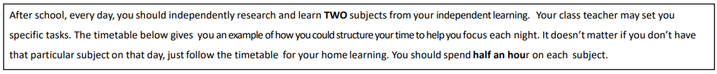
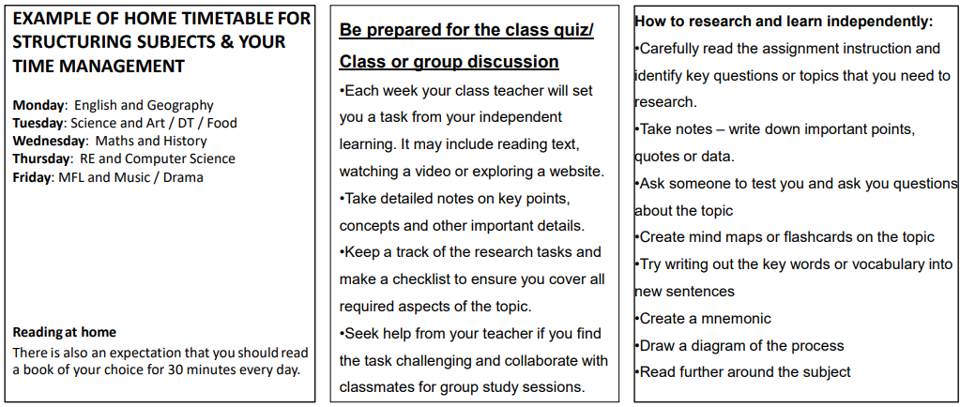

Slide 3

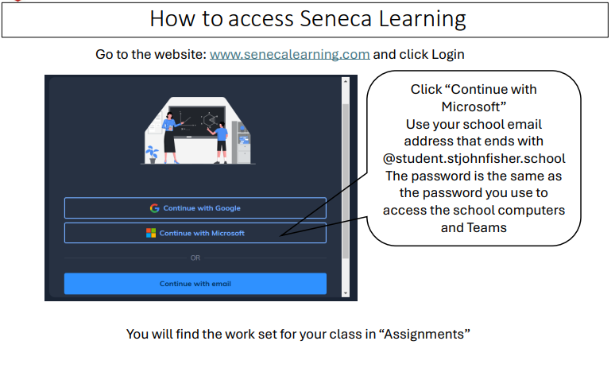

Slide 4
Mathematics Year 7 (MS)
Week 1:
HOMEWORK
Log into Sparx Maths using the provided log in detail.
Complete the task set on: Congruency and enlargements
Having log in issues?
Email:e.nyantakyi@stjohnfisher.school
Week 5:
HOMEWORK
Log into Sparx Maths using the provided log in detail.
Complete the task set on: Translations and combined transformations
Having log in issues?
Email: e.nyantakyi@stjohnfisher.school
Week 2:
HOMEWORK
Log into Sparx Maths using the provided log in detail.
Complete the task set on: Symmetry
Having log in issues?
Email:e.nyantakyi@stjohnfisher.school
Week 6:
HOMEWORK
Log into Sparx Maths using the provided log in detail.
Complete the task set on: Revision I
Having log in issues?
Email: e.nyantakyi@stjohnfisher.school
Week 3:
HOMEWORK
Log into Sparx Maths using the provided log in detail.
Complete the task set on: Reflection
Having log in issues?
Email:e.nyantakyi@stjohnfisher.school
Week 7:
HOMEWORK
Log into Sparx Maths using the provided log in detail.
Complete the task set on: Revision II
Having log in issues?
Email: e.nyantakyi@stjohnfisher.school
Week 4:
HOMEWORK
Log into Sparx Maths using the provided log in detail.
Complete the task set on: Rotation
Having log in issues?
Email: e.nyantakyi@stjohnfisher.school
Key Vocabulary: Congruency, Enlargement, Symmetry, Reflection, Rotation, Translation, combined transformation

Slide 5
Mathematics Year 7 (GS)
Week 1:
HOMEWORK
Log into Sparx Maths using the provided log in detail.
Complete the task set on: Fractions and decimals
Having log in issues?
Email:e.nyantakyi@stjohnfisher.school
Week 5:
HOMEWORK
Log into Sparx Maths using the provided log in detail.
Complete the task set on: Revision on Percentages
Having log in issues?
Email: e.nyantakyi@stjohnfisher.school
Week 2:
HOMEWORK
Log into Sparx Maths using the provided log in detail.
Complete the task set on: Equivalent proportions
Having log in issues?
Email:e.nyantakyi@stjohnfisher.school
Week 6:
HOMEWORK
Log into Sparx Maths using the provided log in detail.
Complete the task set on: Revision I
Having log in issues?
Email: e.nyantakyi@stjohnfisher.school
Week 3:
HOMEWORK
Log into Sparx Maths using the provided log in detail.
Complete the task set on: Writing percentages
Having log in issues?
Email:e.nyantakyi@stjohnfisher.school
Week 7:
HOMEWORK
Log into Sparx Maths using the provided log in detail.
Complete the task set on: Revision II
Having log in issues?
Email: e.nyantakyi@stjohnfisher.school
Week 4:
HOMEWORK
Log into Sparx Maths using the provided log in detail.
Complete the task set on: Increased or Decreased Percentages Having log in issues?
Email: e.nyantakyi@stjohnfisher.school
Key Vocabulary: Fractions, Decimals, Equivalent proportions, Percentages, Multiplier, Increased, Decreased

Slide 6
ENGLISH:Year 7
Week 1:
  Complete the “Meet the Characters of ’Much Ado About Nothing’” assignment on Seneca Learning.
  This will be marked automatically by Seneca Learning.
Week 5:
  Complete the “Exploring Shakespeare and Elizabethan Women” assignment on Seneca Learning.
  This will be marked automatically by Seneca Learning.
Week 2:
  Complete the “The Story of’Much Ado About Nothing’” assignment on Seneca Learning.
  This will be marked automatically by Seneca Learning.
Week 6:
  Complete the “Unlocking the Language of ’Much Ado About Nothing’” assignment on Seneca Learning.
  This will be marked automatically by Seneca Learning.
Week 3:
  Complete the “’Much Ado About Nothing’: A Tale of Deception” assignment on Seneca Learning.
  This will be marked automatically by Seneca Learning.
Week 7:
  Complete the “Exploring Themes and Context in’Much Ado About Nothing’” assignment on Seneca Learning.
  This will be marked automatically by Seneca Learning.
Week 4:
  Complete the “Comedy in Shakespeare’s Plays” assignment on Seneca Learning.
  This will be marked automatically by Seneca Learning.
Key Vocabulary:
WIT / MISOGYNY / SLANDER / PATRIARCHY / BACHELOR / PERNICIOUS

Slide 7
Science
Week 1:
Complete Seneca Learning Assignment.
This will be marked by Seneca.
Week 5:
Complete Seneca Learning Assignment.
This will be marked by Seneca.
Week 2:
Complete Seneca Learning Assignment.
This will be marked by Seneca.
Week 6:
Complete Seneca Learning Assignment.
This will be marked by Seneca.
Week 3:
Complete Seneca Learning Assignment.
This will be marked by Seneca.
Week 7:
Complete Seneca Learning Assignment.
This will be marked by Seneca.
Week 4:
Complete Seneca Learning Assignment.
This will be marked by Seneca.
Key Vocabulary: Food chain – food web – producer – consumer – respiration – photosynthesis – decomposer – sedimentary rock – igneous rock – metamorphic rock – mantal – crust – core

Slide 8
Religious Education
Week 1: What was the Council of Nicaea, and when did it take place?
What is the Nicene Creed, and why is it important?
What decision did the Council make about the nature of Jesus Christ?
Why do you think it was important for early Christians to agree on key beliefs?
How might disagreements about Jesus’ nature have caused division in the early Church?
How might Christianity have developed differently if the Council of Nicaea had not taken place?
Week 5:
Why do you think Christians interpret the Bible in different ways?
In what ways do cultural and geographical differences influence the development of denominations?
Do you think having many denominations helps or harms Christianity? Explain your answer.
Week 2:Who were the Gentiles, and why was their inclusion in the Church controversial?
What issue was being debated at the Council of Jerusalem?
What decision was made at the end of the Council?
How was the decision communicated to other Christians?
Why do you think some Jewish Christians wanted Gentiles to follow Jewish laws?
How might the decision of the Council have helped Christianity spread further?
What does the Council teach us about handling disagreements in religious communities today?
Week 6:
Research task: Choose two Christian denominations and create a comparison chart showing differences in beliefs, worship styles, and leadership.
Week 7:
What is ecumenism? How does this fulfil the Catholic Social Teaching principle of ‘common’ good’?
Investigate ways different Christian groups work together for the common good in your local community.
What ideas can you come up with so that we can work with others’ in our local community.
Choose one way in which Christians could respond to this statement “ in word and deed, we must obey Christ who expressly wills, that we may all be one”
Week 3: What was the Council of Trent, and when did it take place?
Why was the Council of Trent called?
What were the main decisions made at the Council of Trent?
How did the Council of Trent try to deal with corruption in the Church?
In what ways did the Council of Trent reinforce Catholic beliefs?
How did the Council of Trent respond to Martin Luther’s criticisms?
What long-term effects did the Council of Trent have on Europe?
Week 4: What is a Christian denomination?
Name three major Christian denominations.
What historical event led to the creation of Protestant denominations?
Why did Martin Luther disagree with the Catholic Church?
How did the Reformation contribute to the growth of different Christian denominations?
How do beliefs or practices differ between Catholic and Protestant Christians?
Key vocabulary: Theological, Great Commission, Ecumenical Council, Dogma, Universal Church, Gentile, Schism, Heresy, Reform, Indulgence,
Body of Christ, Ecumenism, Common good, Nicaea, Creed, Dialogue

Slide 9
Citizenship- Year 07
Week 1:
Create a mini fact file about three different crimes. Include what the crime is, who it affects and one possible punishment.
Week 5:
Design a safe community by drawing or describing places and activities that help prevent crime. Label your ideas with short explanations
Week 2:
Write down three reasons why people may commit crimes. Explain each reason in one short sentence.
Week 6:
Write about two features of a successful crime prevention programme. Explain why these features are important.
Week 3
Imagine you are a police officer for one day and write a short diary entry about a problem you solved. Explain how you helped people in the community.
Week 7:
Create your own crime prevention programme for young people. Include the aim of the programme, the activities offered and how it would help the community.
Week 4:
Find a news story or TV report about crime and describe what happened. Explain how the report might make people feel.
Key Vocabulary: criminal, police, justice, community

Slide 10
Computing
Week 1: Study the evolution of computing. Name the devices used over time until present day.
Week 4: Name the 5 foundational theorists of computer science and explain what each one has done for computers.
Week 2: Name the Five Generations of Electronic Computing and write about each of the computing Generations and their devices used.
Week 5: What is a transistor and state all its importance in computers. Also, explore a picture of how it looks. What was used in the past on computers before the birth of the transistors.
Week 3: Who is Charles Babbage and explain the 5 key impacts Charles Babbage has done in computer science.
Week 6: One of the importance of computers is the transistor. Explore Moore’s Law regarding the transistor and write a paragraph on the understanding of Moore’s Law with reference to the transistor.
Key vocabulary: evolution, electronic, transistor, vacuum tube, generations, theorists

Slide 11
Subject Name History
Week 1:
Themes: Choose form: gunpowder plot, The causes of the English Civil War, the trial and execution of the King.MEDWAY
Begin your independent research homework. This is a Term Five and six task.
Make sure your work is detailed and well presented.
Week 5:
Continue with your independent research homework. This is a Term Five and six task. Make sure your work is detailed and well presented.
Challenge yourself by completing the extra reading task.
Week 2:
Continue with your independent research homework. This is a Term Five and six task. Make sure your work is detailed and well presented.
Challenge yourself by completing the extra reading task.
Week 6:
Hand in your work.
Class discussion on your research.
Revision.
Week 3
Continue with your independent research homework. This is a Term Five and six task. Make sure your work is detailed and well presented.
Challenge yourself by completing the extra reading task.
Week 7:
Week 4:
Continue with your independent research homework. This is a Term Five and six task. Make sure your work is detailed and well presented.
Challenge yourself by completing the extra reading task.
Key Vocabulary:
Plot. Treason, taxation, Parliament, Roundhead, cavalier, trial, evidence, interpretation, spy, Catholic, Protestant.Mdeway. Dockyard. Bricks.Industry.Military.

Slide 12
Geography
Week 1:
Complete set tasks on SENECA
This will be marked online
Week 4:
Complete set tasks on SENECA
This will be marked online
Week 2:
Complete set tasks on SENECA
This will be marked online
Week 5:
Complete set tasks on SENECA
This will be marked online
Week 3:
Complete set tasks on SENECA
This will be marked online
Key vocabulary: Drainage basin, weathering, erosion, deposition, tributary, source, upper/middle and lower course

Slide 13
Year 7 French term 6
Week 1: Revision for Term 6 Reading assessment – Clothes + Weather
Week 5: Cultural project
Week 2: Learn vocab on teams
Week 6: Cultural project
Week 3: learn vocab on teams
Week 7: Cultural project
Week 4: Writing HW - Hobbies
Key Vocabulary: je porte, tu portes, les vetements, je joue, tu joues, il joue, elle joue, nous jouons, je fais

Slide 14
Art and Design Year 7 Term 6
Week 1:
Research examples of ancient iconic buildings e.g. The Pyramids in Egypt, The Parthenon in Greece, The Colosseum in Rome etc. Collect images of at least five buildings and present on a PowerPoint slide or Word document. Think about the design or layout of your page.
Week 5:
Research the work of Architect Zaha Hadid. Find at least five examples of buildings she designed and present the images on a PowerPoint slide or Word document. Write some information about the buildings and about Zaha Hadid.
Week 2:
Draw one of the ancient buildings that you found for last week’s homework and write some information to explain what the building is, when it was built, where it is, what it was used for etc.
Week 6:
Create a page of drawings from Zaha Hadid’s designs that you found for last week’s homework. Draw in line and add tone, to show the depth of the buildings.
Week 3:
Research iconic buildings and landmarks from around the world e.g. The Eiffel Tower, The Sydney Opera House, Big Ben, The Taj Mahal, The Chrysler Building etc. Collect at least five images and present those on a PowerPoint slide or a Word document. Think about the design or layout of your page.
Week 7:
Research the work of the artist Ian Murphy. Most of Ian Murphy’s work is based on Architecture. Some of his work focuses on details of buildings. Collect at least five images of Ian Murphy’s work and present these on a PowerPoint slide or Word document. Include some information about Ian Murphy and his work.
Week 4:
Draw one of the iconic buildings or landmarks you found for last week’s homework and write some information to explain when it was built, what it was used for, where it is, who the architect was etc.
Key Vocabulary:
Ancient architecture, iconic buildings and landmarks, stone masonry, structure, contemporary architecture, architect, depth, architectural details.

Slide 15
Subject Name: Drama
Week 1:
Scripting
We have looked at the character of Hercules in class. Write a short monologue to explain why he is undergoing the labours that he has had set for him.
Week 5:
Greek Theatre – Summary
We have now reached the end of your work on Greek Theatre. Write out a summary of what you have learned on this topic, and what you think was particularly impressive about your own work.
Week 2:
Rehearsal
Find ten minutes at the start of one lunch or breaktime to practice the work that you have been doing in your group to make it ready to show the rest of the class.
Week 6:
Make a list of ten different things that you think you now know about Drama based on all of the work that you have done so far at school. This can be theory based or practical based.
Week 3:
Evaluate
Take some time to reflect on your performance in the class so far. What could you do in order to improve your work moving forwards?
Week 7:
Make a list of ten things that you would like to know more about with regards to Drama. Are there any specific areas you would like to build upon or to know more about?
Week 4:
Greek Masks
Design a mask that shows a specific emotion. Remember that in Greek Theatre they would have a wide space for the mouth, and expressive eyes
Key Vocabulary: Set, Staging, Mythology, Character, Character Profile, Monologue

Slide 16
Term 6 Music
Watch the following clip about the instruments of a percussion section in an orchestra.
https://www.youtube.com/watch?v=xGKpngesISI
Challenge: Find another piece of music where the percussion section is important
Week 4:
Watch the following clip about the instruments of the string section in an orchestra.
https://www.youtube.com/watch?v=MP2_6OLummA
Challenge: Find a piece of music with only a string quartet.
Watch the following clip about the instruments of the brass section in an orchestra.
https://www.youtube.com/watch?v=yE0aSxziNdY
Challenge: Find a piece of music with only brass instruments.
Watch and listen to the following clip of the piece Hedwig’s Theme (from Harry Potter and the Philosopher’s Stone) by John Williams.
https://www.youtube.com/watch?v=GTXBLyp7_Dw
1 List 10 instruments you can hear.
Describe the music in exactly 15 words.
3 Research another film score composed by John Williams –
What is the film?
What is it about?
Is it similar/different to
Hedwig’s theme?
Watch the following clip about the instruments of the woodwind section in an orchestra.
https://www.youtube.com/watch?v=KEt1Mm8sSkA
Challenge: Find a piece of music featuring a clarinet.
Key vocabulary percussion, woodwind, brass, percussion, orchestra, plucked, bowed
soprano, alto, tenor, bass, timbre, sound quality, technique

Slide 17
Physical Education –Term 6 - Homework Tasks
Week 1: Bowling and Skeleton (Part 1)
Hands (Practical) Watch the following video on how to perform a bowl correctly
Video: Practice your bowling at home with a ball (Rounders)
Video: How to bowl in cricket (Practice @ Home) (Cricket
Head (Mastery) – Bones in the Axial Skeleton
Week 4: Umpiring and Joints
Watch the following video on umpiring
How to Officiate - Rounders (Watch both videos)
How to Umpire in Cricket
Head (Theory Mastery) - Skeletal Joints
Week 2: Wicket Keeper/Backstop and Skeletal Functions
Watch the following video on the shot-put throwing technique
Hands (Practical) Video: Practice Bowling at the Batter (Rounders)
Video: Practice Bowling at the Batter (Cricket)
Head (Mastery) – Seneca Link Week 2 - Functions of the Skeleton
Week 5:Developing Tactics
Developing Team Tactics in Cricket
Developing Tactics in Rounders
Head (Theory Mastery) - Skeletal Joints
Week 3: Matchplay
Watch the following video on how to play the game
Howto play Pairs Cricket
Rules of Roudners
Week 6:
Watch the following footage of a Rounders/Cricket game and identify
Areas of Strength and Weakness for 1 of the teams.
Rounders Match
Cricket Match
Keywords: Hand-eye coordination, Timing, Shot selection, Accuracy, Power, Bat control, Reaction speed, Decision-making, Concentration, Technique

