Slide 1

Independent Learning
Year 11
Term 6

Slide 2

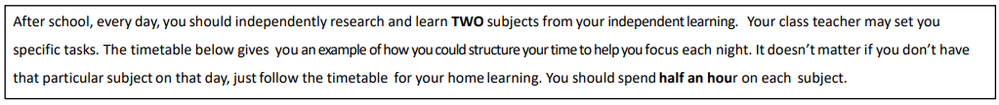
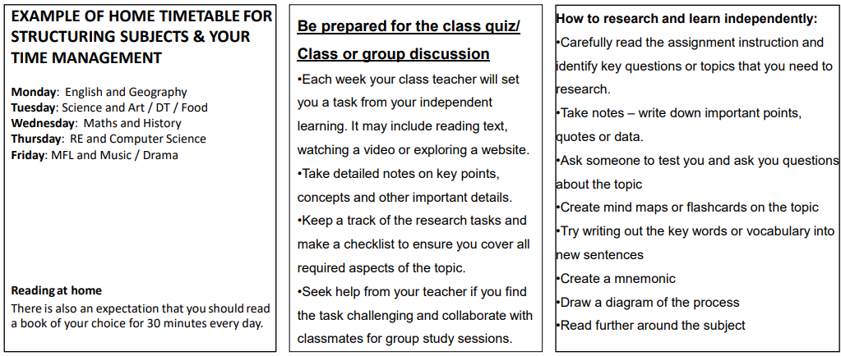

Slide 3

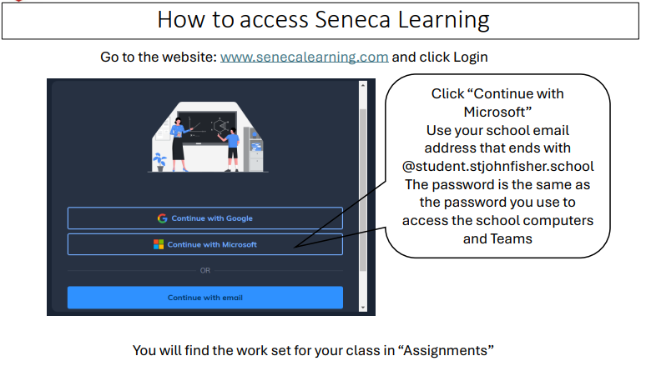

Slide 4
Please note
No Home Learning tasks have been provided for the following subjects, as they have been completed by the time that Term 6 begins:
Art
Drama
Health and Social Care
Music
Sociology
COPE
Citizenship
Computer Science
Latin
Hospitality and Catering

Slide 5
Subject : MATHS
Week 1:
EXAM REVISION
Week 5:
EXAM COMPLETED
Week 2:
EXAM REVISION
Week 6:
EXAM COMPLETED
Week 3:
EXAM COMPLETED
Week 7:
EXAM COMPLETED
Week 4:
EXAM COMPLETED
Key Vocabulary:

Slide 6
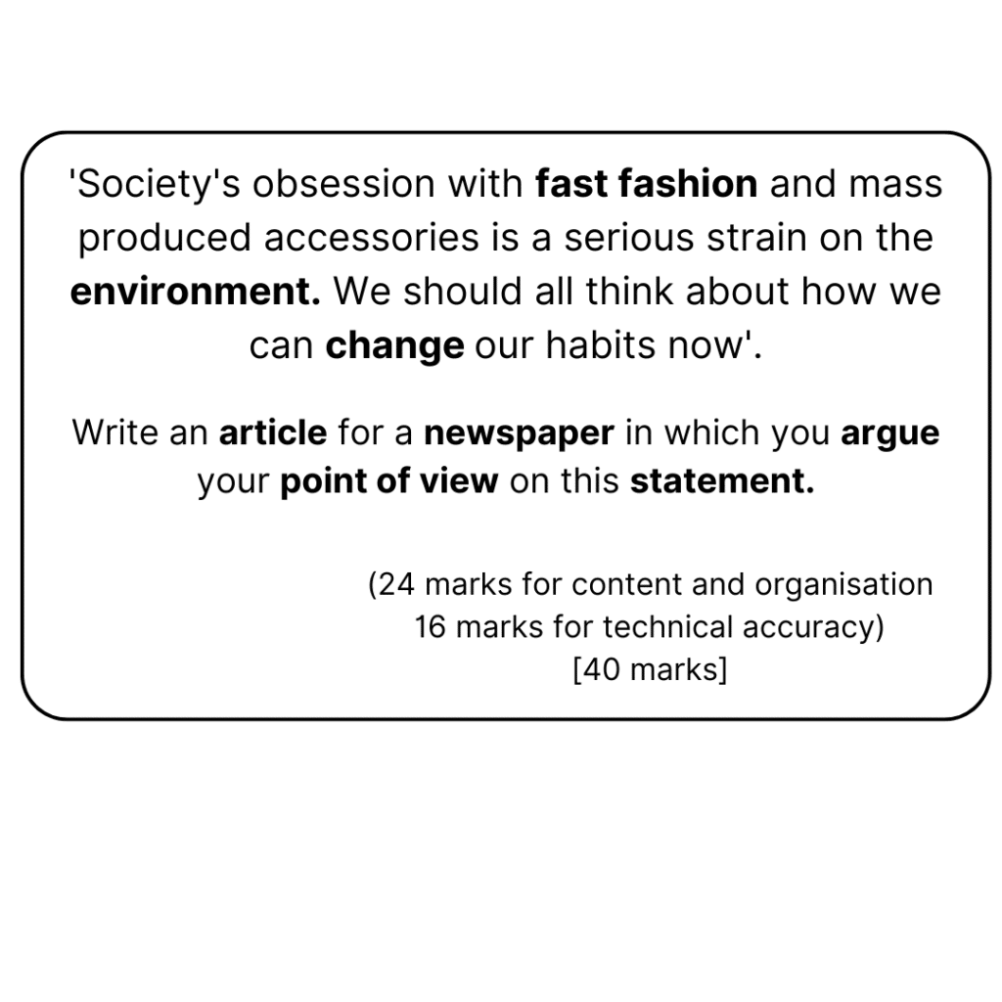
ENGLISH:Year 11
Week 1:
Final Exam is on 5th June

Slide 7
Science
Week 1:
Complete Seneca Learning Assignment.
This will be marked by Seneca.
Week 5:
Science exams are finished
Week 2:
Complete Seneca Learning Assignment.
This will be marked by Seneca.
Week 6:
Science exams are finished
Week 3:
Complete Seneca Learning Assignment.
This will be marked by Seneca.
Week 7:
Science exams are finished
Week 4:
Science exams are finished
Key Vocabulary: Refer to your knowledge organizer

Slide 8
Subject Religious Education
Week 1: Revision
Revision for GCSE exam.
Use Revision guide, resources on Teams, and online textbook to prepare for exam.
Week 2-onwards:
Revise for other subjects

Slide 9
Geography
Week 1:
Continue revision for paper 2 on Wednesday 3rd June. Focus on Changing cities, economic development, resource management and energy.
Hint/Tip: use the past papers provided to produce prompt cards for each question.
Week 5:
Geography exams complete.
Week 2:
Continue revision for our final paper 3 on 11th June. Review the fieldwork and how it was completed. Use the final work booklets of past papers provided to prepare for the UK Challenges section.
Week 6:
Geography exams complete.
Week 3:
Geography exams complete.
Week 7:
Geography exams complete.
Week 4:
Geography exams complete.
Key Vocabulary:

Slide 10
History
Week 1: On going for term 5 and 6
Revision for GCSE exams. Revision booklets are all on Teams, and paper copies have been provided.
Ensure you have completed all your flash cards and revision booklets. Watch YouTube clips on the topics you find hardest.
Prepare for the revision tests set by your class teacher.
Week 4 On going for term 5 and 6
:Revision for GCSE exams. Revision booklets are all on Teams, and paper copies have been provided. Ensure you have completed all your flash cards and revision booklets. Watch YouTube clips on the topics you find hardest .Prepare for the revision tests set by your class teacher.
Week 2:On going for term 5 and 6
Revision for GCSE exams. Revision booklets are all on Teams, and paper copies have been provided.
Ensure you have completed all your flash cards and revision booklets. Watch YouTube clips on the topics you find hardest.
Prepare for the revision tests set by your class teacher.
Week 5:On going for term 5 and 6
Revision for GCSE exams. Revision booklets are all on Teams, and paper copies have been provided.
Ensure you have completed all your flash cards and revision booklets. Watch YouTube clips on the topics you find hardest.
Prepare for the revision tests set by your class teacher.
Week 3: On going for term 5 and 6
Revision for GCSE exams. Revision booklets are all on Teams, and paper copies have been provided.
Ensure you have completed all your flash cards and revision booklets. Watch YouTube clips on the topics you find hardest.
Prepare for the revision tests set by your class teacher.
Week 6: On going for term 5 and 6
Revision for GCSE exams. Revision booklets are all on Teams, and paper copies have been provided.
Ensure you have completed all your flash cards and revision booklets. Watch YouTube clips on the topics you find hardest.
Prepare for the revision tests set by your class teacher.
Key vocabulary:
.Infer, use of evidence, provenance, context, judgement, explain, similarity, difference, how far, consequence, narrative, interpretation, .

Slide 11
Year 11 T6 French
Week 1
Reading Exam revision on ActiveHub
Week 4 –Course completed
Week 2
Writing Exam Revision – all revision material shared on Teams
Week 5 – Course completed
Week 3 – Course completed
Key vocabulary:

Slide 12
PE Year 11 Term 6 Course completed
Week 1:
Everlearner Live Revision Session Video:
https://www.youtube.com/live/9_KeYsOF2CU?si=zv6tHDZFteheH3Us
Revision Paper: Written Paper
Week 5:
Course completed
Week 2:
Course completed
Week 6:
Course completed
Week 3:
Course completed
Week 7:
Course completed
Week 4:
Course completed
Key Vocabulary:

Slide 13
Design Technology – Product Design (EXAM PREP)
Week 1: New and emerging technologies
Complete the following on Bitesize:
https://www.bbc.co.uk/bitesize/guides/zn4bcj6/revision/1
Week 5: Timber-based materials
Complete the following on Bitesize:
https://www.bbc.co.uk/bitesize/guides/zkvny4j/revision/1
Week 2: Energy generation and storage
Complete the following on Bitesize: https://www.bbc.co.uk/bitesize/guides/zf8ck2p/revision/1
Week 6: Metal-based materials
Complete the following on Bitesize:
https://www.bbc.co.uk/bitesize/guides/z6d48mn/revision/1
Week 3: Developments in new materials
Complete the following on Bitesize:
https://www.bbc.co.uk/bitesize/guides/zfq8jty/revision/1
Week 7: Polymers
Complete the following on Bitesize:
https://www.bbc.co.uk/bitesize/guides/zrstng8/revision/1
Week 4: Papers and boards
Complete the following on Bitesize:
https://www.bbc.co.uk/bitesize/guides/znq8jty/revision/1
Key Vocabulary: Emerging Technologies, Energy Generation, Storage, New Materials, Papers and Boards, Timber, Metal, Polymers

