Slide 1

Independent Learning
Year 10
Term 6

Slide 2

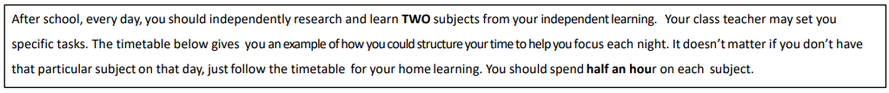
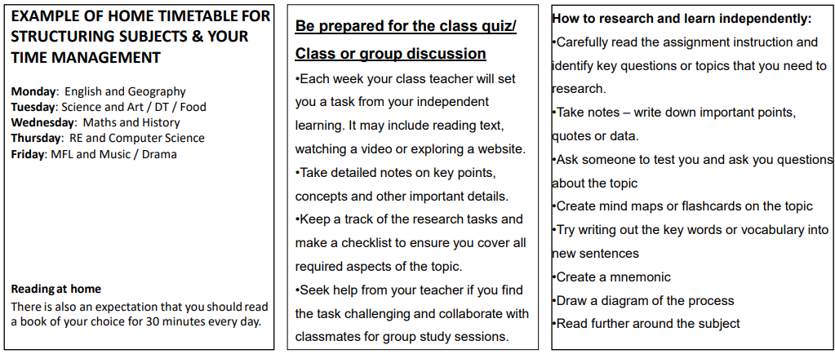

Slide 3

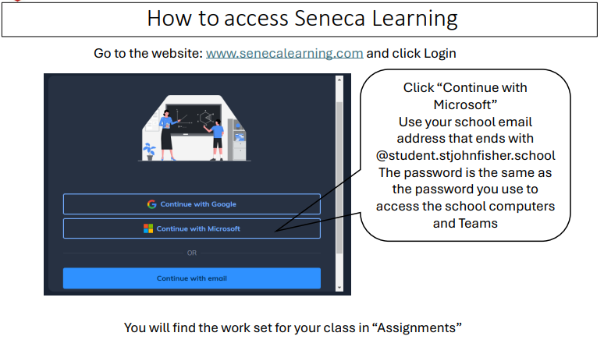

Slide 4
Mathematics – Year 10 Foundation
Week 1:
HOMEWORK
Log into Sparx Maths using the provided log in detail.
Complete the task set on: Mean and Range
Having log in issues?
Email:e.nyantakyi@stjohnfisher.school
Week 5:
HOMEWORK
Log into Sparx Maths using the provided log in detail.
Complete the task set on: Sampling
Having log in issues?
Email: e.nyantakyi@stjohnfisher.school
Week 2:
HOMEWORK
Log into Sparx Maths using the provided log in detail.
Complete the task set on: Mode, Median and range
Having log in issues?
Email:e.nyantakyi@stjohnfisher.school
Week 6:
HOMEWORK
Log into Sparx Maths using the provided log in detail.
Complete the task set on: Revision I
Having log in issues?
Email: e.nyantakyi@stjohnfisher.school
Week 3:
HOMEWORK
Log into Sparx Maths using the provided log in detail.
Complete the task set on: Types of average
Having log in issues?
Email:e.nyantakyi@stjohnfisher.school
Week 7:
HOMEWORK
Log into Sparx Maths using the provided log in detail.
Complete the task set on: Revision II
Having log in issues?
Email: e.nyantakyi@stjohnfisher.school
Week 4:
HOMEWORK
Log into Sparx Maths using the provided log in detail.
Complete the task set on: Estimating the mean
Having log in issues?
Email: e.nyantakyi@stjohnfisher.school
Key Vocabulary: Mean, Mode, Median, Average, Range, Estimating, Sampling

Slide 5
Mathematics – Year 10 Higher
Week 1:
HOMEWORK
Log into Sparx Maths using the provided log in detail.
Complete the task set on: Sampling
Having log in issues?
Email:e.nyantakyi@stjohnfisher.school
Week 5:
HOMEWORK
Log into Sparx Maths using the provided log in detail.
Complete the task set on: Comparing and describing distribution
Having log in issues?
Email: e.nyantakyi@stjohnfisher.school
Week 2:
HOMEWORK
Log into Sparx Maths using the provided log in detail.
Complete the task set on: Cumulative Frequency
Having log in issues?
Email:e.nyantakyi@stjohnfisher.school
Week 6:
HOMEWORK
Log into Sparx Maths using the provided log in detail.
Complete the task set on: Revision I
Having log in issues?
Email: e.nyantakyi@stjohnfisher.school
Week 3:
HOMEWORK
Log into Sparx Maths using the provided log in detail.
Complete the task set on: Box Plots
Having log in issues?
Email:e.nyantakyi@stjohnfisher.school
Week 7:
HOMEWORK
Log into Sparx Maths using the provided log in detail.
Complete the task set on: Revision II
Having log in issues?
Email: e.nyantakyi@stjohnfisher.school
Week 4:
HOMEWORK
Log into Sparx Maths using the provided log in detail.
Complete the task set on: Histograms
Having log in issues?
Email: e.nyantakyi@stjohnfisher.school
Key Vocabulary: Sampling, Cumulative frequency, Interquartile Range, Box plots, Histogram, distribution

Slide 6
ENGLISH:Year 10
Week 1:
  Complete the “Exploring Power and Conflict in AQA Poetry” assignment on Seneca Learning.
  This will be marked automatically by Seneca Learning.
Week 5:
  Complete the Power and Conflict: Thesis Statements” assignment on Seneca Learning.
  This will be marked automatically by Seneca Learning.
Week 2:
  Complete the “Mastering AQA Power and Conflict Poetry” assignment on Seneca Learning.
  This will be marked automatically by Seneca Learning.
Week 6:
  Complete the “Exploring Human Power in AQA’s Power and Conflict Poetry” assignment on Seneca Learning.
  This will be marked automatically by Seneca Learning.
Week 3:
  Complete the “AQA Power and Conflict Poetry: Exploring Themes of Authority, War and Human Nature” assignment on Seneca Learning.
  This will be marked automatically by Seneca Learning.
Week 7:
  Complete the “Nature’s Power and Conflict n Poetry” assignment on Seneca Learning.
  This will be marked automatically by Seneca Learning.
Week 4:
  Complete the “Key Quotations from AQA’s Power and Conflict Poetry” assignment on Seneca Learning.
  This will be marked automatically by Seneca Learning.
Key Vocabulary:
COLONIALISM / CONFLICT / DEHUMANISE / DESENSITISED / JUXTAPOSITION / PERSPECTIVE

Slide 7
Science
Week 1:
Complete Seneca Learning Assignment.
This will be marked by Seneca.
Week 5:
Complete Seneca Learning Assignment.
This will be marked by Seneca.
Week 2:
Complete Seneca Learning Assignment.
This will be marked by Seneca.
Week 6:
Complete Seneca Learning Assignment.
This will be marked by Seneca.
Week 3:
Complete Seneca Learning Assignment.
This will be marked by Seneca.
Week 7:
Complete Seneca Learning Assignment.
This will be marked by Seneca.
Week 4:
Complete Seneca Learning Assignment.
This will be marked by Seneca.
Key Vocabulary: Rate of reaction – concentration – collisions – activation energy – surface area – pressure – moles – temperature – equilibrium – Le Chatelier’s Principle – shift of equilibrium

Slide 8
Citzenship Homework Term 6
Revision for Paper One
Week 4:
Theme C: Role and principle of law, Criminal and Civil Law, Justice system, Courts and Tribunals, Youth justice, Crime and society, Sentencing and Punishment
Week 1:
Watch the following clip to remind yourself of the content covered in paper 1.
As you watch add key words and definitions to your glossary
https://www.youtube.com/watch?v=MEYIGpzR1pI
Week 5:
Past papers: Use the following website to practice past papers:
https://qualifications.pearson.com/en/qualifications/edexcel-gcses/citizenship-studies-2016.coursematerials.html#filterQuery=Pearson-UK:Category%2FExam-materials
Week 2:
Theme A: Living together in the UK
Create revision cards for the main sections: Changing UK population, Migration, Respect, Understanding, Identity and Rights, Citizens and local government and paying for local services
Week 6:
Citizenship Action
Review all the topics on paper 1 and create a citizenship action that is related to one of them.
Week 3:
Theme B: Democracy
Create revision cards for the main sections: Parties, candidates, elections, voting, forming a government, Parliament: what it is and how it works, making laws, constitution and devolution.
Key Vocabulary: Community, Migration, Respect, Understanding, Identity and Rights, Citizens, Local Government, Local Services, Parties, candidates, elections, voting, forming a government, Parliament, Constitution and Devolution. Role and principle of law, Criminal and Civil Law, Justice system, Courts and Tribunals, Youth justice, Crime and society, Sentencing and Punishment

Slide 9
Religious Education
Week 1: Magisterium a) Where does the word ‘Magisterium’ comes from?
b) Who makes up the Magisterium?
c) What does the term ‘Infallible’ means?
d) Why do Catholics believe that the church’s teachings are infallible?
Week 5: Four marks of the church
There are four marks , that help us identify Jesus’s Church.
1. The Church is….. because we are united in Faith and worship to Catholics around the world and throughout time.
2.The Church is ………. because it was founded by Jesus..
5.The Church is………… because it is for everyone.
6.The Church is Apostolic because it is the same Church given by Jesus to the ………..
Week 2: History of the Catholic Church:
Before Jesus died, he chose twelve apostles to go out into the world to witness. After his death, the Apostles needed a little help. What did Jesus promise would come to the apostles?
Watch the link with the video below, then Summarise what happened during the festival of Pentecost.
The Day of Pentecost (Shavuot)
Week 6: Create a mind map exploring different aspects of Mary, including her role in the Bible, her importance in the Church, and how she is honoured.
The Month of Mary
Week 3: Apostolic Succession
a)Who was Peter and why was he important for the Catholic Church?
b) Before their death, who did the original apostles pass their knowledge and wisdom on to?
c) This succession has continued for approximately 2000 years. What does this means for the Catholic Church leaders today?
Week 7: Choose any 2 topics or task done between week 1 to week 6. Create a revision concept map or spider diagram showing key terms and all that you have learnt.
Week 4: The Church as the body of Christ
a) Create a collage or drawing representing the different parts of the Church (like teachers, volunteers, families, etc.) as members of a body, with Christ as the head.
Key Vocabulary: Magisterium, infallible, Ecumenical council, laity, clergy, apostolic, In Persona Christi, Discipleship, Catholic, Holy, Dei Verbum, Lumen Gentium, Sacrosanctum Concilium, Ecumenism

Slide 10
Subject History
Week 1:
Continue with flash cards started in T5, to the end of the topic
Booklet issued: British America
Make revision flash cards for two pages of the booklet each week.
Bring these to class for your teacher to check.
Week 4:Continue with flash cards started in T5, to the end of the topic
Booklet issued: British America
Make revision flash cards for two pages of the booklet each week.
Bring these to class for your teacher to check.
.
Week 2:Continue with flash cards started in T5, to the end of the topic
Booklet issued: British America
Make revision flash cards for two pages of the booklet each week.
Bring these to class for your teacher to check.
Week 5:Continue with flash cards started in T5, to the end of the topic
Booklet issued: British America
Make revision flash cards for two pages of the booklet each week.
Bring these to class for your teacher to check.
Week 3: Continue with flash cards started in T5, to the end of the topic
Booklet issued: British America
Make revision flash cards for two pages of the booklet each week.
Bring these to class for your teacher to check.
Week 6:Continue with flash cards started in T5, to the end of the topic
Booklet issued: British America
Make revision flash cards for two pages of the booklet each week.
Bring these to class for your teacher to check.
Key vocabulary:
Independence, intolerable , coercive, alliance, Enlightenment, inventor, Fort, Continental Congress, Declaration.

Slide 11
Geography
Week 1:
Complete your exam-based questions.
Spend time reading the information and then set a time limit to answer the questions. Once finished, use the information side to add more to your responses in green or purple pen.
Week 4:
Complete your exam-based questions.
Spend time reading the information and then set a time limit to answer the questions. Once finished, use the information side to add more to your responses in green or purple pen.
Week 2:
Complete your exam-based questions.
Spend time reading the information and then set a time limit to answer the questions. Once finished, use the information side to add more to your responses in green or purple pen.
Week 5:
Complete your exam-based questions.
Spend time reading the information and then set a time limit to answer the questions. Once finished, use the information side to add more to your responses in green or purple pen.
Week 3:
Complete your exam-based questions.
Spend time reading the information and then set a time limit to answer the questions. Once finished, use the information side to add more to your responses in green or purple pen.
Key vocabulary: Urbanisation, rural-urban migration, UK city, Gentrification, Urban change. Opportunities/Challenges waste management Crime Poverty

Slide 12
French Year 10
Week 1:
Revision for Term 6 Reading Assessment -
Module 8 (Studying and my Future)
Week 5:
Writing HW to be set on Teams – Role play
Week 2:
Vocab Test to be set on Teams
Week 6:
Cultural project – create a poster / presentation
La Francophonie
Week 3:
Writing HW to be set on Teams – Photo description
Week 7:
Cultural project – create a poster / presentation
La Francophonie
Week 4:
Vocabulary Test to be set on Teams
Key Vocabulary: Read aloud , Role play, photo description, PALMS
la Francophonie, le monde francophone, les pays francophones, la langue, les traditions

Slide 13
Year 10 Latin Homework
Week 1: Revision for T6 Assessment .
Week 5:
Roman Life – Write a paragraph about.Life of women in Roman society. Write out some Latin words to justify your facts.
Week 6:
Vocabulary test. See Prescribed Vocab list by Eduqas. Revise the first 2 pages
Week 7: Cultural Project
  bbbb
Week 2: Perfect tense
Write out the 5 tenses of Latin, with their endings.
Give examples of verbs in each tense.
  .
Week 3 Past Paper
Paper 2021 – Component 1
Week 4:
Write out the 6 cases of Latin with Examples
Key words

Slide 14
Sociology
Week 1: Create a double-sided revision sheet on Paul Willis’ ‘Learning to Labour’, including what he found, what methods he used, what perspective he writes from.
Use the following clips to help you:
https://www.youtube.com/watch?v=WWSj_OJeh6M
Week 5:
Create a glossary of all key terms in the sociology of education and learn them.
Week 2
Create a double-sided revision sheet on the effects of gender on attainment.
Use the following clip to help you: https://www.youtube.com/watch?v=guZwqbykw7g
Week 6:
Use the following website to access and practice past papers:
https://www.aqa.org.uk/subjects/sociology/gcse/sociology-8192/assessment-resources
Week 3:
Create a double-sided revision sheet on the effects of ethnicity on attainment.
Use the following clip to help you:
https://www.youtube.com/watch?v=tUzVUXLbd20
Week 7: Why is Sociology an important subject?
Create a poster explaining what Sociology is, what we study and why it is an important subject in school.
The best will be given a prize
Week 4:
What factor do you think has the biggest impact on attainment, class, gender or ethnicity?
Write your answer in the style of a 12m essay question.
Key Vocabulary:
Lads, subculture, anti-school subculture, stereotypes, sexism, racism, ethnocentric curriculum, labelling

Slide 15
Computing
Week 1: What is a flow chart and provide its key components and purpose.
Week 4: What are the logic gates symbols and truth tables and explain the core logic gate symbols and truth tables. Research diagrams on it
Week 2: With reference to Week 1, label the different flowchart symbols in a Word or PowerPoint file. You will find the flowchart symbols in shapes in Word or PowerPoint. Also, research the advances flow chart symbols in Google and label these.
Week 5: What are the core purpose and functions as well as key points of using logic gates.
Week 3: Research a data flow chart on making a sandwich and then create a data flow chart on it using symbols. Thereafter create a data flow chart of a topic of your choice using symbols.
Week 6: With reference to Week 4 and 5, access the website link: https://www.101computing.net/design-your-own-logic-gates-circuits/ . Complete the 6 exercises on the different logic gates circuits provided.
Key vocabulary: flow chart, start, end, process, decision, arrow, yes, no, input/output, storage, logic gates, and, or , not, exclusive, one, zero, truth table

Slide 16
Art and Design Year 10 Term 6
Week 1:
Research ideas for two of the options for your independent project. Create a mind map for each option. The mind map that includes more ideas is likely to be your best choice for your project moving forward.
Week 5:
Create your own response in the style of the artist you have studied using materials and processes that are relevant to their work.
Week 2:
Create a mood board for your chosen theme. Collect plenty of images that relate to your theme and present in a PowerPoint slide.
Week 6:
Research your first artist for your chosen theme. Collect images and information and present on a PowerPoint. You will use this work in your sketchbook.
Week 3:
Research your first artist for your chosen theme. Collect images and information and present on a PowerPoint. You will use this work in your sketchbook.
Week 7:
Create a double page critical study for your second artist. Use the images you collected last week and create visual studies of parts of the work. Write about the artist in your own words, adding your own opinion of the work
Week 4:
Create a double page critical study for your first artist. Use the images you collected last week and create visual studies of parts of the work. Write about the artist in your own words, adding your own opinion of the work.
Key Vocabulary: Critical analysis, annotation, content, form, process, mood, composition, mark making, expression, meaning, context

Slide 17
Drama: Year 10 Term 6
Week 1:
Write out the structure of the exam. How many questions are there, how many marks are each one worth and how long should you spend on each question?
Week 5:
Revise and recap the technical skills that we have learned. Make a revision clock of the four different areas – costume, set, lighting and sound – with as much detail as you can on each of them.
Week 2:
Spend some time making sure you are ready for your lines to be learned. Highlight the script, and add in any of the moves that you have focused on in class (in pencil, in case you make any changes)
Week 6:
With your group, find some time at break or lunchtime to practice your piece of drama in preparation for your final performance of the script. See me if you need to organise time in the drama studio.
Week 3:
Make yourself a list of the order of events in the play Blood Brothers. Try to make as much detail as possible so that you remember how the play runs and what happens where.
Week 7:
Take some time to evaluate your piece. Write out what you think went well and you can use in your final exam next year, and also what you think are your key areas that you will need to work particularly hard when we come to your final performance.
Week 4:
Find some time at break or lunch time to get together with your group and run your lines. You should go back over any that you miss in order to make sure that you are fully confident.
Key Vocabulary: Proxemics, gait, posture, pace, emphasis, volume, projection

Slide 18
Music
Week 1: Compose a short 4–8 bar motif (melody only).
Develop it in at least two different ways, such as:
Repetition, Sequence (moving the motif up/down) variation, Inversion
Week 5: Write a short composition in a clear structure, such as:
  ABA
  Verse–Chorus
  Binary form (AB)
Week 2:
Write an 8-bar chord progression in a chosen key.
Use at least four different chords (e.g., I, IV, V, vi).
Create a simple melody to fit your chords
Week 6: Create a remix or reimagined version of Twinkle Twinkle Little Star by:
  Changing tempo or style
  Altering harmony
  Adding new instrumentation
Week 3: Choose a genre (e.g., pop, EDM, rock, jazz).
Compose a 16-bar piece that demonstrates:
  Typical rhythm patterns
  Instrumentation
  Structure or groove
Week 7: Create a 8–12 bar rhythmic pattern using:
  Syncopation
  Rests
Variation
Week 4: Compose a 12–16 bar piece using at least 3 layers, such as:
  Melody
  Harmony (chords/pads)
  Bassline or rhythm
Week 8: Write a bassline to match a chord progression (can reuse HW2).
Use:
  Root notes + passing tones
Rhythmic variation
Key Vocabulary:
Motif Harmony Chord progression Melody Texture Structure Dynamics Bassline

Slide 19
Subject: Business Studies
Week 1: Interest Rates
- Watch Interest Rate Video included in study slides available on Teams
- Explain the concept of interest.
- How does an increase in the rate of interest potentially impact
businesses? Justify your reasons.
- What is the formula to calculate interest rates on a bank loan?
Submit answers on Teams
Week 5: Cash Flow Forecasting
Watch the video on Activity 25 on Slide 123 on Teams.
- Explain what cash flow forecasting is?
- Justify its importance in business
- Provide at least 3 benefits to a business.
- Describe the term insolvency
- Suggest how a cash flow forecast can help businesses to avoid insolvency.
Week 2: Explain what Break-even is.
- How do you calculate contribution per unit?
- What is the calculation for the break-even point?
- List the 4 uses for doing a break-even analysis.
- Assess the benefits and limitations of using break-even analysis.
Submit Answers on Teams.
Week 6: Sources of Business Finance
- What is meant by ‘source of Finance’?
- Explain 4 roles and importance of finance to a business.
- What are the six major stages that businesses require finance?
- Discuss 4 sources of finance to a business
-What is the difference between short and long term finance?
- Submit answers in class.
Week 3: Break-Even Calculation Exercise
- Calculate the Break-even Scenario Activity 13 (Slide 74 available on Teams). Below is the financial information Tatiana has provided you with: Fixed Costs of £2000
  Variable cost per unit of £5 per t-shirt
  Selling price of £10 per t-shirt
  Maximum number of sales of 1200 t-shirts.
Week 7: Sources of Finance Essay
Refer to Activity 32 Aman scenario in study Power Point slide on Teams:
Write an essay that clearly compares the options Aman is considering and then support this with justified recommendations of which he should choose for this burger restaurant expansion.
- Answers will be discussed in class.
Week 4: Cash Flow
- What do you understand by Cash Flow?
- Why is it important for businesses to have an indepth understanding of their cash flow?
- List and explain three benefits of understanding and three drawbacks of not understanding cash flow within a business?
- Submit answers on teams.
Key Vocabulary: Interest rates, Break-even, Cash Flow, Cash Flow Forecasting, insolvency, Business Finance, Sources of finance.

Slide 20
Physical Education –Term 6 - Homework Tasks (AQA GCSE)
Week 1: NEA Mastery Knowledge Support
Support Materials and Taught lesson can be found here
Preparation for NEA
Worksheet
Week 4: Week 2: NEA Analysis of Sporting Performance
Choose a Sport from list and complete Session 3 skills PowerPoint.
Athletics, Football, Badminton, Basketball, Handball
Week 2: NEA Analysis of Sporting Performance
Choose a Sport from list and complete Session 1 skills PowerPoint.
Athletics, Football, Badminton, Basketball, Handball
Week 5: Week 2: NEA Analysis of Sporting Performance
Choose a Sport from list and complete Session 4 skills PowerPoint.
Athletics, Football, Badminton, Basketball, Handball
Week 3: Week 2: NEA Analysis of Sporting Performance
Choose a Sport from list and complete Session 2 skills PowerPoint.
Athletics, Football, Badminton, Basketball, Handball
Week 6: Sports Psychology
Sport psychology: skill and ability KS4 | Y10 Physical education Lesson Resources |
Keywords: Analysis, Evaluation, Performance, Development, Frequency, Intensity, Time, Type, Training, Psychology, Skills, Abilities

Slide 21
CoPE
: Week 1: Choose a book to read. This could be a story, facts-based book on a topic you find interesting.
This can be a book at home, or one from the school/ local library
Read 10 pages. We will discuss what you have read in class
Week 5:Continue with your book.
Read the next 10 pages of your book.
You will be giving an update on what is happening to your partner/ class
Week 2:Continue with your book.
Read the next 10 pages of your book.
You will be giving an update on what is happening to your partner/ class
:
Week 6:Continue with your book.
Read the next 10 pages of your book.
You will be giving an update on what is happening to your partner/ class
Week 3:Continue with your book.
Read the next 10 pages of your book.
You will be giving an update on what is happening to your partner/ class
Week 7: Prepare a 5-minute verbal presentation.
The presentation is on the book you have read.
The presentation should include:
What you enjoyed about the book.
What you didn’t enjoy.
If there was another book to be written what do you think would happen in the story.
Week 4: Continue with your book.
Read the next 10 pages of your book.
You will be giving an update on what is happening to your partner/ class
Key Vocabulary:

Slide 22
Hospitality and Catering Year 10
Week 1:
Identify the 3 Macronutrients and revise the purpose, sources and amounts required in the diet for each.
Week 5:
Produce recipes and product lists, with amounts, for 3 different meals that are high in carbohydrate content.
Week 2:
Revise the purpose, sources and amounts required in the diet of the Micronutrients.
Give at least 3 examples of each type of micronutrient.
Week 6:
Produce recipes and product lists, with amounts, for 3 different meals that are high in protein content.
Week 3:
Revise the impact of different methods of cooking on the nutritional value of different food types.
Week 7:
Produce a recipe and product list, with amounts, for each of the following:
Vegan
Pescatarian
Muslim
Week 4:
Revise the 6 different life stages and list 3 important considerations for diet planning for each.
Key Vocabulary: Micronutrient, Macronutrient, Life- Stages, Recommended Daily Intake, Special Dietary Needs, Nutritional Value

Slide 23
Core Physical Education –Term 6 - Homework Tasks
Week 1: Bowling and Skeleton (Part 1)
Hands (Practical) Watch the following video on how to perform a bowl correctly
Video: Practice your bowling at home with a ball (Rounders)
Video: How to bowl in cricket (Practice @ Home) (Cricket
Head (Mastery) – Bones in the Axial Skeleton
Week 4: Umpiring and Joints
Watch the following video on umpiring
How to Officiate - Rounders (Watch both videos)
How to Umpire in Cricket
Head (Theory Mastery) - Skeletal Joints
Week 2: Wicket Keeper/Backstop and Skeletal Functions
Watch the following video on the shot-put throwing technique
Hands (Practical) Video: Practice Bowling at the Batter (Rounders)
Video: Practice Bowling at the Batter (Cricket)
Head (Mastery) – Seneca Link Week 2 - Functions of the Skeleton
Week 5:Developing Tactics
Developing Team Tactics in Cricket
Developing Tactics in Rounders
Head (Theory Mastery) - Skeletal Joints
Week 3: Matchplay
Watch the following video on how to play the game
Howto play Pairs Cricket
Rules of Roudners
Week 6:
Watch the following footage of a Rounders/Cricket game and identify
Areas of Strength and Weakness for 1 of the teams.
Rounders Match
Cricket Match
Keywords: Hand-eye coordination, Timing, Shot selection, Accuracy, Power, Bat control, Reaction speed, Decision-making, Concentration, Technique

