Slide 1

Independent Learning
Year 9
Term 4

Slide 2

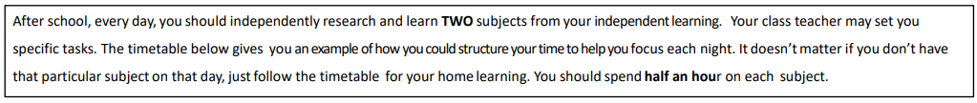
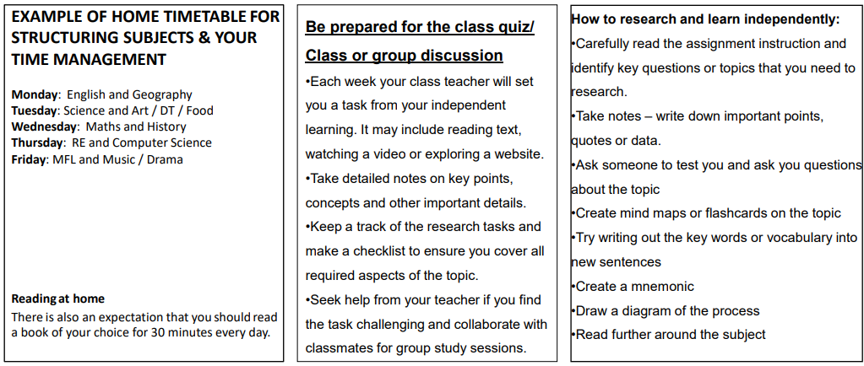

Slide 3

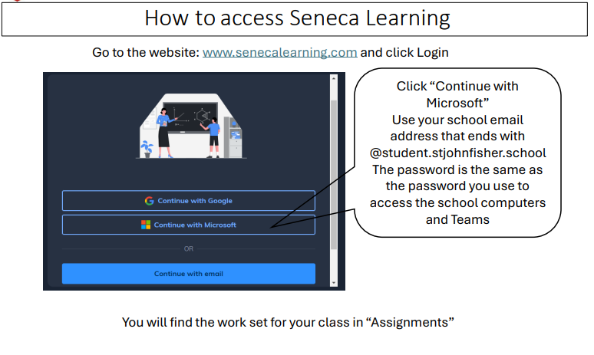

Slide 4
Mathematics Year 9 (GS)
Week 1:
HOMEWORK
Log into Sparx Maths using the provided log in detail.
Complete the task set on: FRACTIONS
Having log in issues?
Email: e.nyantakyi@stjohnfisher.school
Week 4:
HOMEWORK
Log into Sparx Maths using the provided log in detail.
Complete the task set on: PERCENTAGES
Having log in issues?
Email: e.nyantakyi@stjohnfisher.school
Week 2:
HOMEWORK
Log into Sparx Maths using the provided log in detail.
Complete the task set on: LINE RATIO
Having log in issues?
Email: e.nyantakyi@stjohnfisher.school
Week 5:
HOMEWORK
Log into Sparx Maths using the provided log in detail.
Complete the task set on: FRACTIONS, DECIMALS AND PERCENTAGES
Having log in issues?
Email: e.nyantakyi@stjohnfisher.school
Week 3:
HOMEWORK
Log into Sparx Maths using the provided log in detail.
Complete the task set on: RATIO AND PROPORTION
Having log in issues?
Email: e.nyantakyi@stjohnfisher.school
Week 6:
HOMEWORK
Log into Sparx Maths using the provided log in detail.
Complete the task set on: END OF UNIT VARIETY QUESTIONS
Having log in issues?
Email: e.nyantakyi@stjohnfisher.school
Key vocabulary: Fractions, Decimals, Ratio, Proportion, Percentages,

Slide 5
Mathematics Year 9 (MS)
Week 1:
HOMEWORK
Log into Sparx Maths using the provided log in detail.
Complete the task set on: CIRCUMFERENCE OF A CIRCLE
Having log in issues?
Email: e.nyantakyi@stjohnfisher.school
Week 4:
HOMEWORK
Log into Sparx Maths using the provided log in detail.
Complete the task set on: PRISM
Having log in issues?
Email: e.nyantakyi@stjohnfisher.school
Week 2:
HOMEWORK
Log into Sparx Maths using the provided log in detail.
Complete the task set on: AREA OF A CIRCLE
Having log in issues?
Email: e.nyantakyi@stjohnfisher.school
Week 5:
HOMEWORK
Log into Sparx Maths using the provided log in detail.
Complete the task set on: CYLINDER
Having log in issues?
Email: e.nyantakyi@stjohnfisher.school
Week 3:
HOMEWORK
Log into Sparx Maths using the provided log in detail.
Complete the task set on: PYTHAGORAS’ THEOREM
Having log in issues?
Email: e.nyantakyi@stjohnfisher.school
Week 6:
HOMEWORK
Log into Sparx Maths using the provided log in detail.
Complete the task set on: ERRORS AND BOUNDS
Having log in issues?
Email: e.nyantakyi@stjohnfisher.school
Key vocabulary: Circumference, Area, Circle, Pythagoras’ theorem, Prism, Cylinder, Errors, Bounds

Slide 6
English
Week 1:
Complete the “Unveiling the Storm: Act 1 of The Tempest” assignment on Seneca Learning.
This will be marked automatically by Seneca Learning.
Week 4:
Complete the “Exploring Magic and Mystery in The Tempest” assignment on Seneca Learning.
This will be marked automatically by Seneca Learning.
Week 2:
Complete the “Exploring Prospero’s World in Act 1 of The Tempest” assignment on Seneca Learning.
This will be marked automatically by Seneca Learning.
Week 5:
Complete the “Exploring Caliban in Shakespeare’s The Tempest” assignment on Seneca Learning.
This will be marked automatically by Seneca Learning.
Week 3:
Complete the “Shakespearean Comedies: From Chaos to Harmony in The Tempest” assignment on Seneca Learning.
This will be marked automatically by Seneca Learning.
Week 6:
Complete the “Prospero’s Final Act of Mercy in The Tempest” assignment on Seneca Learning.
This will be marked automatically by Seneca Learning.
Key vocabulary:
Illusion – Reconciliation – Manipulation – Usurp – Colonisation – Magic

Slide 7
Science
Week 1:
Complete the assignment on Seneca Learning. This will be marked automatically by Seneca.
Week 4:
Complete the assignment on Seneca Learning. This will be marked automatically by Seneca.
Week 2:
Complete the assignment on Seneca Learning. This will be marked automatically by Seneca.
Week 5:
Complete the assignment on Seneca Learning. This will be marked automatically by Seneca.
Week 3:
Complete the assignment on Seneca Learning. This will be marked automatically by Seneca.
Week 6:
Complete the assignment on Seneca Learning. This will be marked automatically by Seneca.
Key vocabulary: animal cell – plant cell – cell membrane – cytoplasm – mitochondria – ribosome – nucleus – cell wall – chloroplast – vacuole – magnification – microscope – focus – diffusion – osmosis – active transport

Slide 8
Citizenship - Year 09 Term 4
Week 1: Why do people migrate? Create a table with two columns:
Push factors (reasons people leave a country)
Pull factors (reasons people are attracted to another country)
Add at least three examples in each column.
Choose one factor and explain in 3–4 sentences how it could affect a real person or family.
Week 4: What support is available for migrants?
Research two types of support available to migrants or refugees in the UK or internationally (for example: charities, schools, healthcare, housing, legal advice).
For each type of support:
Name the organisation or service
Explain what help it provides
Explain why this support is important
Week 2: What is the relationship between climate change and migration?
Write a short paragraph explaining two ways climate change can force people to migrate (e.g. floods, drought, rising sea levels).
Draw a simple cause-and-effect chain: Climate change → environmental impact → effect on people → migration
Add one sentence explaining why this type of migration might increase in the future.
Week 5: What are the benefits and drawbacks of controlling migration?
Create a PPT:
Benefits of controlling migration
Drawbacks of controlling migration
Add at least two points to each side. Write a short conclusion (3–4 sentences) explaining which side you find more convincing
Week 3: Is conflict a children’s rights issue?
Choose two children’s rights from the UN Convention on the Rights of the Child (for example: education, safety, healthcare).
Explain how conflict threatens each right in 3–4 sentences.
Week 6: How does migration affect communities?
List three positive impacts migration can have on communities (e.g. culture, economy, skills).
List two challenges communities might face.
Describe: “How can communities make migration a positive experience for everyone?”
Key vocabulary: migration, democracy, climate change, conflict, drawbacks, economy

Slide 9
Subject: Religious Education Year 9 Term 4 2026
Week 1:
Vocabulary Focus: write a definition for the following key terms
-Atonement High Priest Day of Atonement Salvation Redemption
Mystery of Redemption Sinai covenant
Week 4
Design your own poster that shows reconciliation
Guide
Show peace and fixing relationships- Use simple symbols (handshake, dove)- Add a short message about forgiveness- Use calm, positive colours
Week 2
Vocabulary Focus: Write a definition for the following key terms
Grace Reparation Sanctification Saints Messiah Repentance Temple Holy of Holies
Week 5:
Revise Chapter 4 –’Desert to Garden’ for assessment in week 6
Week 3
Create a Fact File on Jesus the High Priest
Priest: Offers sacrifice and helps people reach God.
Jesus’ sacrifice: He offered himself.
Why he connects us to God: He is human and divine.
Bible: Hebrews calls him the High Priest.
Why it matters: His sacrifice brings forgiveness and restores our relationship with God.
Week 6:
Assessment on Chapter 4 – Desert to Garden
Key Vocabulary Atonement High Priest Day of Atonement Salvation Redemption Mystery of Redemption Sinai covenant Grace Reparation Sanctification Saints Messiah Repentance Temple Holy of Holies High Priest

Slide 10
History
Week 1:
Begin your independent research homework. This is a Term Four task. Make sure your work is detailed and well presented.
Challenge yourself by completing the extra reading task.
Week 5:
Continue with your independent research homework. This is a Term Four task. Make sure your work is detailed and well presented.
Challenge yourself by completing the extra reading task.
Week 2:
Continue with your independent research homework. This is a Term Four task. Make sure your work is detailed and well presented.
Challenge yourself by completing the extra reading task.
Week 6:
Continue with your independent research homework. This is a Term Four task. Make sure your work is detailed and well presented.
Challenge yourself by completing the extra reading task.
Week 3:
Continue with your independent research homework. This is a Term Four task. Make sure your work is detailed and well presented.
Challenge yourself by completing the extra reading task.
Key Vocabulary:
Democracy, Dictatorship, Economy, Economic, Diplomacy, Culture, Mass unemployment, Nationalism, Militarism, Fascism, Nazism, Communism, Wall Street Crash, Depression
Week 4:
Continue with your independent research homework. This is a Term Four task. Make sure your work is detailed and well presented.
Challenge yourself by completing the extra reading task.
.

Slide 11
Geography
Week 1:
Complete set tasks on SENECA
This will be marked online
Week 4:
Complete set tasks on SENECA
This will be marked online
Week 2:
Complete set tasks on SENECA
This will be marked online
Week 5:
Complete set tasks on SENECA
This will be marked online
Week 3:
Complete set tasks on SENECA
This will be marked online
Week 6:
Complete set tasks on SENECA
This will be marked online
Key vocabulary: India, NEE, development, core, periphery, TNC Slums

Slide 12
French Year 9
Week 1:
WR: Describe a photo. 40 words.
Week 5:
Revision for Speaking Assessment – 3 Tenses
Week 2:
Grammar Test - Avoir
Week 6:
WR:
Respond to Speaking Assessment Questions - 3 Tenses.
Week 3:
. Grammar Test - Aller
Week 4:
Vocabulary Test
Key Vocabulary: Family activities / celebrations

Slide 13
Latin Year 9
Week 1: Translate:
Caecilius est pater,
Metella est mater.
Quintus est filius.
Grumio est servus.
Week 4: Translate the following text. Into English. Highlight the imperfect tenses. :
Dominus in villa sedwbat, servi laborabant. Ancilla cenam parabat et pater aquam portabat, postea dominus servos vocavit et canavit. .
Week 2. Translate into English using the perfect and imperfect tense. Metella cenam parat
Grumio laborat.
Quintus clamat.
Caecilius dormit.
Week 5: Translate into English and then highlight the prepositions. What do they mean?
Caecilius in horto ambulat.
Metella cum amica ambulat.
Quintus in via currit.
What does it mean?
in
Cum
Ad
Ex:
What is ablative? Give examples.
Week 6:
Week 3:Translate into English and say if it singular/plural
servi laborant.
puellae clamant.
Caecilius ambulat.
Ambulat Puella,
Key vocabulary:

Slide 14
Art and Design Year 9 Term 4
Week 1:
Take photographs of different facial features and present on a PowerPoint slide.
Week 4:
From one of your other portrait photos create a careful drawing using line and tone.
Week 2:
Take portrait photographs of yourself or someone else (with permission). Consider background and lighting. Present your images on a PowerPoint slide.
Week 5:
Research the biro portrait drawings of artist Mark Powell. Present images and information on a PowerPoint slide.
Week 3:
From your one of your photographs from last week create a line drawing.
Week 6:
Create a biro drawing from part of one of the images you collected for your Mark Powell research.
Key vocabulary:
Portraiture, facial features, proportion, pose, expression, character, continuous line drawing, mixed media, perspective, human anatomy, figure drawing and painting, sculpture, charcoal, wax resist.

Slide 15
Drama Year 9
Week 1:
Bertolt Brecht
This term we are studying Bertolt Brecht. Write a mini fact file about Brecht explaining where and when he was born, when he died, what his thoughts were about theatre, and five of the plays that he wrote.
Week 4:
Placards
Brecht liked to use placards in his work to emphasis the points that he was trying to make. Design your own placard for a cause that you believe in – that can be a large scale cause, or something more personal.
Week 2:
Gestus
Using a mirror to help you, practice a series of different Gestus. Make sure that this movement is exaggerated in order to really bring out the over the top nature that Brecht intended through his work.
Week 5:
Rehearsal
Find ten minutes at the start of a break or lunchtime with your group to go over the performance so far. Focus on making sure you have covered everything that you need to be doing for your final performance.
Week 3:
Banksy
We are using some of the work of the street artist Banksy in our lessons. Research another piece of artwork that he has done and find out what his political meaning for creating the piece is.
Week 6:
Reflection
Think over the work that you have done this term on Brecht. Write a reflection of this working, thinking about what went really well, and what needed some improvements.
Key vocabulary: Epic theatre, Political Theatre, Gestus, Exaggeration, Placards, Freeze Frames, Tableaux

Slide 16
Music
Week 1: Choose a song for keyboard that will challenge your skills
Week 4: Add in the chords and left hand accompaniment to your song
Week 2: Practise a major scale eg C or G using the correct fingerings learnt in class
C D E F G A B C
1 2 3 1 2 3 4 5 and down the same way
Week 5: Play with both hands lead sheet style
Week 3: Practise playing your chosen song 10 minutes on at least 3 days of the week
Week 6: Prepare for a performance adding in backing beats, dynamics and expression . Evaluate the progress you have made.
Key vocabulary: correct fingers practice chords lead sheet dynamics expression

Slide 17
Subject Computing Y9 Data Representation
Week 1:
Convert the following binary value into denary: 10100111
Convert the following Decimal number into binary: 145
Remember to show your working
Week 4:
Create a 6 x 6 resolution image with 3-bit depth. Show the grid as a 6 x 6 and use any colour options you choose as the key.
Week 2:
Convert the following number into hexadecimal: 155
Convert the following hexadecimal into decimal: 5 F
Remember to show your working
Week 5:
Assessment Week
Week 3:
Show an example of an ASCII character set and a Unicode character set.
Create your name in binary using ASCII
Week 6:
Purple pen lesson
Key vocabulary: Binary, Decimal, Hexadecimal, Conversion, ASCII, resolution, Bit Depth

Slide 19
Physical Education – Key Stage 3 Homework Tasks
Week 1: Rules & regulations in hockey
Watch the following video on rules and regulations in hockey -https://www.youtube.com/watch?v=3oIWk5qhlC0
Week 4: Shooting in hockey
Watch the following video on shooting techniques in hockey - https://www.youtube.com/watch?v=ww3fYa7Dd1Q
Week 2: Dribbling in hockey
Watch the following video on dribbling in hockey -https://www.youtube.com/watch?v=QH-swZZPNZY
Week 5: Tackling in hockey
Watch the following video on tackling in hockey -https://www.youtube.com/watch?v=mNlIygEpuf8
Week 3: Passing and receiving in hockey
Watch the following video on passing and receiving in hockey -https://www.youtube.com/watch?v=QH-swZZPNZY
Week 6:
Watch the following footage from a recent hockey match and make notes about which skills you see, that you have also learned this term.
https://www.youtube.com/watch?v=uSC-su3CgRM
Key vocabulary:
Rules & regulations, slap shot, slap pass, guard, block, stick, dribbling, passing, shooting, teamwork.

