Slide 1

Independent Learning
Year 8
Term 4

Slide 2

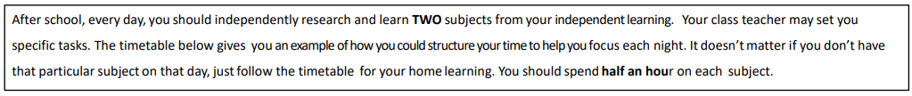
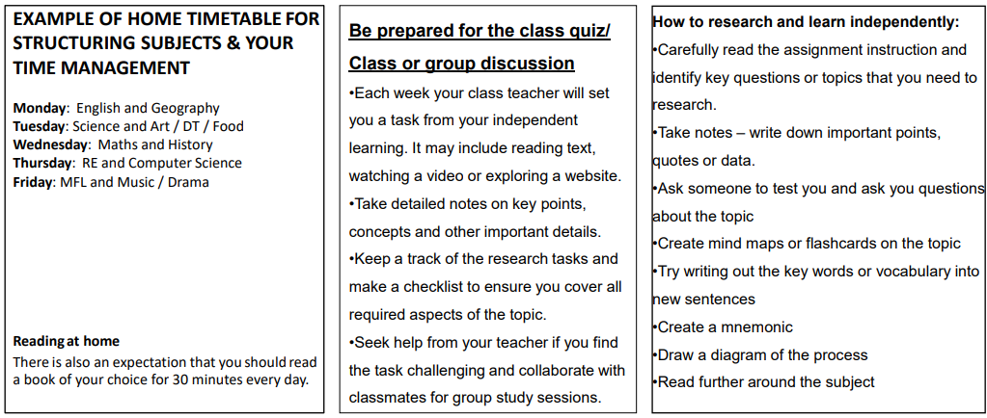

Slide 3

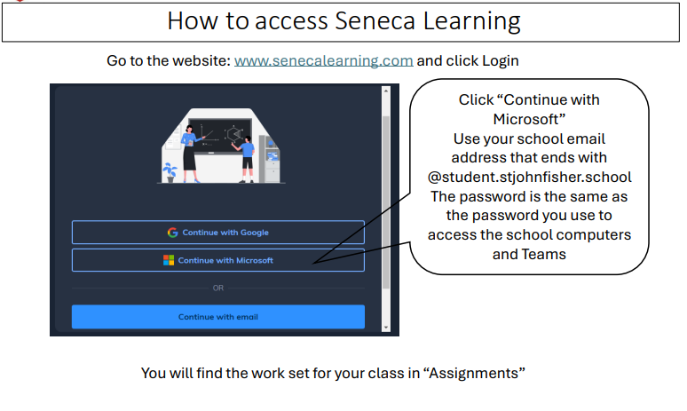

Slide 4
Mathematics Year 8 (GS)
Week 1:
HOMEWORK
Log into Sparx Maths using the provided log in detail.
Complete the task set on: CIRCUMFERENCE OF A CIRCLE
Having log in issues?
Email: e.nyantakyi@stjohnfisher.school
Week 4:
HOMEWORK
Log into Sparx Maths using the provided log in detail.
Complete the task set on: PRISM
Having log in issues?
Email: e.nyantakyi@stjohnfisher.school
Week 2:
HOMEWORK
Log into Sparx Maths using the provided log in detail.
Complete the task set on: AREA OF A CIRCLE
Having log in issues?
Email: e.nyantakyi@stjohnfisher.school
Week 5:
HOMEWORK
Log into Sparx Maths using the provided log in detail.
Complete the task set on: CYLINDER
Having log in issues?
Email: e.nyantakyi@stjohnfisher.school
Week 3:
HOMEWORK
Log into Sparx Maths using the provided log in detail.
Complete the task set on: PYTHAGORAS’ THEOREM
Having log in issues?
Email: e.nyantakyi@stjohnfisher.school
Week 6:
HOMEWORK
Log into Sparx Maths using the provided log in detail.
Complete the task set on: ERRORS AND BOUNDS
Having log in issues?
Email: e.nyantakyi@stjohnfisher.school
Key vocabulary: Circumference, Area, Circle, Pythagoras’ theorem, Prism, Cylinder, Errors, Bounds

Slide 5
Mathematics Year 8 (GS)
Week 1:
HOMEWORK
Log into Sparx Maths using the provided log in detail.
Complete the task set on: CIRCUMFERENCE OF A CIRCLE
Having log in issues?
Email: e.nyantakyi@stjohnfisher.school
Week 4:
HOMEWORK
Log into Sparx Maths using the provided log in detail.
Complete the task set on: PRISM
Having log in issues?
Email: e.nyantakyi@stjohnfisher.school
Week 2:
HOMEWORK
Log into Sparx Maths using the provided log in detail.
Complete the task set on: AREA OF A CIRCLE
Having log in issues?
Email: e.nyantakyi@stjohnfisher.school
Week 5:
HOMEWORK
Log into Sparx Maths using the provided log in detail.
Complete the task set on: CYLINDER
Having log in issues?
Email: e.nyantakyi@stjohnfisher.school
Week 3:
HOMEWORK
Log into Sparx Maths using the provided log in detail.
Complete the task set on: PYTHAGORAS’ THEOREM
Having log in issues?
Email: e.nyantakyi@stjohnfisher.school
Week 6:
HOMEWORK
Log into Sparx Maths using the provided log in detail.
Complete the task set on: ERRORS AND BOUNDS
Having log in issues?
Email: e.nyantakyi@stjohnfisher.school
Key vocabulary: Circumference, Area, Circle, Pythagoras’ theorem, Prism, Cylinder, Errors, Bounds

Slide 6
English
Week 1:
Complete the “The Dramatic Beginnings of Romeo and Juliet” assignment on Seneca Learning.
This will be marked automatically by Seneca Learning.
Week 4:
Complete the “Violence in Romeo and Juliet” assignment on Seneca Learning.
This will be marked automatically by Seneca Learning.
Week 2:
Complete the “The Dramatic Events of Romeo and Juliet” assignment on Seneca Learning.
This will be marked automatically by Seneca Learning.
Week 5:
Complete the “Fate in Romeo and Juliet” assignment on Seneca Learning.
This will be marked automatically by Seneca Learning.
Week 3:
Complete the “Love in Romeo and Juliet” assignment on Seneca Learning.
This will be marked automatically by Seneca Learning.
Week 6:
Complete the “The Tragic Conclusion of Romeo and Juliet” assignment on Seneca Learning.
This will be marked automatically by Seneca Learning.
Key vocabulary:
Fate – Feud – Prologue – Soliloquy – Conflict - tragedy

Slide 7
Science
Week 1:
Complete the assignment on Seneca Learning. This will be marked automatically by Seneca.
Week 4:
Complete the assignment on Seneca Learning. This will be marked automatically by Seneca.
Week 2:
Complete the assignment on Seneca Learning. This will be marked automatically by Seneca.
Week 5:
Complete the assignment on Seneca Learning. This will be marked automatically by Seneca.
Week 3:
Complete the assignment on Seneca Learning. This will be marked automatically by Seneca.
Week 6:
Complete the assignment on Seneca Learning. This will be marked automatically by Seneca.
Key vocabulary: conduction – convection – radiation – latent heat – heat – temperature – fuel – energy – conservation of energy

Slide 8
Year 8 Religious Education
Week 1: Paschal Mystery
Watch the following clip: https://www.youtube.com/watch?v=AI97PCs-Pck
Create a piece of art – you can use internet images to retell the Paschal Mystery. Ensure that you explain the importance of each part.
Week 4: Research Crucifixion art (search the names)
Crucifixion and Resurrection – Rabbula Gospels
The Crucifixion – Catholic Missal c.1270
The Crucifixion – Matthias Grunewald c.1512
The Crucifixion – Michael Rothenstein 1937
What do they have in common? Presentation? Characters? Use of colour?
How are they different? Presentation? Characters? Use of colour?
Week 2: Create a leaflet on the Easter Triduum
What does Triduum mean?
For each day of the Paschal Mystery (in fact file) explain what happened to Jesus, give one symbolic practice used in Catholic worship on this day and how it shows Catholic beliefs.
For:
Holy Thursday, Good Friday, Holy Saturday and Easter Sunday
Week 5:
Revise for the assessment.
Use information on Teams and from class to help you prepare for the assessment.
Week 3: Prepare for a debate.
‘If you’ve done wrong, you should just say sorry to the person you’ve upset.’ Give 2 opinions on this statement, ensure that one reflects what happens during the Sacrament of Reconciliation
Week 6: Forgiveness Project Watch: https://www.youtube.com/watch?v=AsHq5FBpsX8
Respond to the following:
What do Margaret and Barry Mizen do?
Why do they do this?
Why is their message so important?
Key vocabulary: Eucharist, Salvation, Atonement, Sacrifice, Sacraments, consecrated, transubstantiation, Mass, in persona Christi, Last Supper, Resurrection, Passover, Pashal Mystery.

Slide 9
Citizenship - Year 08 Term 4
Week 1: What is the media? Create a media map showing at least 6 different types of media (e.g. TV news, newspapers, social media, podcasts, blogs, radio). For each type:
Give one example
Explain what kind of information it usually shares
Say who you think the main audience is
Week 4: How does the media hold those in power to account?
Choose one group in power (e.g. government, police, large companies). Explain:
How the media can investigate this group
How reporting can lead to change or consequences
Why this is important for ordinary people
Week 2: Media responsibility
Write an article describing the responsibilities of the media.
(1/2page)
Week 5: Should we believe everything we see in the media?
Create a “Can I Trust This?” checklist with at least 6 questions someone should ask before believing a media story. For example:
• Who created this?
• What is their purpose?
Week 3. What is the role of the media in a democracy? Create a poster on: “Why is a free media important in a democracy?” You must include: •One way the media informs citizens
• One way it supports democracy
• One key word (e.g. free press, transparency, accountability)
Week 6: Does the media create more harm than good?
Write a short response answering the question: “Does the media create more harm than good?” You must include:
Two positives of the media
Two negatives of the media
Your final judgement, with a reason
Key vocabulary: media, democracy

Slide 10
History
Week 1:
Begin your independent research homework. This is a Term Four task. Make sure your work is detailed and well presented.
Challenge yourself by completing the extra reading task.
Week 5:
Continue with your independent research homework. This is a Term Four task. Make sure your work is detailed and well presented.
Challenge yourself by completing the extra reading task.
Week 2:
Continue with your independent research homework. This is a Term Four task. Make sure your work is detailed and well presented.
Challenge yourself by completing the extra reading task.
Week 6:
Continue with your independent research homework. This is a Term Four task. Make sure your work is detailed and well presented.
Challenge yourself by completing the extra reading task.
Week 3:
Continue with your independent research homework. This is a Term Four task. Make sure your work is detailed and well presented.
Challenge yourself by completing the extra reading task.
Key Vocabulary:
Democracy, Democratic, Parliament, Social Class, Reform, Chartism, Chartist, Suffrage, Suffragist, Suffragette, Representation
Week 4:
Continue with your independent research homework. This is a Term Four task. Make sure your work is detailed and well presented.
Challenge yourself by completing the extra reading task.
.

Slide 11
Geography
Week 1:
Complete set tasks on SENECA
This will be marked online
Week 4:
Complete set tasks on SENECA
This will be marked online
Week 2:
Complete set tasks on SENECA
This will be marked online
Week 5:
Complete set tasks on SENECA
This will be marked online
Week 3:
Complete set tasks on SENECA
This will be marked online
Week 6:
Complete set tasks on SENECA
This will be marked online
Key vocabulary: India, Tree rings, Ice cores, Natural causes, Human causes, Adaptation, Mitigation

Slide 12
Year 8 T4 French
Week 1: collect booklet set in class.
Learn key vocab set on teams:
Week 4:
extended writing task which will be set on teams about your favourite hobbies. The question is: qu’est que tu aimes faire?
Week 2
extended writing: Write a paragraph, describing what sports you do or don’t do in French . Include: the negative in French, give opinions and reasons in French. This needs to be 40 words
Week 5:
Learn the vocab set on teams. You’ll be tested on this on teams
Week 6:
Revision for term 4 test. This will be set on teams.
In addition to this learn vocab for term 5. This will be set on teams.
Week 3:
Learn the vocab set on teams. You’ll be tested on this in class.
Key vocabulary:

Slide 13
Latin Year 8
Week 1: Translate:
Caecilius est pater,
Metella est mater.
Quintus est filius.
Grumio est servus.
Week 4: Translate the following text. Into English. Highlight the imperfect tenses. :
Dominus in villa sedwbat, servi laborabant. Ancilla cenam parabat et pater aquam portabat, postea dominus servos vocavit et canavit. .
Week 2. Translate into English using the perfect and imperfect tense. Metella cenam parat
Grumio laborat.
Quintus clamat.
Caecilius dormit.
Week 5: Translate into English and then highlight the prepositions. What do they mean?
Caecilius in horto ambulat.
Metella cum amica ambulat.
Quintus in via currit.
What does it mean?
in
Cum
Ad
Ex:
What is ablative? Give examples.
Week 6:
Week 3:Translate into English and say if it singular/plural
servi laborant.
puellae clamant.
Caecilius ambulat.
Ambulat Puella,
Key vocabulary:

Slide 14
Art and Design Year 8 Term 4
Week 1:
Research the work of artist Henry Rousseau, particularly his jungle paintings. Create an A4 page or PowerPoint slide with images of the artist’s work, information about the artist and your own opinion of the work.
Week 4:
Create a careful drawing from one of the photographs you collected last week.
Week 2:
Watch the following video about one of Henri Rousseau’s most famous paintings:
Henri Rousseau, Surprised! | Art and Design - Your Paintings
Week 5:
Use your imagination to create a drawing of a tiger in an unusual place.
Week 3:
Create a mood board of jungle animals, insects and reptiles
Week 6:
Create an imaginative drawing of a plant that is spreading over and clinging to an object of your choice.
Key vocabulary:
Composition, imaginative, observation, repeating motifs, shape, colour, pattern, jungle inhabitants

Slide 15
Drama Year 8
Week 1:
Commedia Dell’arte
This term we are studying commedia dell’arte, and will be creating some character fact-files. This week, do a starter page for this with some interesting facts about commedia dell’arte, either learned in class, or researched yourself.
Week 4:
Zanni
Using the internet if you need help, draw a picture of the Commedia character Zanni. Label this character with his personality traits and how he acts.
Week 2:
Arlecchino/Harlequin
Using the internet if you need help, draw a picture of the Commedia character Arlecchino (also known as Harlequin). Label this character with his personality traits and how he acts.
Week 5:
Magnifico
Using the internet if you need help, draw a picture of the Commedia character Magnifico. Label this character with his personality traits and how he acts.
Week 3:
Pantelone
Using the internet if you need help, draw a picture of the Commedia character Pantelone. Label this character with his personality traits and how he acts.
Week 6:
Commedia Dell’arte characters
There are many more different Commedia Dell’arte characters that we have not covered in this module. Do some research to find another that you like, and make a character sheet like the ones we have done previously.
Key vocabulary: commedia dell’arte, Pantelone, Zanni, Magnifico, Arlecchino, Harlequin, exaggeration

Slide 16
Music
Watch the following clip – Short Ride in a Fast Machine by John Adams
https://www.youtube.com/watch?v=5LoUm_r7It8
Challenge: Find another piece of music where the percussion section is important.
Watch the following of Respect by Aretha Franklin
https://www.youtube.com/watch?v=EcGjZHvD5q4
What is the genre of this song? How does the lead singer relate to the backing vocalists? What instruments can you hear?
Watch the following clip about the instruments of the brass section in an orchestra.
https://www.youtube.com/watch?v=yE0aSxziNdY
Choose 1 of the brass instruments in the section to research. Are there any pieces where it is a solo instrument? Are there any famous players? What key does it play in?
Watch and listen to the following clip of the piece Theme from “Jurassic Park” by John Williams.
https://www.youtube.com/watch?v=-NqaupGcCpw
Answer these questions:
List 10 instruments you can hear.
2 What is the role of the conductor in the video?
Watch the following clip of Rhapsody in Blue by George Gershwin up to 4:01
https://www.youtube.com/watch?v=cH2PH0auTUU
Listen carefully to the music thinking about the tempo, dynamics and instruments you can hear.
Research another film score composed by John Williams –
What is the film?
What is it about?
Is it similar/different to Jurassic Park?
2 Find 3 more living film composers.
Key vocabulary percussion, woodwind, brass, orchestra, singer, vocals, unison, call-and-response, soul, composer, conductor

Slide 17
Subject Computing Y8
Week 1:
Research the history of computing. What was the first ever computer that was built. What was the technology advancement in the 90’s, and 2020’s.
Week 4:
What is AI? Thinking of copyright, what are the main problems with AI? Should we trust AI? Explain your answer.
Week 2:
What is an operating system? What does an operating system do and why are they important when using a PC?
Week 5:
Assessment Week
Week 3:
What are the 3 different logic gates. Explain how each gate works to get an output of 1
Week 6:
Purple pen lesson
Key vocabulary: Artificial intelligence, Machine Learning, Copyright, Logic gates

Slide 18
Physical Education – Key Stage 3 Homework Tasks
Week 1: Rules & regulations in hockey
Watch the following video on rules and regulations in hockey -https://www.youtube.com/watch?v=3oIWk5qhlC0
Week 4: Shooting in hockey
Watch the following video on shooting techniques in hockey - https://www.youtube.com/watch?v=ww3fYa7Dd1Q
Week 2: Dribbling in hockey
Watch the following video on dribbling in hockey -https://www.youtube.com/watch?v=QH-swZZPNZY
Week 5: Tackling in hockey
Watch the following video on tackling in hockey -https://www.youtube.com/watch?v=mNlIygEpuf8
Week 3: Passing and receiving in hockey
Watch the following video on passing and receiving in hockey -https://www.youtube.com/watch?v=QH-swZZPNZY
Week 6:
Watch the following footage from a recent hockey match and make notes about which skills you see, that you have also learned this term.
https://www.youtube.com/watch?v=uSC-su3CgRM
Key vocabulary:
Rules & regulations, slap shot, slap pass, guard, block, stick, dribbling, passing, shooting, teamwork.

