Slide 1

Independent Learning
Year 7
Term 4

Slide 2

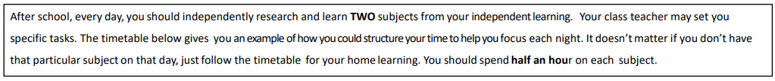
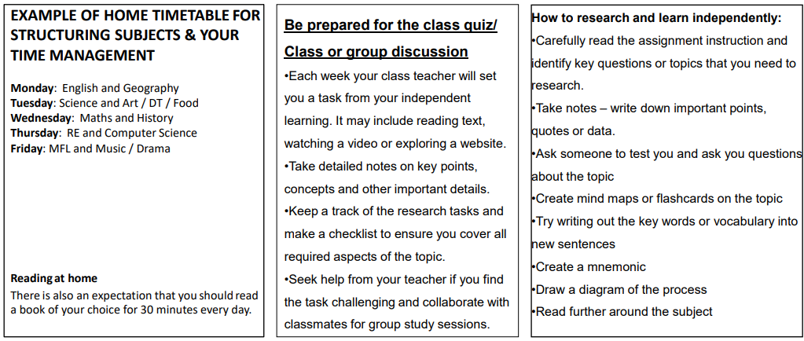

Slide 3

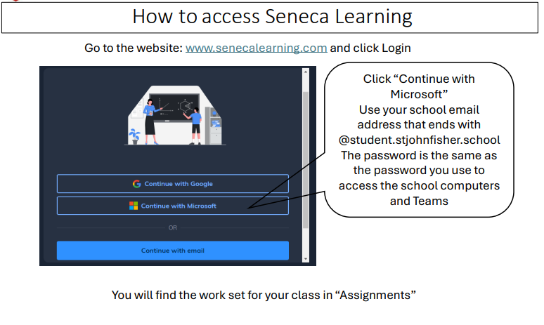

Slide 4
Mathematics Year 7 (GS)
Week 1:
HOMEWORK
Log into Sparx Maths using the provided log in detail.
Complete the task set on: QUADRILATERALS
Having log in issues?
Email: e.nyantakyi@stjohnfisher.school
Week 4:
HOMEWORK
Log into Sparx Maths using the provided log in detail.
Complete the task set on: INTERIOR ANGLES
Having log in issues?
Email: e.nyantakyi@stjohnfisher.school
Week 2:
HOMEWORK
Log into Sparx Maths using the provided log in detail.
Complete the task set on: ALTERNATE ANGLES AND PROOF
Having log in issues?
Email: e.nyantakyi@stjohnfisher.school
Week 5:
HOMEWORK
Log into Sparx Maths using the provided log in detail.
Complete the task set on: SOLVING GEOMETRIC PROBLEMS Having log in issues?
Email: e.nyantakyi@stjohnfisher.school
Week 3:
HOMEWORK
Log into Sparx Maths using the provided log in detail.
Complete the task set on: ANGLES IN PARALLEL LINES
Having log in issues?
Email: e.nyantakyi@stjohnfisher.school
Week 6:
HOMEWORK
Log into Sparx Maths using the provided log in detail.
Complete the task set on: SOLVING GEOMETRIC PROBLEMS
Having log in issues?
Email: e.nyantakyi@stjohnfisher.school
Key vocabulary: Quadrilaterals, Alternate angles, Parallel Lines, Exterior angles, Interior Angles, Geometric, Proof, Line of symmetry, Isosceles triangles

Slide 5
Mathematics Year 7 (MS)
Week 1:
HOMEWORK
Log into Sparx Maths using the provided log in detail.
Complete the task set on: DIRECT PROPORTION
Having log in issues?
Email: e.nyantakyi@stjohnfisher.school
Week 4:
HOMEWORK
Log into Sparx Maths using the provided log in detail.
Complete the task set on: SOLVING WORD PROBLEMS INVOLVING RATIOS
Having log in issues?
Email: e.nyantakyi@stjohnfisher.school
Week 2:
HOMEWORK
Log into Sparx Maths using the provided log in detail.
Complete the task set on: WRITING RATIOS
Having log in issues?
Email: e.nyantakyi@stjohnfisher.school
Week 5:
HOMEWORK
Log into Sparx Maths using the provided log in detail.
Complete the task set on: RATIOS, PROPORTIONS AND FRACTIONS
Having log in issues?
Email: e.nyantakyi@stjohnfisher.school
Week 3:
HOMEWORK
Log into Sparx Maths using the provided log in detail.
Complete the task set on: USING RATIOS
Having log in issues?
Email: e.nyantakyi@stjohnfisher.school
Week 6:
HOMEWORK
Log into Sparx Maths using the provided log in detail.
Complete the task set on: PROPORTIONS AND PERCENTAGES
Having log in issues?
Email: e.nyantakyi@stjohnfisher.school
Key vocabulary: Direct proportion, Ratio, Simplifying, Equivalent, Percentages, Fractions, Comparing proportions

Slide 6
English
Week 1:
Complete the “Exploring the Wonders of the English Language” assignment on Seneca Learning.
This will be marked automatically by Seneca Learning.
Week 4:
Complete the “The Legendary Tales of King Arthur” assignment on Seneca Learning.
This will be marked automatically by Seneca Learning.
Week 2:
Complete the “Exploring the History of Language: Key Terms Uncovered” assignment on Seneca Learning.
This will be marked automatically by Seneca Learning.
Week 5:
Complete the “Understanding Shakespearean Language” assignment on Seneca Learning.
This will be marked automatically by Seneca Learning.
Week 3:
Complete the “The Fascinating Life and Works of Geoffrey Chaucer” assignment on Seneca Learning.
This will be marked automatically by Seneca Learning.
Week 6:
Complete the “Victorian England: An Era of Empire, Progress and Social Contrasts” assignment on Seneca Learning.
This will be marked automatically by Seneca Learning.
Key vocabulary:
Etymology - Identity – Standardisation – Resilience – Borrowing – Old English – Middle English

Slide 7
Science
Week 1:
Complete the assignment on Seneca Learning. This will be marked automatically by Seneca.
Week 4:
Complete the assignment on Seneca Learning. This will be marked automatically by Seneca.
Week 2:
Complete the assignment on Seneca Learning. This will be marked automatically by Seneca.
Week 5:
Complete the assignment on Seneca Learning. This will be marked automatically by Seneca.
Week 3:
Complete the assignment on Seneca Learning. This will be marked automatically by Seneca.
Week 6:
Complete the assignment on Seneca Learning. This will be marked automatically by Seneca.
Key vocabulary: Force – friction – tension – weight – mass – speed – distance-time graph – air resistance – normal contact force – resultant force

Slide 8
Year 7 Religious Education
Week 1: Paschal Mystery
• Draw a picture or design a poster to illustrate one of the key events of the Paschal Mystery (e.g., Jesus on the Cross, the Resurrection, or the Empty Tomb).
• Include a Bible verse or short quote that connects with the event you’ve chosen. Write a brief explanation (2-3 sentences) about why this event is important.
Week 4: Follow the link:
https://www.bbc.co.uk/bitesize/guides/zv93rwx/revision/1
Read the information, watch the clips and complete the test
Week 2: Sacraments
Create 5 multiple choice questions on the Seven Sacraments. Bring to class to challenge a classmate.
Week 5:
Revise for the assessment.
Use information on Teams and from class to help you prepare for the assessment.
Week 3: Research Liturgy of the Eucharist and read Luke 22:7-23 on www.biblegateway .com
Create a table to show the similarities and differences between the Eucharist and the actual Last Supper.
Week 6: What is Corpus Christi?
Create a powerpoint with pictures and facts about the importance of this festival to Catholic Christians.
Big question – How do processions of the blessed sacrament honour Jesus?
Key vocabulary: Eucharist, Salvation, Atonement, Sacrifice, Sacraments, consecrated, transubstantiation, Mass, in persona Christi, Last Supper, Resurrection, Passover, Pashal Mystery.

Slide 9
Citizenship - Year 07 Term 4
Week 1: How is local government different to central government?
Create a simple comparison table with two columns: Local Government and Central Government. Include at least 3 differences, for example:
Who makes decisions
Where decisions affect people
One example of something each controls
Week 4: How do local elections work?
Write the 5 stages of a local election in the correct order and explain what happens at each stage.
Week 2: What do councils do?
Make a list of 5 services your local council might provide. Next to each one, write one sentence explaining how it affects people in your area (e.g. parks, rubbish collection, libraries).
Week 5: Why is registering to vote so important?
Finish this sentence in 3 different ways:
“Registering to vote is important because…”
Week 3: What is the role of a councillor?
Imagine you are a local councillor for a day. Write 3 bullet points explaining:
Who you represent
One problem you might help solve
One way you would listen to local people
Week 6: How can young people be more involved in local decision making?
Design a mini poster or bullet list showing 3 ways young people can influence local decisions without voting yet. Examples might include:
Youth councils, Campaigns, Community groups
Key vocabulary: Government, election, councillor, campaign

Slide 10
History
Week 1:
Begin your independent research homework. This is a Term Four task. Make sure your work is detailed and well presented.
Challenge yourself by completing the extra reading task.
Week 5:
Continue with your independent research homework. This is a Term Four task. Make sure your work is detailed and well presented.
Challenge yourself by completing the extra reading task.
Week 2:
Continue with your independent research homework. This is a Term Four task. Make sure your work is detailed and well presented.
Challenge yourself by completing the extra reading task.
Week 6:
Continue with your independent research homework. This is a Term Four task. Make sure your work is detailed and well presented.
Challenge yourself by completing the extra reading task.
Week 3:
Continue with your independent research homework. This is a Term Four task. Make sure your work is detailed and well presented.
Challenge yourself by completing the extra reading task.
Key Vocabulary:
Plague, Bubonic, Pneumonic, Septicemic, Apothecary, Physician, Penance, Statute, Revolt, Protestant, Reformation, Annulment, Act, Supremacy, Dissolution
Week 4:
Continue with your independent research homework. This is a Term Four task. Make sure your work is detailed and well presented.
Challenge yourself by completing the extra reading task.
.

Slide 11
Geography
Week 1:
Complete set tasks on SENECA
This will be marked online
Week 4:
Complete set tasks on SENECA
This will be marked online
Week 2:
Complete set tasks on SENECA
This will be marked online
Week 5:
Complete set tasks on SENECA
This will be marked online
Week 3:
Complete set tasks on SENECA
This will be marked online
Week 6:
Complete set tasks on SENECA
This will be marked online
Key vocabulary: China, One child policy, Communism, Demography, Three Gorges dam Yangtze

Slide 12
Year 7 T4 French
Week 1: collect booklet set in class.
Learn key vocab set on teams:
Week 4:
extended writing task which will be set on teams about your favourite hobbies. The question is: qu’est que tu aimes faire?
Week 2
extended writing: Write a paragraph, describing what sports you do or don’t do in French . Include: the negative in French, give opinions and reasons in French. This needs to be 40 words
Week 5:
Learn the vocab set on teams. You’ll be tested on this on teams
Week 6:
Revision for term 4 Speaking Assessment. This will be set on teams.
In addition to this learn vocab for term 5. This will be set on teams.
Week 3:
Learn the vocab set on teams. You’ll be tested on this in class.
Key vocabulary:

Slide 13
Art and Design Year 7 Term 3
Week 1:
From your research of Yellena James’s work, draw part of one of her pieces of work using line only. Keep this work for week two as you will be adding to the drawing.
Week 4:
Make a careful line drawing from an image of a seahorse or starfish. Keep this work until next week as you will be adding to it.
Week 2:
From the drawing you did last week that was inspired by Yellena James please complete this using tone or colour.
Week 5:
Add tone or colour to your seahorse or starfish drawing.
Week 3:
Make a careful line drawing from an image of a piece of coral or a sea fern.
Week 6:
Research watercolour painting. Create a PowerPoint slide of examples of watercolour paintings.
Key vocabulary:
Line, pattern, shape, colour, composition, coral, sea ferns, starfish, seahorse, watercolour, critical study

Slide 14
Drama Year 7
Week 1:
Greek Theatre
Using Google as a tool, revise the different parts of the theatre. Draw out a plan of a Greek Amphitheatre, and label it correctly with all of the different elements that we have done in class.
Week 4:
Scripting
We have looked at the character of Hercules in class. Write a short monologue to explain why he is undergoing the labours that he has had set for him.
Week 2:
Greek Heroes
Pick a hero from Greek mythology. Write a character profile for this hero at one of their most important victories. Try to explain how this character feels at any particular point.
Week 5:
Rehearsal
Find ten minutes at the start of one lunch or breaktime to practice the work that you have been doing in your group to make it ready to show the rest of the class.
Week 3:
Greek Myths
Pick one of the Greek myths that we have looked at in class so far. Draw out a storyboard of six different panels to show what would happen if you were to put this story on stage.
Week 6:
Evaluate
Take some time to reflect on your performance in the class so far. What could you do in order to improve your work moving forwards?
Key vocabulary: Set, Staging, Mythology, Character, Character Profile, Monologue

Slide 15
Music
Watch the following clip about the instruments of a percussion section in an orchestra.
https://www.youtube.com/watch?v=xGKpngesISI
Challenge: Find another piece of music where the percussion section is important
Week 4:
Watch the following clip about the instruments of the string section in an orchestra.
https://www.youtube.com/watch?v=MP2_6OLummA
Challenge: Find a piece of music with only a string quartet.
Watch the following clip about the instruments of the brass section in an orchestra.
https://www.youtube.com/watch?v=yE0aSxziNdY
Challenge: Find a piece of music with only brass instruments.
Watch and listen to the following clip of the piece Hedwig’s Theme (from Harry Potter and the Philosopher’s Stone) by John Williams.
https://www.youtube.com/watch?v=GTXBLyp7_Dw
1 List 10 instruments you can hear.
Describe the music in exactly 15 words.
3 Research another film score composed by John Williams –
What is the film?
What is it about?
Is it similar/different to Hedwig’s theme?
Watch the following clip about the instruments of the woodwind section in an orchestra.
https://www.youtube.com/watch?v=KEt1Mm8sSkA
Challenge: Find a piece of music featuring a clarinet.
Key vocabulary percussion, woodwind, brass, percussion, orchestra, plucked, bowed soprano, alto, tenor, bass, timbre, sound quality, technique

Slide 16
Computing
Week 1: Explain what online privacy is and give two examples of personal data that should be protected. Then explain one rule or law that helps protect people’s data online.
Week 4: Choose one type of malware and explain:
What it is
How it can cause harm
One way to prevent it
Week 2:Describe what social engineering is and explain one example of how someone could be tricked online. Include one way to stay safe from social engineering attacks.
Week 5: Explain one personal cyber threat and one organisational cyber threat. Describe how each could affect people or businesses.
Week 3: Explain the difference between a DDoS attack and a brute force attack. Include one way organisations can protect themselves from these attacks.
Week 6: Create a Top 5 Cybersecurity Prevention Tips list. Include tips for both individuals and organisations.
Key vocabulary: Cyber security, Threats, Attacks, Malware, Social Engineering

Slide 17
Physical Education – Key Stage 3 Homework Tasks
Week 1: Rules & regulations in hockey
Watch the following video on rules and regulations in hockey -https://www.youtube.com/watch?v=3oIWk5qhlC0
Week 4: Shooting in hockey
Watch the following video on shooting techniques in hockey - https://www.youtube.com/watch?v=ww3fYa7Dd1Q
Week 2: Dribbling in hockey
Watch the following video on dribbling in hockey -https://www.youtube.com/watch?v=QH-swZZPNZY
Week 5: Tackling in hockey
Watch the following video on tackling in hockey -https://www.youtube.com/watch?v=mNlIygEpuf8
Week 3: Passing and receiving in hockey
Watch the following video on passing and receiving in hockey -https://www.youtube.com/watch?v=QH-swZZPNZY
Week 6:
Watch the following footage from a recent hockey match and make notes about which skills you see, that you have also learned this term.
https://www.youtube.com/watch?v=uSC-su3CgRM
Key vocabulary:
Rules & regulations, slap shot, slap pass, guard, block, stick, dribbling, passing, shooting, teamwork.

