Slide 1

Independent Learning
Year 11
Term 4

Slide 2

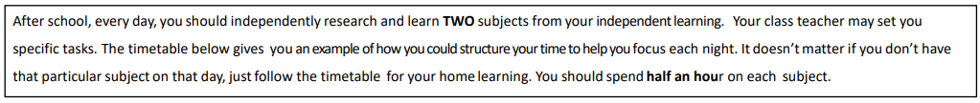
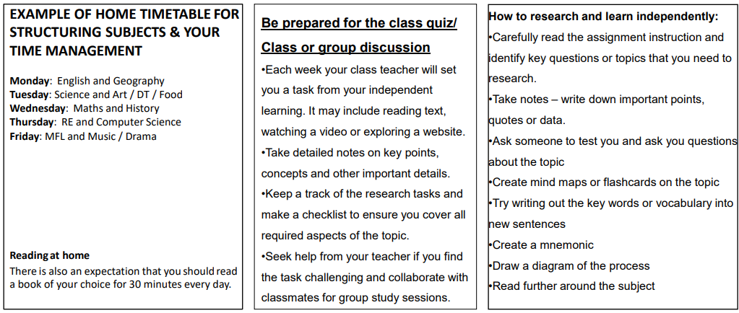

Slide 3

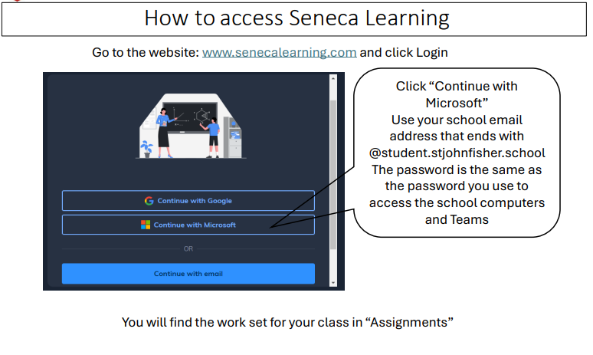

Slide 4
Mathematics Year 11 (Foundation)
Week 1:
HOMEWORK
Log into Sparx Maths using the provided log in detail.
Complete the task set on: REVISION ON NUMBER
Having log in issues?
Email: e.nyantakyi@stjohnfisher.school
Week 4:
HOMEWORK
Log into Sparx Maths using the provided log in detail.
Complete the task set on: REVISION ON FRACTION AND PERCENTAGES
Having log in issues?
Email: e.nyantakyi@stjohnfisher.school
Week 2:
HOMEWORK
Log into Sparx Maths using the provided log in detail.
Complete the task set on: REVISION ON ALGEBRA
Having log in issues?
Email: e.nyantakyi@stjohnfisher.school
Week 5:
HOMEWORK
Log into Sparx Maths using the provided log in detail.
Complete the task set on: REVISION ON EQUATIONS, INEQUALITIES AND SEQUENCES
Having log in issues?
Email: e.nyantakyi@stjohnfisher.school
Week 3:
HOMEWORK
Log into Sparx Maths using the provided log in detail.
Complete the task set on: REVISION ON GRAPHS
Having log in issues?
Email: e.nyantakyi@stjohnfisher.school
Week 6:
HOMEWORK
Log into Sparx Maths using the provided log in detail.
Complete the task set on: REVISION ON ANGLES
Having log in issues?
Email: e.nyantakyi@stjohnfisher.school
Key vocabulary: INTEGERS, ADDITION, SUBTRACTION, MULTIPLICATION, DIVISION, AVERAGE, FRACTION, DECIMAL, PERCENTAGE, EQUATION, INEQUALIITY, SEQUENCE,

Slide 5
Mathematics Year 11 (Higher)
Week 1:
HOMEWORK
Log into Sparx Maths using the provided log in detail.
Complete the task set on: REVISION ON NUMBER
Having log in issues?
Email: e.nyantakyi@stjohnfisher.school
Week 4:
HOMEWORK
Log into Sparx Maths using the provided log in detail.
Complete the task set on: REVISION ON FRACTION AND PERCENTAGES
Having log in issues?
Email: e.nyantakyi@stjohnfisher.school
Week 2:
HOMEWORK
Log into Sparx Maths using the provided log in detail.
Complete the task set on: REVISION ON ALGEBRA
Having log in issues?
Email: e.nyantakyi@stjohnfisher.school
Week 5:
HOMEWORK
Log into Sparx Maths using the provided log in detail.
Complete the task set on: REVISION ON EQUATIONS, INEQUALITIES AND SEQUENCES
Having log in issues?
Email: e.nyantakyi@stjohnfisher.school
Week 3:
HOMEWORK
Log into Sparx Maths using the provided log in detail.
Complete the task set on: REVISION ON GRAPHS
Having log in issues?
Email: e.nyantakyi@stjohnfisher.school
Week 6:
HOMEWORK
Log into Sparx Maths using the provided log in detail.
Complete the task set on: REVISION ON ANGLES
Having log in issues?
Email: e.nyantakyi@stjohnfisher.school
Key vocabulary: INTEGERS, ADDITION, SUBTRACTION, MULTIPLICATION, DIVISION, AVERAGE, FRACTION, DECIMAL, PERCENTAGE, EQUATION, INEQUALIITY, SEQUENCE,

Slide 6
English
Week 1:
Complete the “Unpacking An Inspector Calls” assignment on Seneca Learning.
This will be marked automatically by Seneca Learning.
Week 4:
Complete the “Unveiling the Layer of An Inspector Calls” assignment on Seneca Learning.
This will be marked automatically by Seneca Learning.
Week 2:
Complete the “Understanding An Inspector Calls” assignment on Seneca Learning.
This will be marked automatically by Seneca Learning.
Week 5:
Complete the “Key Quotations in An Inspector Calls” assignment on Seneca Learning.
This will be marked automatically by Seneca Learning.
Week 3:
Complete the “Exploring Theme in An Inspector Calls” assignment on Seneca Learning.
This will be marked automatically by Seneca Learning.
Week 6:
Complete the “Unravelling the Structure of An Inspector Calls” assignment on Seneca Learning.
This will be marked automatically by Seneca Learning.
Key vocabulary:
Responsibility – Social Class – Capitalism – Socialism – Morality – Dramatic Irony

Slide 7
Science
Week 1:
Complete the assignment on Seneca Learning. This will be marked automatically by Seneca.
Week 4:
Complete the assignment on Seneca Learning. This will be marked automatically by Seneca.
Week 2:
Complete the assignment on Seneca Learning. This will be marked automatically by Seneca.
Week 5:
Complete the assignment on Seneca Learning. This will be marked automatically by Seneca.
Week 3:
Complete the assignment on Seneca Learning. This will be marked automatically by Seneca.
Week 6:
Complete the assignment on Seneca Learning. This will be marked automatically by Seneca.
Key vocabulary: cell membrane – nucleus – cytoplasm – mitochondria – chloroplast – ribosome – cell wall – vacuole – chloroplast – magnification – focus – atom – electron – neutron – proton – group 1 elements – reactivity – shells – energy – kinetic energy – gravitational potential energy – elastic potential energy – chemical energy – energy stores – energy transfers – radiation – heating – electrical transfer – mechanical working

Slide 8
Religious Education
Week 1:
Access Seneca Learning
Religious Studies A: EDEXCEL GCSE Religions
Catholic Christianity (Beliefs and teachings)
Complete all sections: 1.1.1-1.1.9
Week 4:
Access Seneca Learning
Religious Studies A: EDEXCEL GCSE Religions
Catholic Christianity (Practices)
Complete all sections: 1.2.3-1.2.10
Week 2:
Complete the following exam questions using your revision guide and book:
Outline three events of Jesus’ resurrection (3)
Explain two Catholic beliefs about the nature of God from the creation story (4)
Explain 2 Catholic beliefs about the Trinity. Your answer must contain a source of wisdom and authority. (5)
Week 5:
Complete the following exam questions using your revision guide and book:
Outline 3 features of the Catholic funeral rite (3)
Explain two reasons why popular piety is important (4)
Explain two important principles of Catholic Social Teaching. You must contain a source of Wisdom and authority (5)
Week 3:
Using your book and revision guide, answer the following question:
“Resurrection is the most important feature of the Paschal Mystery” – Evaluate this statement
Week 6:
Using your book and revision guide, answer the following question:
“Reconciliation is the most important sacrament” – Evaluate this statement.

Slide 9
Citizenship Revision
Week 1: Create revision flash cards for Theme A: Living Together in the UK in preparation for in class tests
Create a separate key terms list to prepare for key terms test on this theme
Week 4: Create revision flash cards for Theme D: Power and Influence in preparation for in class tests
Create a separate key terms list to prepare for key terms test on this theme
Week 2: Create revision flash cards for Theme B: Democracy at Work in the UK in preparation for in class tests
Create a separate key terms list to prepare for key terms test on this theme
Week 5: Create revision flash cards for Theme E: Citizenship Action/coursework in preparation for in class tests
Create a separate key terms list to prepare for key terms test on this theme
Week 3: Create revision flash cards for Theme C: How the Law Works in preparation for in class tests
Create a separate key terms list to prepare for key terms test on this theme
Week 6: Create a list of areas that you would like your teacher to help you with during revision sessions
Key vocabulary: The complete glossary for the GCSE

Slide 10
Subject History
Week 1:
Booklet issued :Germany 1918-39
Students are to make flash cards for 3 pages each week, to use for retrieval tests in class each week.
Week 4:
Use your revision notes to prepare for past questions.
You will be given a past question for your starter.
Peer mark
Week 2:
Booklet issued :Germany 1918-39
Students are to make flash cards for 3 pages each week, to use for retrieval tests in class each week.
.
Week 5:
Use your revision notes to prepare for past questions.
You will be given a past question for your starter.
Peer mark
Booklet issued :Germany 1918-39
Students are to make flash cards for 3 pages each week, to use for retrieval tests in class each week.
Week 6:
Use your revision notes to prepare for past questions.
You will be given a past question for your starter.
Peer mark
Key vocabulary:
. Weimar republic. Versailles Treaty. Democracy. Putsch. Politics. Right wing. Left wing. Constitution.

Slide 11
Geography
Week 1:
Complete geographical skills booklet – Percentage change
Week 4:
Complete geographical skills booklet – Median
Week 2:
Complete geographical skills booklet – Percentage change
Week 5:
Complete geographical skills booklet – Interquartile range
Week 3:
Complete geographical skills booklet – Median
Week 6:
Complete geographical skills booklet – Interquartile range
Key vocabulary: Coasts Rivers Hazards Climate change extreme weather ecosystems

Slide 12
Subject: Sociology Year 11 Term 4 2026
Week 1:
Exam preparation
Start questions in ‘Family ’ revision booklet
Week 4:
Exam preparation
Complete questions in Education revision booklet
Week 2
Exam preparation
Complete questions in Family revision booklet
Week 5:
Exam preparation
Start questions in Crime and Deviance revision booklet
Week 3
Exam preparation
Start questions in Education booklet revision guide
Week 6:
Exam preparation
Complete questions in Crime and Deviance revision booklet
Refer to Sociology Glossary for all key terms

Slide 13
Year 11 T4 French
Week 1: collect booklet set in class.
Learn key vocab set on teams
Week 4:
Complete a listening practice on the active hub website . This will be set on my tasks.
Week 5:
Learn the vocab set on teams. You’ll be tested on this on teams
Week 2
complete an independent grammar practice task set on the Active hub. This will be set under my tasks.
Week 6:
Revision for term 4 test. This will be set on teams.
In addition to this learn vocab for term 5. This will be set on teams.
Week 3:
Learn the vocab set on teams. You’ll be tested on this in class.
Key vocabulary:

Slide 14
Year 11 Latin Homework
Week 1: Translate into English:
servus laborat.
puellae rident.
dominus iratus est.
agricola in agro ambulat.
servi cenam parant.
Explain how to recognise present, past and future tenses.
Week 4: Perfect tense
The City of Rome. In Rome, image was everything provided it looked good to the to the ruling classes.
What do you think about this statement? Make sure to present a logical and balanced argument.
Week 2: Imperfect tense
Translate into English:
servus laborabat.
puella cantabat.
milites oppidum oppugnabant.
dominus cenabat.
ancilla clamabat.
Week 3 : Cattullus poems 5 and 8.
What would you say is the difference in terms of love and marriage.
Week 5:
Download from Eduqas website the 2023 past paper component 1. Complete all questions.
Week 6
Eduqas year 2024 Past paper, component 2B. Complete all questions.
Key words: servus, agricola, milites
Vocabat, cenebat, oppugnabant

Slide 15
Art and Design Year 11 Term 3
Week 1:
Produce a double page of your own initial ideas for an outcome in response to your chosen question and to the artists you have studied trying different compositions.
Week 4:
Continue developing your own ideas, making clear connections with your artists. Experiment with materials and processes refining your work as you move forward and reflecting on what you have learned so far. Consider creating another mind map that considers what you have achieved so far and where your ideas might develop further.
Week 2:
Review the work produced last week and all work leading up to it. Move your ideas forward showing increasing independence. You may need to introduce another artist, gather more images, create drawings or photographs from observation, experiment with different materials, explore new compositions etc.
Week 5:
Start considering ideas for the final exam piece. Compositional ideas (alternatives). Consider materials and scale. Write your intentions for the final piece. Ensure your project flows and makes sense.
Week 3:
Produce at least two further double pages in your sketchbook showing clear progression of your ideas and links to your artists. Annotate your ideas to explain your thinking.
Week 6:
Produce test pieces for the final piece (in lessons and for homework). Review all work produced so far, evaluate and refine ideas. Annotate to explain your thoughts, what you have learned and your intentions moving forward.
Key vocabulary:
Imagery, Content, Form, Process, Mood, Composition, mind-mapping, illustration, critical analysis, process, technique, media, mark-making

Slide 16
Drama
Week 1:
Learn lines for GCSE Drama Performance
Read your line aloud from the sheet. Cover the words you have just read and then say them again out loud. Then add an additional line afterwards, and do the same again. If you make a mistake, then repeat the process until you are clear on everything.
Week 4:
Learn lines for GCSE Drama Performance
You will probably find at this point that there are a few lines that you are finding particularly tricky. Write these on post-it notes and put them in places you are likely to see them every day – next to your bed, on your mirror etc.
Week 2:
Learn lines for GCSE Drama Performance
Go through your script with a pencil. Alongside each line that you know, make sure you add in exactly what you are doing on stage for this line. Do this alongside the work you have done last week on line learning.
Week 5:
Learn lines for GCSE Drama Performance
Get a family member or friend to support you with this. Give them the script and get them to read in the other people’s lines. If you make a mistake – no matter how small – get them to correct you and then do the line again until it is right.
Week 3:
Learn lines for GCSE Drama Performance
You will need a pencil again for this. Go through the script and for each line, make sure that you know exactly how your character is feeling. Mark this down next to the lines in the script as you revise your lines.
Week 6:
Learn lines for GCSE Drama Performance
We are nearly at the performance now. Speak to the rest of your group and organise a line run as a group. This can be done virtually if that is more suitable. No scripts!
Key vocabulary:

Slide 17
Music
Week 1: Students to work on Component 3
Refer to question paper and helpsheets
Understanding the Brief & Research
Week 4: Rough Structure and First Draft
Week 2: Idea Generation and Musical Sketches
Week 5: Refinement and Editing
Week 3: Experiment with sound pallets for your chosen song
Week 6: Final product recording
Key vocabulary: remix arrangement development collaboration mix-down panning

Slide 18
Subject: YEAR 11 GCSE PE
Week 1:
EVER LEARNER PLATFORM: Socio-Cultural Influences
Please complete the practice exam questions for this topic.
Week 4:
EVER LEARNER PLATFORM: Movement Analysis
Please complete the practice exam questions for this topic
Week 2:
EVER LEARNER PLATFORM: Sports psychology
Please complete the practice exam questions for this topic
Week 5:
EVER LEARNER PLATFORM: Aerobic and Anaerobic Exercise
Please complete the practice exam questions for this topic
Week 3:
EVER LEARNER PLATFORM: Physical Training
Please complete the practice exam questions for this topic
Week 6:
EVER LEARNER PLATFORM: Structure and function of the cardiovascular system and Applied Anatomy and Physiology
Please complete the practice exam questions for this topic
Key vocabulary:
HEART FUNCTION OBESITY ILLNESS AEROBIC ANAEROBIC FITNESS RACE RELIGION CULTURE DISABILITY SOCIAL GROUPS FAMILY
FRIENDS PEERS GENDER AGE MOTIVATION INERTED U THEORY STRESS MANAGEMENT DEEP BREATHING SELF-TALK VISUALISATION
VISUAL VERBAL MANUAL MECHANICAL GUIDANCE INFORMATION PROCESSING INPUT OUTPUR DECISION-MAKING FEEDBACK GOAL SETTING SMART TARGETS SKILLS BASIC COMPLEX SELF-PACED EXTERNALLY-PACED GROSS FINE PERFORMANCE CLOSED OPEN

Slide 19
Subject Computing Y11
Week 1:
Write an algorithm which: - asks the user to input 2 numbers - outputs the larger of the two numbers along with a suitable message [5 marks]
Week 4:
A dog that is 5 years old is equivalent to a 42-year-old human. You need to write a program that converts the age of a dog to the equivalent age of a human.
Write an algorithm which:
- Asks for the age of the dog in years
- If the age is 2 or less, the human equivalent is 12 times the age
- If the age is more than 2, the human equivalent is 24 for the first 2 years, plus 6 for every additional year. [5 marks]
Week 2: If Monday = 0, Tuesday = 1 etc…
write an algorithm which: - Asks the user to enter a number, - Outputs the day that the number represents, - Validates the number so that an error message displays if the number is not a valid weekday number.
[5 marks]
Week 5:
Consider the array numbers = [2, 5, 3, 6, 2, 3, 6, 4] where the value of numbers[2] is 3.
Write an algorithm which: - Adds up the numbers in the array, - Displays the result.
To get full marks a loop should be used in your algorithm.
[5 marks]
Week 3: A program has been written to obtain 3 random virtual dice rolls:
dice_roll_1 = random(1,6)
dice_roll_2 = random(1,6)
dice_roll_3 = random(1,6)
Rewrite this algorithm so that it makes use of iteration. [4 marks]
Week 6:
Purple pen lesson
Key vocabulary: Programming, iteration, coding, efficient, variables, naming conventions

Slide 20
Design Technology Year 11
Week 1- Complete the Following on Teams:
Week 4 - Complete the Following on Teams:
3.1.4 - Systems approach to designing
3.1.1 - New Technologies
Week 2- Complete the Following on Teams:
Week 5- Complete the Following on Teams:
3.1.2 - Energy Generation
3.1.5 - Mechanical devices
Week 3 - Complete the Following on Teams
Week 6- Complete the Following on Teams:
3.1.3 - Developments in new materials
3.1.6.1 - Materials categories
Key vocabulary:
Contextual Challenge, Client Profile, Target Market, Primary Research, Secondary Research, User Requirements, Design Criteria, Anthropometrics, Ergonomics, Product Analysis

Slide 21
CoPE
Week 1:
Research the solar system
Find out 2 facts about each planet in our solar system and list them as bullet points on a word document.
Email work to Miss Chapman
Week 4:
Write a short story or a poem about the solar system.
Email your work to Miss Chapman
Week 2: Design a poster –
Design a poster about a planet of your choice with pictures and information – make sure the writing is in your own words not copied and pasted.
Email your poster to Miss Chapman
Week 5: Written response
If you could choose any planet other than the Earth to live, where would you choose and why?
Write 2 10 line paragraphs in response to this question.
Email your work to Miss Chapman
Week 3: Design a poster –
Design a poster about a planet of your choice with pictures and information – make sure the writing is in your own words not copied and pasted.
Email your poster to Miss Chapman
Space, solar system, Universe, Moon, planets,
Week 6:
Find out 3 facts about the sun and why is it so important to life on Earth. Make sure you write down your facts and reference any websites or books you used.
Email your work to Miss Chapman
Key vocabulary:

Slide 22
Health and Social Care
Week1
Erevision
B1 Physiological indicators
Gapfill and reorder activities
Week 4:
Erevision
B1 Physiological indicators
Wipeout and exam activities
Week 2:
Erevision
B1 Physiological indicators
Categorise and pindrop activities
Week 5:
Erevision
B2 Lifestyle indicators
Categorise and multiple choice activities
Week 3:
Erevision
B1 Physiological indicators
Type it and wipe out activities
Physiological, Exercise, Diet, blood pressure, heart rate, peak flow
Week 6:
Erevision
B2 Lifestyle indicators
Type it and exam activities
Key vocabulary:

Slide 23
Hospitality and Catering
Week 1
Hospitality and Catering and the law – use the knowledge organiser on TEAMs to make revision notes/ a flash card.
Include 5 main bullet points to revise. Hand in to your teacher.
Week 4:
Food safety
Use the knowledge organiser on TEAMS to make revision notes/flash card
Include 5 main bullet points to revise. Hand in to your teacher.
Week 2:
Food related causes of ill health
Use the knowledge organiser on TEAMS to make revision notes/flash card
Include 5 main bullet points to revise. Hand in to your teacher.
Week 5:
Preventative control measures of food induced ill health
Use the knowledge organiser on TEAMS to make revision notes/flash card
Include 5 main bullet points to revise. Hand in to your teacher.
Week 3:
Symptoms and signs of food related ill health
Use the knowledge organiser on TEAMS to make revision notes/flash card
Include 5 main bullet points to revise. Hand in to your teacher.
Week 6:
The Environmental health officer
Use the knowledge organiser on TEAMS to make revision notes/flash card
Include 5 main bullet points to revise. Hand in to your teacher.
Key vocabulary: Chemical, physical, biological hazards

