Slide 1

Independent Learning
Year 10
Term 4

Slide 2

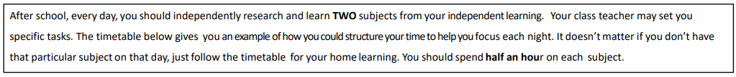
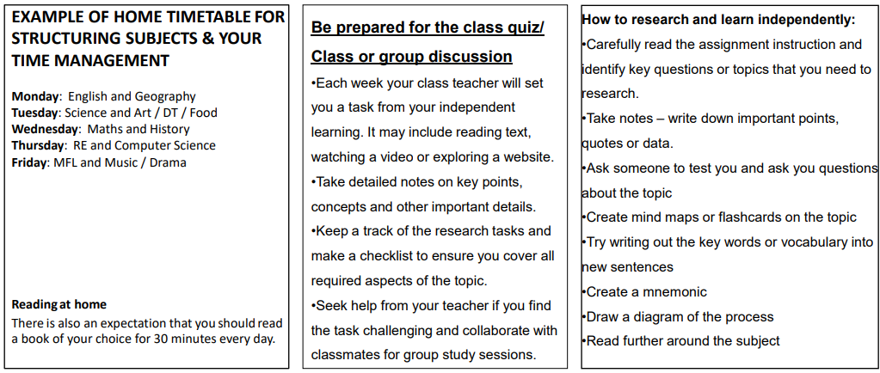

Slide 3

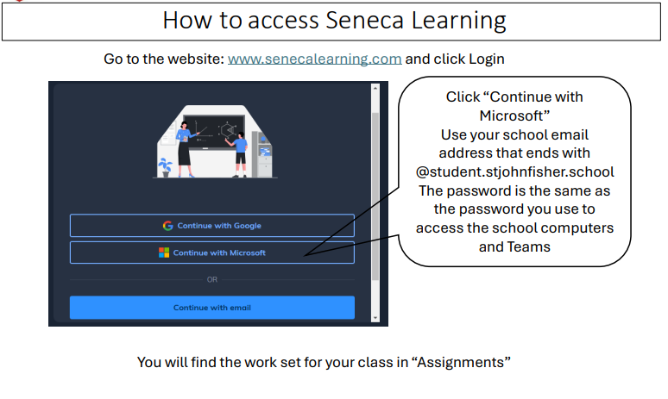

Slide 4
Mathematics Year 10 (Foundation)
Week 1:
HOMEWORK
Log into Sparx Maths using the provided log in detail.
Complete the task set on: CALCULATING PROBABILITY
Having log in issues?
Email: e.nyantakyi@stjohnfisher.school
Week 4:
HOMEWORK
Log into Sparx Maths using the provided log in detail.
Complete the task set on: GROWTH AND DECAY
Having log in issues?
Email: e.nyantakyi@stjohnfisher.school
Week 2:
HOMEWORK
Log into Sparx Maths using the provided log in detail.
Complete the task set on: TWO ENEVTS AND EXPERIMENTAL PROBABILITY
Having log in issues?
Email: e.nyantakyi@stjohnfisher.school
Week 5:
HOMEWORK
Log into Sparx Maths using the provided log in detail.
Complete the task set on: COMPOUND MEASURES
Having log in issues?
Email: e.nyantakyi@stjohnfisher.school
Week 3:
HOMEWORK
Log into Sparx Maths using the provided log in detail.
Complete the task set on: VENN DIAGRAMS AND TREE DIAGRAMS
Having log in issues?
Email: e.nyantakyi@stjohnfisher.school
Week 6:
HOMEWORK
Log into Sparx Maths using the provided log in detail.
Complete the task set on: DIRECT AND INVERSE PROPORTION
Having log in issues?
Email: e.nyantakyi@stjohnfisher.school
Key vocabulary: PROBABILITY, EXPERIMENTAL, VENN DIAGRAMS, TREE DIAGRAMS, GROWTH AND DECAY, DIRECT AND INVERSE PROPORTION

Slide 5
Mathematics Year 10 (Higher)
Week 1:
HOMEWORK
Log into Sparx Maths using the provided log in detail.
Complete the task set on: CONGRUENCE
Having log in issues?
Email: e.nyantakyi@stjohnfisher.school
Week 4:
HOMEWORK
Log into Sparx Maths using the provided log in detail.
Complete the task set on: MORE SIMILARITY
Having log in issues?
Email: e.nyantakyi@stjohnfisher.school
Week 2:
HOMEWORK
Log into Sparx Maths using the provided log in detail.
Complete the task set on: GEOMETRIC PROOF AND CONGRUENCE
Having log in issues?
Email: e.nyantakyi@stjohnfisher.school
Week 5:
HOMEWORK
Log into Sparx Maths using the provided log in detail.
Complete the task set on: SIMILARITY IN 3D SOLIDS
Having log in issues?
Email: e.nyantakyi@stjohnfisher.school
Week 3:
HOMEWORK
Log into Sparx Maths using the provided log in detail.
Complete the task set on: SIMILARITY
Having log in issues?
Email: e.nyantakyi@stjohnfisher.school
Week 6:
HOMEWORK
Log into Sparx Maths using the provided log in detail.
Complete the task set on: END OF UNIT VARIETY QUESTIONS
Having log in issues?
Email: e.nyantakyi@stjohnfisher.school
Key vocabulary: Congruence, Similarity, Scaler factor, Geometric, 3D Solids,

Slide 6
English
Week 1:
  Complete the “English Lit: AQA GCSE Macbeth” assignment on Seneca Learning.
  This will be marked automatically by Seneca Learning.
Week 4:
  Complete the “The Tragic Descent of Macbeth and Lady Macbeth” assignment on Seneca Learning.
  This will be marked automatically by Seneca Learning.
Week 2:
  Complete the “English Lit: GCSE Macbeth - Quotations” assignment on Seneca Learning.
  This will be marked automatically by Seneca Learning.
Week 5:
  Complete the “Exploring Guilt in Shakespeare’s Macbeth” assignment on Seneca Learning.
  This will be marked automatically by Seneca Learning.
Week 3:
  Complete the “Lady Macbeth – English Lit: AQA GCSE Macbeth” assignment on Seneca Learning.
  This will be marked automatically by Seneca Learning.
Week 6:
  Complete the “Symbolism and Motifs in Macbeth” assignment on Seneca Learning.
  This will be marked automatically by Seneca Learning.
Key vocabulary:
Ambition – Equivocation – Soliloquy – Regicide – Tyranny - Supernatural

Slide 7
Science
Week 1:
Complete the assignment on Seneca Learning. This will be marked automatically by Seneca.
Week 4:
Complete the assignment on Seneca Learning. This will be marked automatically by Seneca.
Week 2:
Complete the assignment on Seneca Learning. This will be marked automatically by Seneca.
Week 5:
Complete the assignment on Seneca Learning. This will be marked automatically by Seneca.
Week 3:
Complete the assignment on Seneca Learning. This will be marked automatically by Seneca.
Week 6:
Complete the assignment on Seneca Learning. This will be marked automatically by Seneca.
Key vocabulary: endothermic – exothermic – activation energy – chemical reaction – force – acceleration – Hooke’s Law – Newton’s 1st Law – Newton’s 2nd Law – Newton’s 3rd Law – mass – weight – vector – scalar – distance – displacement

Slide 8
Year 10 Religious Education
Week 1:
  Revise for the assessment.
  Use information on Teams and from class to help you prepare for the assessment.
Week 4:
  Explain the “Shekhinah” in your own words.
  Research Ezekiel 43 vs 2-3. Describe how G-d was seen in the passage.
  Research three ways Jews experience Shekhinah today.
Week 2:
  Revise for the assessment.
  Use information on Teams and from class to help you prepare for the assessment.
Week 5: Create a digital timeline that illustrates significant events related to the covenant of Abraham across Jewish history. Each event should be researched, analysed, and connected to its impact on Judaism today.
Week 3: Different names for the Almighty. See if you can unscramble the words below:
  1. ayehwh-
  2. danoia
  3. leoaoh-
  4. hsadida-
  5. hehey-
Week 6: Research the history of what happened to Moses at Mount Sinai. Covenant and Mount Sinai - Key beliefs - OCR - GCSE Religious Studies Revision - OCR - BBC Bitesize
1. What did he experience there?
2. What was the role of Moses in the covenant ?
Key vocabulary:
  Adonai, Shekhinah, Messianic age, Messiah, Mount Sinai, Monotheism

Slide 9
Citizenship Term 4
Week 1:
Carry out research on the major political parties in the UK, including:
Leader
Beliefs
Successes/failures
Week 4: 10m question practice:
‘Voting should be made compulsory’ Research arguments for and against this statement.
Week 2: ‘The voting age should be lowered to 16’ Research arguments for and against this idea. 10m question practice.
Week 5: Research First Past the Post. Challenge: What is good and bad about this system and why?
Week 3: Research the roles of the following people:
Back and front benchers
Prime Minister
Speaker
  Voting, Parliament, First Past The Post, Back and Front Benchers, PM, Speaker
Week 6: Watch the news and write a summary on a key feature that involves politics.
Key vocabulary:

Slide 10
Subject History
Week 1:
Booklet issued: preparation for PPE paper 2: HVIII.
Past questions for question 1, features
.Use your completed revision notes from last term, to revise for a past question for your starter each week. These will be marked in class.
Week 4:
Use your revision notes to prepare for past questions.
Use your completed revision notes from last term, to revise for a past question for your starter each week. These will be marked in class.
Week 2:
Past questions for question 1, features
. Use your completed revision notes from last term, to revise for a past question for your starter each week. These will be marked in class.
Week 5:
Use your completed revision notes from last term, to revise for a past question for your starter each week. These will be marked in class.
Week 3:
Past questions for question 1, features.
Use your completed revision notes from last term, to revise for a past question for your starter each week. These will be marked in class.
Use your completed revision notes from last term, to revise for a past question for your starter each week. These will be marked in class.
Key vocabulary: .Feature. Describe. Hierarchy. Faction. Foreign policy. Finance. Government. Religion. Law and order.

Slide 11
Geography
Week 1:
Complete revision for your PPE – this will be checked in class
Mind maps Use knowledge organisers
Flash cards Seneca
Week 4:
Complete geographical skills booklet – Percentage change
Week 2:
Complete revision for your PPE – this will be checked in class
Mind maps Use knowledge organisers
Flash cards Seneca
Week 5:
Complete geographical skills booklet – Median
Week 3:
Complete revision for your PPE – this will be checked in class
Mind maps Use knowledge organisers
Flash cards Seneca
Week 6:
Complete geographical skills booklet – Interquartile range
Key vocabulary: Coasts Rivers Hazards Climate change extreme weather ecosystems

Slide 12
Year 10 Latin Homework
Week 1: Translate into English:
servus laborat.
puellae rident.
dominus iratus est.
agricola in agro ambulat.
servi cenam parant.
Week 4: Perfect tense
Translate into English:
servus laboravit.
puella risit.
milites venerunt.
dominus cenam paravit.
ancilla cucurrit.
Week 2: Imperfect tense - PPE Revision
Translate into English:
servus laborabat.
puella cantabat.
milites oppidum oppugnabant.
dominus cenabat.
ancilla clamabat.
Week 3 Translate into Latin – PPE Revision
The slave was working.
The girls were laughing.
The master was shouting.: Download eduqas 20 21 past paper, Roman civilisation and complete all questions. Talk to be taled about in class.
  .
Week 5:
Give an example of a poem you have done. What would you say is the main message of the poet in the poem?
  bbbb
Week 6
Eduqas year 2023 Past paper, component 1.
Complete all questions.
Key words: servus
Vocabat

Slide 13
T4 French Year 10
Week 1:
Learn 20 words for a Vocab Test (Teams)
Week 5:
Writing task – Module 8 Speaking Exam Prep
Week 2:
PPE Revision
Week 6:
Learn 20 words for a Vocab Test (Teams)
Week 3
PPE Revision
Week 4:
Poster with Etre and DR.MRS.VAN.DER.TRAMP
Key Vocabulary:
Je voudrais, devenir, être bénévole, continuer mes études, DR. MRS. VANDERTRAMP, pour gagner de l’argent

Slide 14
Sociology Education and Sociological Methods and Exam Practice
Week 1: How might surveys/questionnaires be used in the field of studying education? What might be beneficial about them? What might be problematic about them?
Week 4: 12m question practice
‘Discuss how far sociologists agree that social class has the biggest impact on educational attainment.
Week 2: How might interviews be used in the field of studying education? What might be beneficial about them? What might be problematic about them?
Week 5: 12M question practice
‘Discuss how far sociologists agree that the main role of education is to prepare people for capitalism’
Week 3: How might surveys/questionnaires be used in the field of studying education? What might be beneficial about them? What might be problematic about them?
Week 6: Revise education unit
Key vocabulary: Questionnaires, Surveys, Interviews, Observations, Social Class, Gender, Ethnicity, Capitalism

Slide 15
Art and Design Year 10 Term 3
Week 1:
Create a mind map on the theme Everyday Objects
Week 4:
Research the work of Andrea Joseph. Collect images and information and present on a PowerPoint slide.
Week 2:
Set up a pile of socks and create a careful drawing using the full range of tones as well as line.
Week 5:
Set up a group of your own objects that are similar to those in Andrea Joseph’s work. Make a careful line drawing. Keep this work until next week as you will be adding to it.
Week 3:
Create a careful observation drawing of a pile of shoes.
Week 6:
Complete last week’s drawing of objects in pen, adding plenty of detail and mark-making.
Key vocabulary:
Composition, imagery, content, form, process, mood, technique, media, mark-making, still life, biro drawing, collections.

Slide 16
Drama Year 10
Week 1:
Costume
Pick a character from the play Blood Brothers. On a piece of paper, design them a costume. Your art skills are not being judged here, so use annotations to explain the choices you have made. Really think about what costume can show about a character.
Week 4:
Character Profile – Eddie
Write a profile of the character Eddie from Blood Brothers. Put down as much information that we know about him as possible, and as much information as we can infer about him.
Week 2:
Character Profile – Mickey
Write a profile of the character Mickey from Blood Brothers. Put down as much information that we know about him as possible, and as much information as we can infer about him.
Week 5:
Ink Theatre
Watch back on the production by Ink Theatre that we watched of Blood Brothers. Pick out a scene and explain what you think they did well to play the characters, and what they could do to make it even better.
Week 3:
Set
Pick a moment from the play Blood Brothers. Design a set for this part of the play. Your art skills are not being judged here, so use annotations to explain the choices you have made.
Week 6:
Character Profile – Mickey
Write a profile of the character Linda from Blood Brothers. Put down as much information that we know about her as possible, and as much information as we can infer about her.
Key vocabulary:

Slide 17
Music
Week 1: Refer to Component 1 Task 2 Sheets for this term Number Sound collection
Week 4: Structure and arrangement. Plan the structure using numbers
Week 2: Rhythm from numbers Turn numbers into drum patterns
Week 5: Sound design and effects.
Week 3: Melody and Harmony from Numbers Generate musical notes using number systems
Week 6: Final Product. Produce your final piece
Key vocabulary: drum loops sequencing development ABA structure voicing refinement quantise

Slide 18
Computing
Week 1: Explain what an operating system is and describe three functions of an operating system.
Use examples to support your answers.
Week 4: Explain how an operating system manages files and folders.
Compare a Graphical User Interface (GUI) and a Command Line Interface (CLI), giving one advantage of each.
Week 2:Describe how an operating system manages memory.
Explain the difference between RAM and virtual memory, including why virtual memory is needed.
Week 5: Choose two types of utility software and explain:
What each one does
Why it is important for a computer system
(Examples: anti-malware, encryption, backup, disk defragmentation)
Week 3: Explain how an operating system manages the processor.
Describe multi-tasking and why it is important in modern operating systems.
Week 6: A school computer system is used by hundreds of users each day.
Explain how operating systems and utility software help keep the system efficient and secure. Your answer should refer to:
At least two OS functions
At least one type of utility software
Key vocabulary: Operating System, Utility Software, Interfaces

Slide 19
BUSINESS – TERM 4
Week 1: Identify and Understand aims and objectives of business
- What are Financial aims (Profit generation, sales, market share, financial security, survival)
- What are non-financial aims and objectives (social, personal satisfaction, challenge, independence)
- Why and how objectives differ between businesses
- Complete activity on Seneca
Week 4: Financial calculations
How to calculate:
- Revenue
- Fixed and variable costs
- Total costs
- Profit and Loss
- Complete financial calculation activity in Tutor2U power point slides on Teams
Week 2: Understand Business Revenue, costs, and profits
- What is the difference between these business terms
- What do these terms represent?
- How do businesses use these factors to determine success?
-Write a brief essay on the importance of revenue, cost and profit to a business of your choice
Week 5: Understanding Cash and Cash-flow
- What is meant by cash and its importance to a business
- What is a cash-flow forecast
- What is a cash-flow statement
- What is the importance of a cash-flow forecast to a business
- Write a 200-word essay on the importance of cash-flow forecast to small business survival and raising finance from a bank. Essay to be submitted via outlook.
Week 3: Understanding core concepts of business finance. What is:
- Revenue, - Fixed and variable costs, - Total costs, - Profit and loss,
- Interest, - Difference between cash and profit
- Conduct online research into the financial performance of Apple, and Facebook and determine if both companies made profit or loss in 2015 to 2018. Findings will be presented in class.
Week 6: Understand how to calculate and interpret cash-flow Forecasts
- What is cash-inflow and how is it calculated
- What is cash-outflow and how is it calculated
- What is net-cashflow and how is it calculated
- Complete financial calculation activity in Tutor2U power point slides on Teams
Key vocabulary: Aims and objectives, Revenue, Costs, Profit, Loss, Fixed cost, Variable cost, Cash flow, Cash flow forecast, Cash-inflow, Cash-outflow, Net-cashflow

Slide 20
CoPE
Week 1:
Research the solar system
Find out 2 facts about each planet in our solar system and list them as bullet points on a word document.
Email work to Miss Chapman
Week 4:
Write a short story or a poem about the solar system.
Email your work to Miss Chapman
Week 2: Design a poster –
Design a poster about a planet of your choice with pictures and information – make sure the writing is in your own words not copied and pasted.
Email your poster to Miss Chapman
Week 5: Written response
If you could choose any planet other than the Earth to live, where would you choose and why?
Write 2 10 line paragraphs in response to this question.
Email your work to Miss Chapman
Week 3: Design a poster –
Design a poster about a planet of your choice with pictures and information – make sure the writing is in your own words not copied and pasted.
Email your poster to Miss Chapman
Space, solar system, Universe, Moon, planets,
Week 6:
Find out 3 facts about the sun and why is it so important to life on Earth. Make sure you write down your facts and reference any websites or books you used.
Email your work to Miss Chapman
Key vocabulary:

Slide 21
Hospitality and Catering
Week 1
Hospitality and Catering and the law – use the knowledge organiser on TEAMs to make revision notes/ a flash card.
Include 5 main bullet points to revise. Hand in to your teacher.
Week 4:
Food safety
Use the knowledge organiser on TEAMS to make revision notes/flash card
Include 5 main bullet points to revise. Hand in to your teacher.
Week 2:
Food related causes of ill health
Use the knowledge organiser on TEAMS to make revision notes/flash card
Include 5 main bullet points to revise. Hand in to your teacher.
Week 5:
Preventative control measures of food induced ill health
Use the knowledge organiser on TEAMS to make revision notes/flash card
Include 5 main bullet points to revise. Hand in to your teacher.
Week 3:
Symptoms and signs of food related ill health
Use the knowledge organiser on TEAMS to make revision notes/flash card
Include 5 main bullet points to revise. Hand in to your teacher.
Week 6:
The Environmental health officer
Use the knowledge organiser on TEAMS to make revision notes/flash card
Include 5 main bullet points to revise. Hand in to your teacher.
Key vocabulary: Chemical, physical, biological hazards

Slide 22
Physical Education – Year 10 GCSE Homework Tasks
Week 1: Everlearner task – Watch now & then test yourself
Watch the video on Everlearner about training methods, ensure to make notes as you go. Following this, test yourself on the topic and achieve a minimum pass score of 60%.
Week 4: Everlearner task – Watch now & then test yourself
Watch the video on Everlearner about rest & recovery, ensure to make notes as you go. Following this, test yourself on the topic and achieve a minimum pass score of 60%.
Week 2: Everlearner task – Watch now & then test yourself
Watch the video on Everlearner about Heart rate training zones, ensure to make notes as you go. Following this, test yourself on the topic and achieve a minimum pass score of 60%.
Week 5: Everlearner task – Watch now & then test yourself
Watch the video on Everlearner about analysis tools, ensure to make notes as you go. Following this, test yourself on the topic and achieve a minimum pass score of 60%.
Week 5: Everlearner task – Watch now & then test yourself
Watch the video on Everlearner about analysis tools, ensure to make notes as you go. Following this, test yourself on the topic and achieve a minimum pass score of 60%.
Week 6: Everlearner task – Watch now & then test yourself
Watch the video on Everlearner about evaluating data, ensure to make notes as you go. Following this, test yourself on the topic and achieve a minimum pass score of 60%.
Key vocabulary:
  Fartlek, interval, continuous, circuit, weight, plyometric, aerobic, anaerobic, sedentary, repair, recovery.

