Slide 1
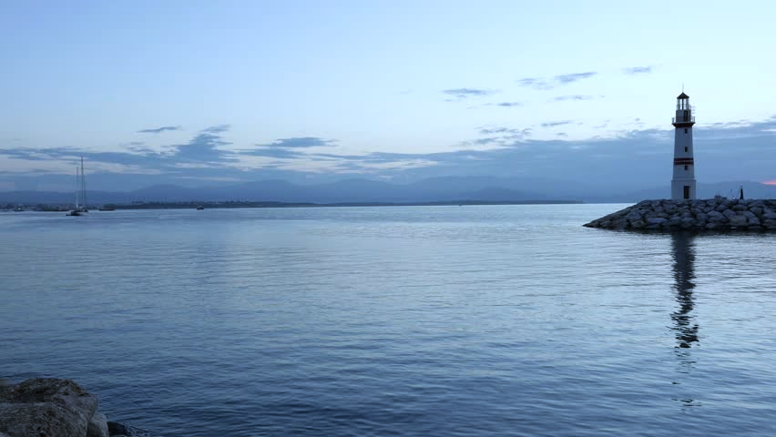
Term 1 – New Beginnings
18/9/18 Wednesday
Sign of the Cross: In the name of the Father, and of the Son and of the Holy Spirit
Prayer: Lord, Inspire me in such a way that my choices each day and my commitment to live in a positive way may transform the negative into something positive, and the ordinariness of daily life into something extraordinary. Amen.
Spiritual Reflection: “My mission in life is not merely to survive, but to thrive; and to do so with some passion, some compassion, some humour and some style” - Maya Angelou
St John Fisher, pray for us.

