Slide 1
Key words charades
Vote
Resident
Mayor
Cabinet
Committee

Slide 2
What does the council do?’
Learning objectives
To be able to explain what a local council does for residents and how it is funded
Starter – Copy date and title. Write a list of services you think are provided by your local council.

Slide 3
What council services can you think of?
Births Deaths and Marriage registration
Street lighting
Planning and transport
Leisure (swimming pools, parks etc.)
Education
Refuse collection
Social Services
Environmental services
Housing

Slide 4
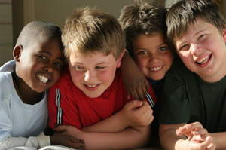
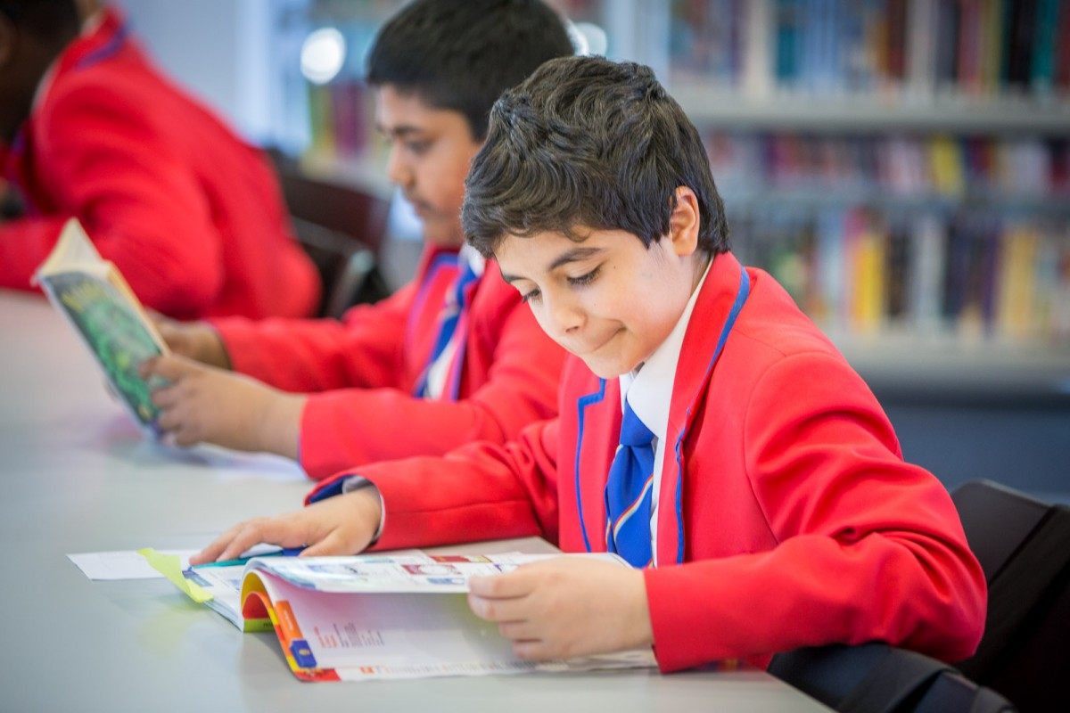
What does the council do?
Your council provides a range of services
How their money is spent depends on the population. More = more £ on schools
More = more £ on Social Services
Some councils work with private businesses e.g. KPMG City Academy, Hackney

Slide 5
Task
Complete the two worksheets

Slide 6
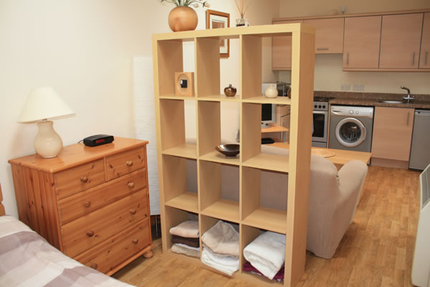
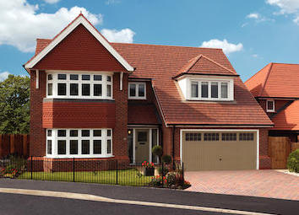
Where does the council’s money come from?
Council tax – a tax paid by all residents which is based on the size of their home.
Business rates – a tax paid by businesses based on the rental value of the premises
Charges – parking fines, library fines, fly tipping fines etc.

Slide 7
Local council’s income and expenditure in £ million
Social services £37.4
Fire and police £8.6
Planning and Transport: £12.8
Leisure £8.8
Other £6.7
Education £62.3
Housing £4.5
Business rates tax - £45.3
Council tax - £68
Government grant - £26.1
Tax surplus from previous year - £1.8

Slide 8
Homework – answer the questions on the council funding worksheet in full sentences – due next lesson

