Slide 1
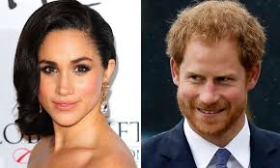
Balancing Human Rights
Objectives:
1. To revisit what is meant by freedom of speech. 2. To suggest why some human rights might be limited

Slide 2
“Prince Harry is aware of curiosity about his private life. He’s never been comfortable with this, but has tried to develop a thick skin about the level of media interest.
But a line has been crossed. His wife, Meghan Markle, has been subject to a wave of abuse and harassment. The smear on the front page of a national newspaper; the racial undertones of comment pieces; the outright sexism and racism of social media trolls. Her mother struggling past photographers to get to her front door; reporters trying to gain illegal entry to her home; the substantial bribes offered by papers to her ex-boyfriend; the bombardment of nearly every friend, co-worker, and loved one.”

Slide 3
“Prince Harry is worried about Ms. Markle’s safety and is deeply disappointed that he has not been able to protect her. He knows commentators will say this is ‘the price she has to pay’ and that ‘this is all part of the game’. He strongly disagrees. This is not a game - it is her life and his.”

Slide 4
Tasks
Read ‘Naomi Campbell wins her case!’ then complete the worksheet
Complete the limiting human rights worksheet
Skim read page 42 and 43 then write a paragraph to answer this statement:
‘Human rights should never be limited’

Slide 5
Balancing Human Rights
Have you met today’s objectives?
1. To explain what is meant by freedom of speech. 2. To suggest why some human rights might be limited

