Slide 1
c/w Balancing Human Rights
Objectives:
1. To explain how human rights can conflict (AO2)
2. To evaluate why it may be important to limit human rights (AO3)
Keywords: Conflict/Limit

Slide 2
Key words Taboo
Human Rights
Election
Legal Rights
Member of Parliament
National Minimum Wage
Contract

Slide 3
Task
1. Read ‘Naomi Campbell wins her case!’ then complete the worksheet.
2. Complete the limiting human rights task on the other side of your worksheet.

Slide 4
Naomi: Right to respect for private and family life
Newspaper: Right to express your view and opinion
The newspaper’s right to express their views and opinions was in conflict with Naomi’s right to respect for private and family life so the paper’s rights need to be limited.
When we are using our right to express our view and opinion in a way that it incites racial hatred or encourages crime, then it can be limited.

Slide 5
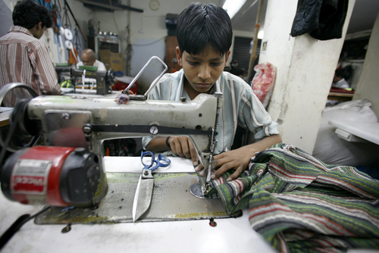
Absolute rights
Not every human right can be limited. Some must be upheld in all circumstances!

Slide 6
Absolute or not?
They are in our country illegally and have committed a crime so they should be sent home!
Torture must never be allowed. It is an absolute human right because no human being should ever be tortured. They should not be sent home.
Scenario: An illegal immigrant who has committed a crime in the UK is allowed to stay in Britain because if they were sent home, they would be tortured in their own country.

Slide 7
Absolute or not?
In reality, the courts would decide how to resolve this situation.
They would:
Firstly decide whether there is a real threat of torture taking place. This is determined by examining the facts and evidence of the case, for example, whether the individual has suffered torture in the past, has been threatened with torture, or is associated with a group of individuals that have been or are at risk of torture.
Secondly they consider the level of severity of the torture. There must be a minimum level of severity for the case to be considered.

Slide 8
Absolute or not?
If it is determined that the threat of torture is (1) real and (2) presents a severe risk, then the absolute right to be protected from torture will be upheld.
Unlike limited human rights, it won’t need to be balanced with the possibility that the individual might commit further crime.

Slide 9
Skim read page 42 and 43 then write a paragraph to answer this statement:
‘Human rights should never be limited’

Slide 10
Balancing Human Rights
Have you met today’s objectives?
1. To explain what is meant by freedom of speech. 2. To suggest why some human rights might be limited

