Slide 1
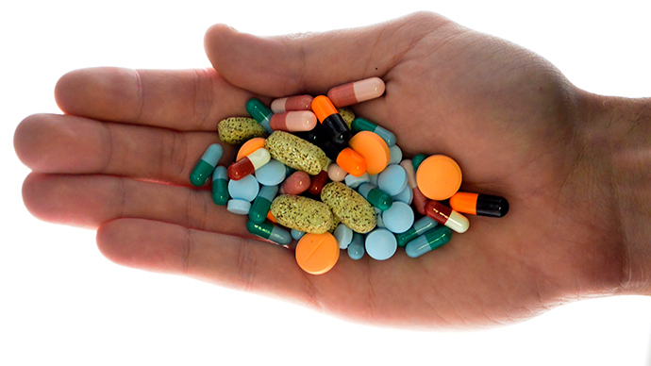
LO: To explain the effects of Legal highs.
All: I can identify what a legal high is
Most: I can classify the effects, the risks and the laws associated with legal highs
Challenge → I can suggest the long term effects of an addiction to legal highs
Key Words:
Legal, Illegal
Substance, Addiction
Notes:
http://www.classtools.net/education-games-php/fruit_machine
3 minutes

Slide 2
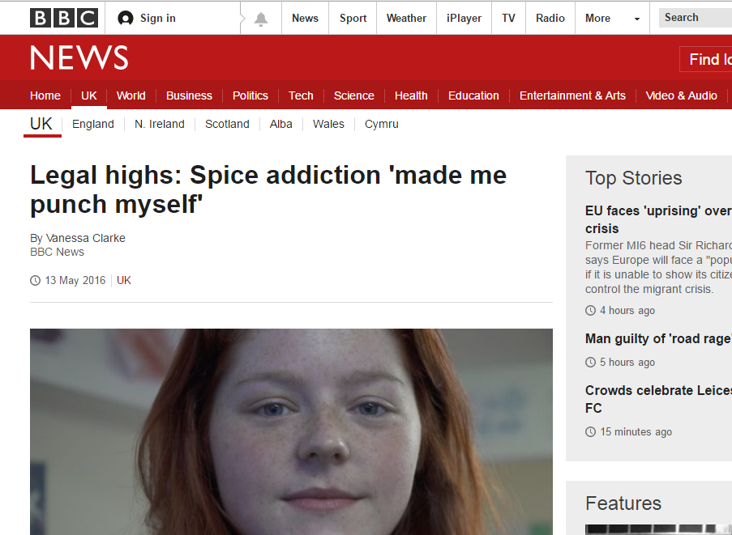
Use the newspaper articles to help you predict the topic of today’s lesson!
Notes:
5 Minutes

Slide 3
Starter Activity So, what is a Legal High? 5 Minutes!
A Legal High is a substance that produces a similar effects to illegal drugs. These new substances are not yet controlled under the Misuse of Drugs Act (1971) and there is often not enough research about them to know about their effects on the human body.
In recent months more and more research is being carried out on ‘legal highs’ to see what their dangers are, and to see whether they should be made illegal. Legal highs cannot be sold for human consumption so they are often sold as different products (such as plant food) to get around the law.
Just because a substance is sold as ‘legal’ it does not mean that it is safe, you can never really be sure if the legal high that you have bought or been given will cause you harm.
Find out the information about Legal highs by putting the paragraphs back together!
Notes:
http://www.talktofrank.com/drug/legal-highs
10 minutes

Slide 4
Alternative Starter → You have 3 minutes to mind-map everything that you already know about drugs!
Notes:
5 minutes

Slide 5
Most: I can classify the effects, the risks and the laws associated with Legal Highs (Level 5-6)
Carousel Activity – Success Criteria
Your task is to investigate the effects, laws and risks associated with Legal highs, to do this you will have to go around each of the workstations and complete the set activities.
You will have 5 minutes on each activity so you must work as a team!
Notes:
20 minutes

Slide 6
What have you learned today?
All: I can identify what a Legal High is
Most: I can classify the effects, the risks and the laws associated with legal highs
Challenge: I can suggest the long term effects of an addiction to legal highs
Notes:
3 minutes

Slide 7
How has Dean’s addiction to Spice affected his life?
How long did it take for Dean to become addicted to Spice?
Why did Dean start taking the drug?
Before
After
Why does Dean smoke Spice?
How did the drug effect Dean the first time that he smoked it?
Challenge → I can suggest the long term effects of an addiction to legal highs
Notes:
5 minutes

Slide 8
Extension → Dean’s Addiction to Spice Using the ideas that we discussed complete your table about Dean’s lifestyle now that he is addicted to Spice.
Before Dean’s Addiction | Dean’s Current Lifestyle | The Future for Dean
Notes:
5 minutes

Slide 9
Write down four things that you have learnt this lesson!
Come up with one challenging question for someone else in the class.
Notes:
10 minutes

