Slide 1
Hypothesise
Making a prediction about something based on limited evidence
Classify
To arrange a group people or things according to their shared qualities
Identify
To recognise something for what it is

Slide 2
A Legal High is a substance that produces a similar effects to illegal drugs. These new substances are not yet controlled under the Misuse of Drugs Act (1971) and there is often not enough research about them to know about their effects on the human body.
In recent months more and more research is being carried out on ‘legal highs’ to see what their dangers are, and to see whether they should be made illegal. Legal highs cannot be sold for human consumption so they are often sold as different products (such as plant food) to get around the law.
Just because a substance is sold as ‘legal’ it does not mean that it is safe, you can never really be sure if the legal high that you have bought or been given will cause you harm.

Slide 3
Workstation 1 Success Criteria
Your task is to read through the information cards as a team
You then need to identify the information for each aspect of the worksheet
You do not need to copy the information just summarise it into your own words
It is important to support each other and work as a team as you only have 5 minutes!

Slide 4
Taking Legal highs can lead to blotchy and discoloured skin. | Legal highs have been known to cause extensive brain damage.
Legal highs can cause the heart rate to speed up or slow down, which can cause heart rate or possibly stroke. | Smoking Legal highs can cause multiple lung problems, including bleeding lungs. | Hallucinogenic ‘legal highs’ act like LSD, magic mushrooms and ketamine They can make you hallucinate (seeing and/or hearing things that aren’t there).
An addiction to Legal highs can be very expensive, with an average spend of £60 a day. | Stimulant ‘legal highs’ act like amphetamines (‘speed’), they can make you feel energised, fast-thinking, and very chatty. | Sedative ‘legal highs’ act similarly to cannabis, they can make you feel euphoric, relaxed or sleepy

Slide 5
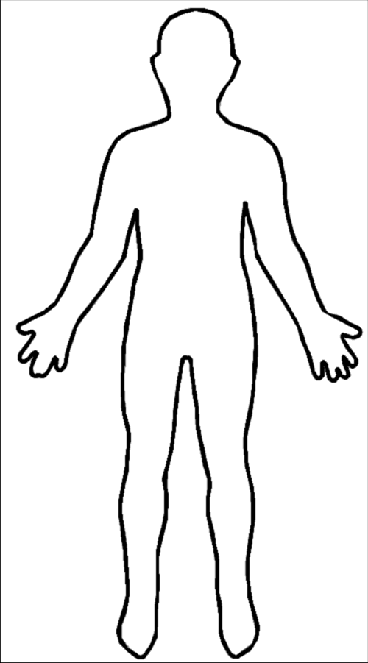
The Effects of Legal Highs on a Person
The Heart
The Lungs
The Wallet
The Skin
Stretch → I can classify the effects, the risks and the laws associated with Legal Highs (Level 5-6)

Slide 6
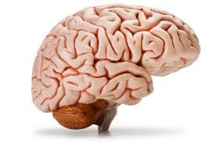
The Effects of Legal Highs on the Brain
Stimulants
Brain Damge
Hallucinogenic
Sedatives
Stretch → I can classify the effects, the risks and the laws associated with Legal Highs (Level 5-6)

Slide 8
Workstation 2
Discuss the images and mind-map the risks of Legal highs as a group!
The Risks of Legal Highs
Stretch → I can classify the effects, the risks and the laws associated with Legal Highs (Level 5-6)

Slide 10
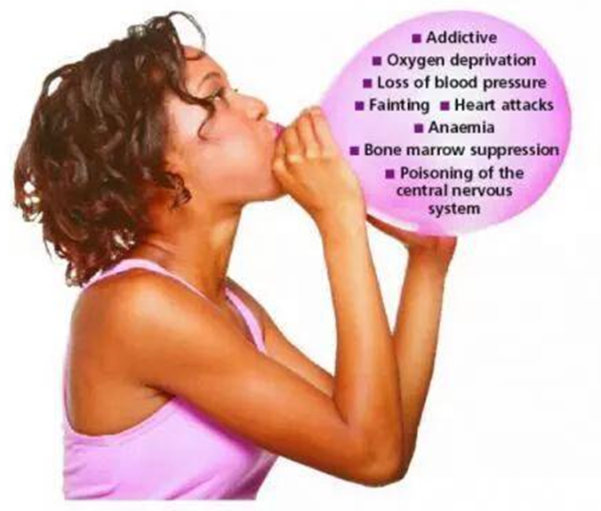
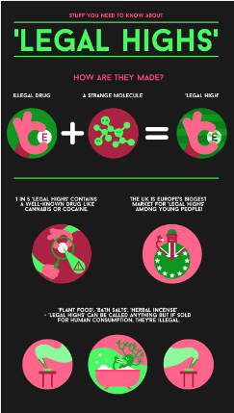

Slide 11
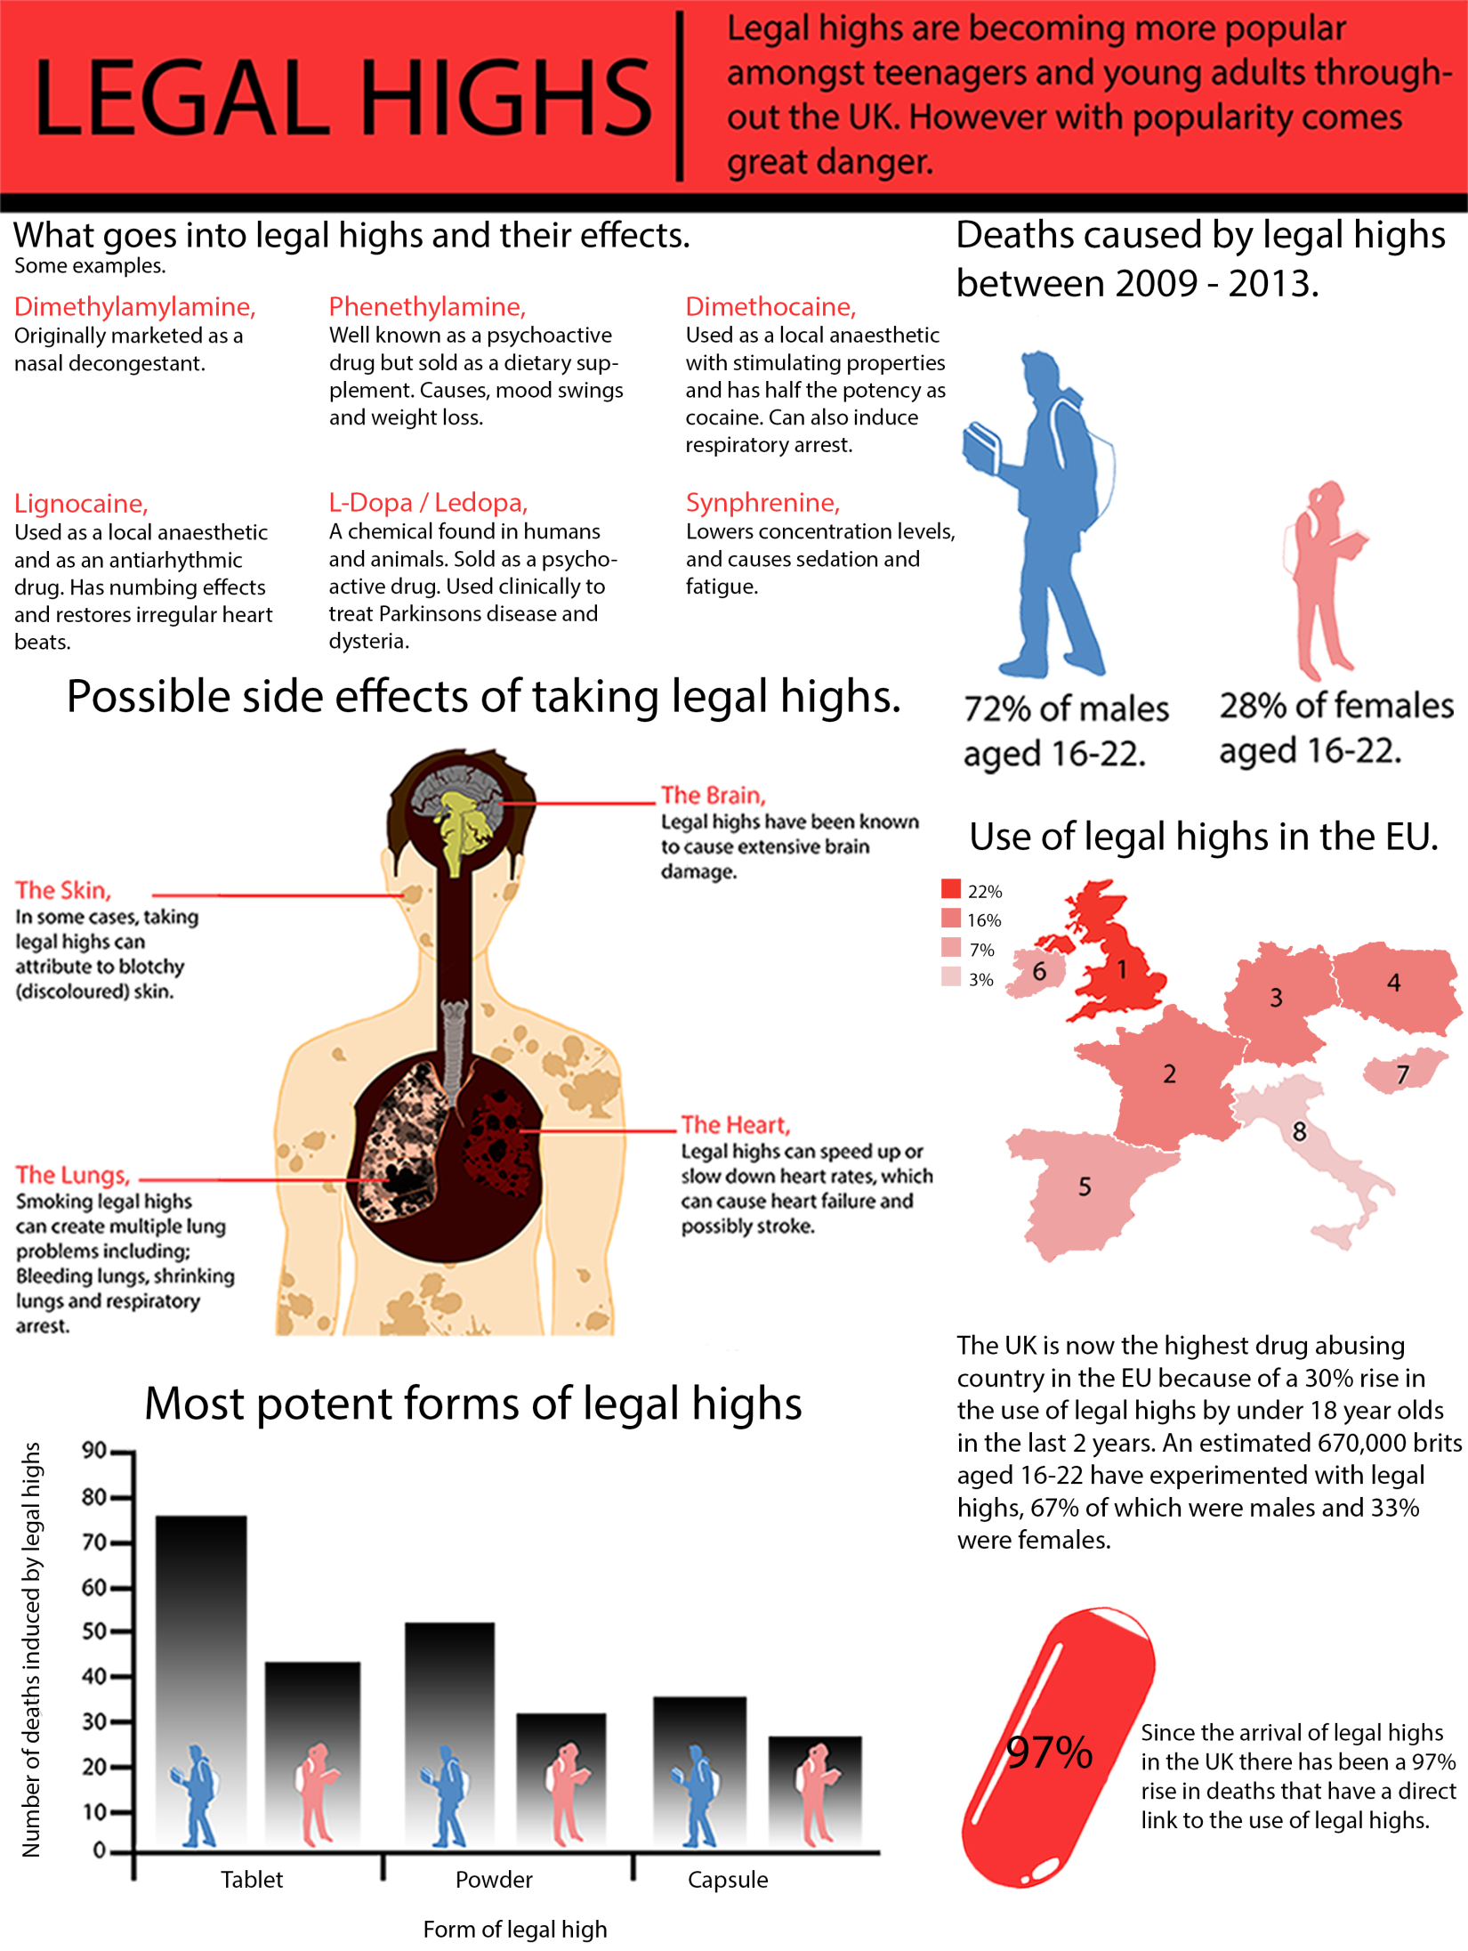

Slide 12
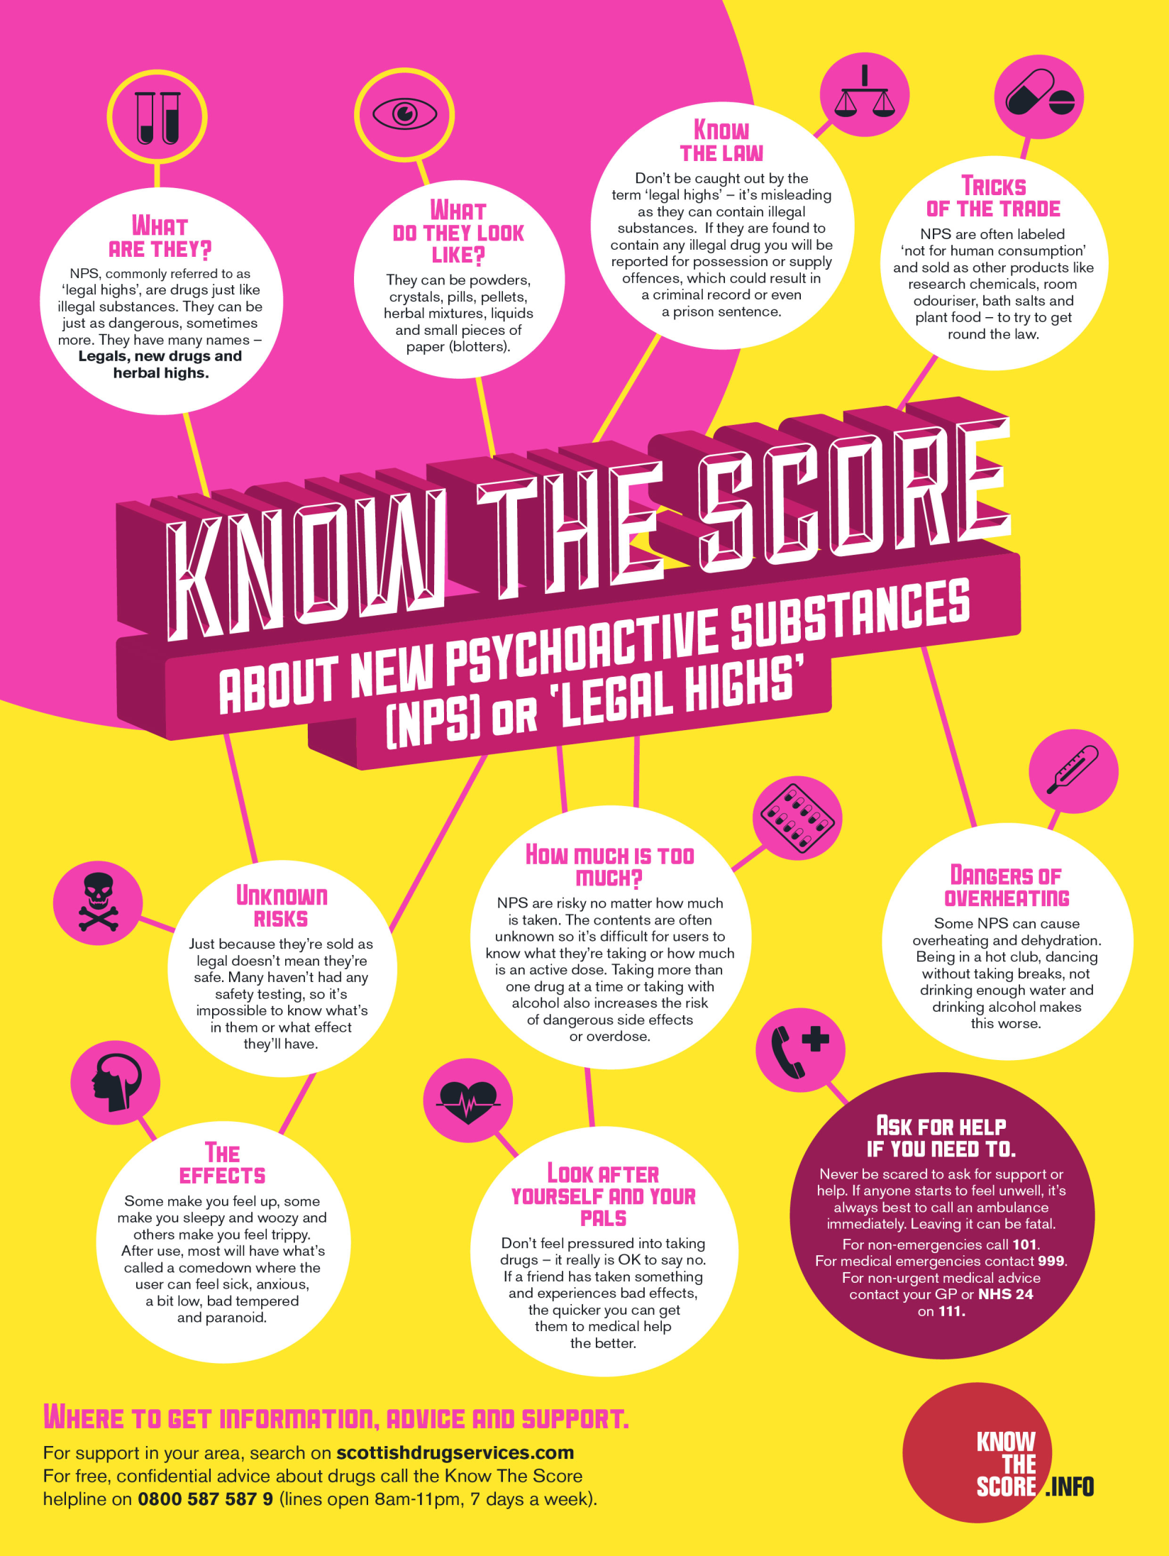

Slide 13
Workstation 3 The Laws Associated with Legal Highs
Just the fact that someone claims that a substance is “legal” doesn’t mean that it’s _ _ _ _ or _ _ _ _ _. Possessing or supplying (includes giving to a friend) a ‘legal high’ that contains a banned _ _ _ _ is
an _ _ _ _ _ _ _ .
So-called legal _ _ _ _ _, or New Psychoactive Substances (NPSs) as they are sometimes known, have long posed a problem to police forces that see them as _ _ _ _ _ _ _ _ _ but _ _ _ _ _ _ do anything about them due to their legality. The Psychoactive Substances _ _ _ will provide a blanket ban on the production, _ _ _ _ _ _ and importation of new psychoactive substances (NPS).
The Act covers any _ _ _ _ _ _ _ _ _ used for getting high and excludes nicotine, _ _ _ _ _ _ _ , caffeine and medicinal products.
Word Bank
Safe Legal Drug Offence Highs
Dangerous Cannot Act Supply
Substance Alcohol
Stretch → I can classify the effects, the risks and the laws associated with Legal Highs (Level 5-6)

Slide 14
Extension → key word anagrams
Rgdu
Diontcdai
Nceatbuss
Eglal ighh
Tlnaumits
Spresdtane
Alw
Ceneffo
Stretch → I can classify the effects, the risks and the laws associated with Legal Highs (Level 5-6)

Slide 15
Drug
Addiction
Substance
Legal High
Stimulant
Depressant
Law
Offence

Slide 16
How has Dean’s addiction to Spice affected his life? > > > >
Challenge → I can hypothesise the long term effects of an addiction to Legal Highs (Level 6-7)
Why did Dean start taking the drug?
How did the drug effect Dean the first time that he smoked it?
How long did it take for Dean to become addicted to Spice?
Why does Dean smoke Spice?

Slide 17
Extension → Dean’s Addiction to Spice Using the ideas that we discussed complete your table about Dean’s lifestyle now that he is addicted to Spice.
Challenge → I can hypothesise the long term effects of an addiction to Legal Highs (Level 6-7)
Before Dean’s Addiction | Dean’s Current Lifestyle | The Future for Dean

Slide 18
Self-Assessment Success Criteria An introduction to ‘Legal Highs’
Activity 1 – Effective Participator
I speak confidently and clearly
I contribute to group discussions
I take part in all activities
Activity 2 – Team Worker
I listen to the ideas of others
I know that I can achieve more by working in a team
I can give helpful feedback and support
Activity 3 – Independent Enquirer
I ask questions to clarify subjects
I express my own ideas and views
I can work independently to research
Activity 4 – Reflective Learner
I can evaluate what I have done well
I am confident to question others
I can set targets for further learning

