Slide 1
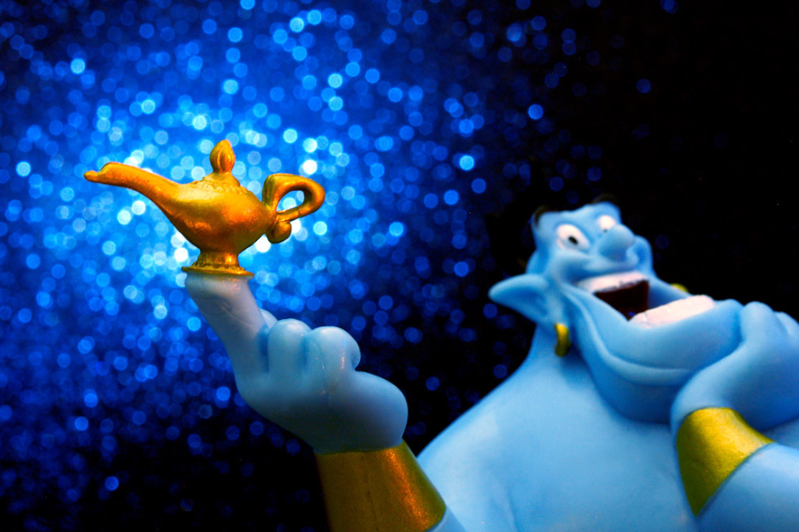
3
Aladdin
Notes:
https://www.flickr.com/photos/jdhancock/7486455230/in/photolist-cpy3jj-RJArWz-WKu69m-XmuKd2-X9rHip-XhAsW7-Xg54gs-XjM7Kv-WHUeSY-X4ZacC-WHWDeo-W3Xb9Y-WKumjS-XjLtkR-X53FPy-WHZh7h-W6qCzr-Xg6wWq-XhAFob-hEdRha-X7U17K-TWY7Ji-XmvF1n-X4YJ4G-Xg599J-Hrn5Uc-X7UZTr-8rCoNh-WHVrgC-W44WyY-WKtPw9-X85tV4-nH8ntt-s1Nxs-nqFM9h-nGYPfU-98E7a3-d8KoDC-nqDnjK-X5cU4f-TxSLv1-6V8TBY-6robm-5HwZ1W-daJCT1-4FNBNN-6ge8hw-py1Km-q7p7Ty-nGSTCx

