Slide 1
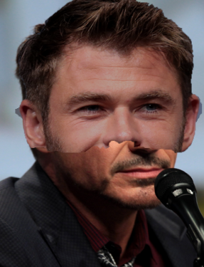
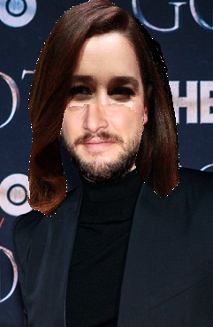
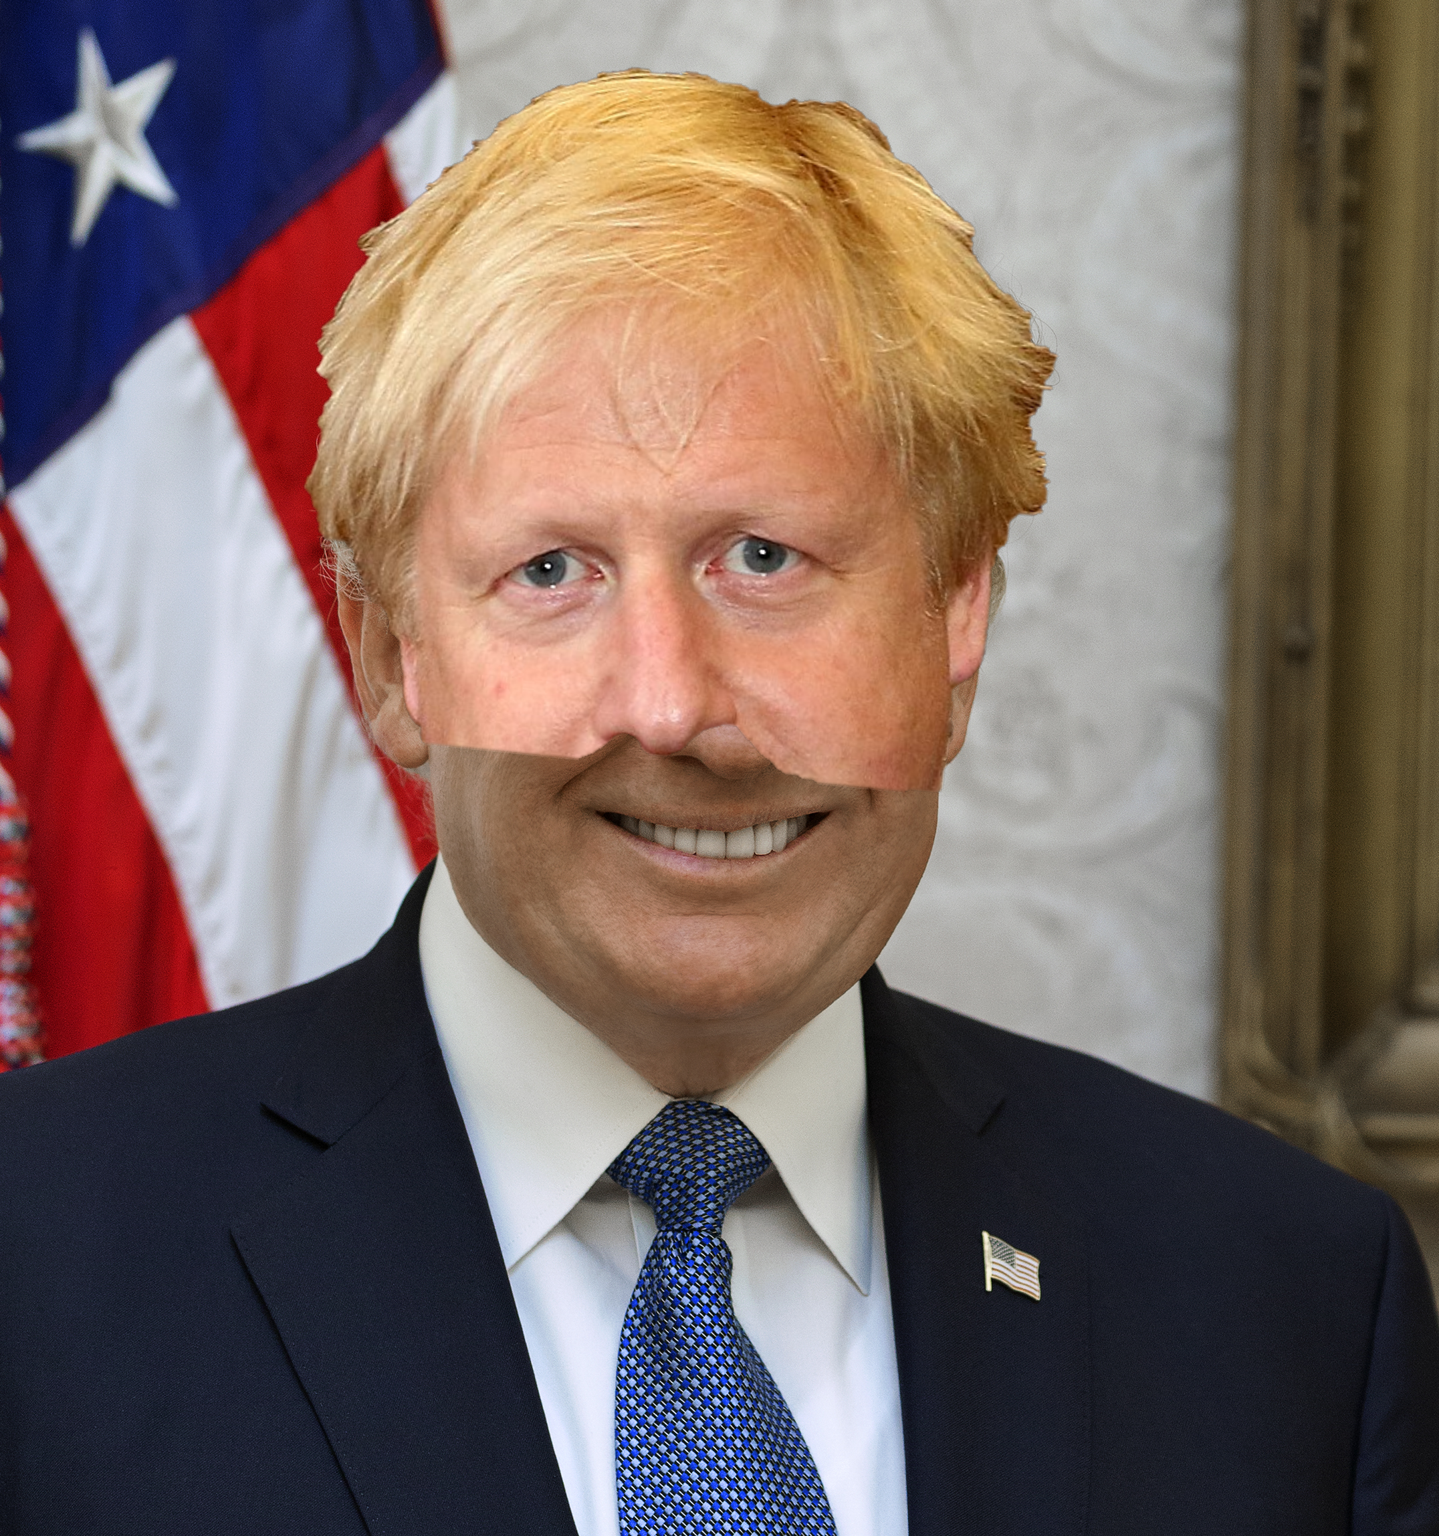
Which celebrities have had their faces morphed together?
1
2
3
Notes:
By Gage Skidmore, CC BY-SA 3.0, https://commons.wikimedia.org/w/index.php?curid=61367335
https://www.flickr.com/photos/gageskidmore/14802403202/
https://www.flickr.com/photos/gageskidmore/14802403202/
By Gage Skidmore, CC BY-SA 3.0, https://commons.wikimedia.org/w/index.php?curid=61367335
By Sachyn - A cropped version of File:Kit harrington by sachyn mital.jpg, CC BY-SA 3.0, https://commons.wikimedia.org/w/index.php?curid=79222510
By Gage Skidmore, CC BY-SA 3.0, https://commons.wikimedia.org/w/index.php?curid=69537547
Donald Trump - This file is a work of an employee of the Executive Office of the President of the United States, taken or made as part of that person's official duties. As a work of the U.S. federal government, it is in the public domain.
By Foreign and Commonwealth Office - International Atomic Energy Agency Director General, CC BY 2.0, https://commons.wikimedia.org/w/index.php?curid=73747417

