Slide 1
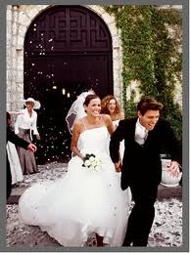
Unit Title: The Rights of Children and Bullying
Today’s title: Review Lesson
Learning Objective: To understand what rights and responsibilities are.
I can list some rights and responsibilities.
I can describe why rights and responsibilities are important
I can explain why rights and responsibilities are important.
Challenge: Write down which one you think is most important and why.
Starter: Can you guess what the rights are?
3.
1.
2.

Slide 2
Unit Title: The Rights of Children and Bullying
Today’s title: Rights and Responsibilities
Learning Objective: To understand what rights and responsibilities are.
I can list some rights and responsibilities.
I can describe why rights and responsibilities are important
I can explain why rights and responsibilities are important.
Copy the keywords
Rights:
A right is a freedom that is protected, such as the right to free speech and religion.
Responsibilities:
A responsibility is a duty or something you should do, such as recycling or doing your homework.

Slide 3
The history of human rights
https://www.youtube.com/watch?v=6XXGF_V8_7M

Slide 4
How has Human right changed over the years.
In small groups discuss how human rights have changed over the years.
Also in the video why have people’s human rights been taken away from them.

Slide 5
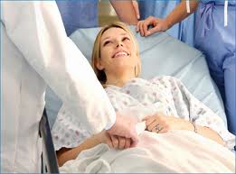
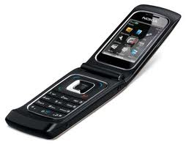
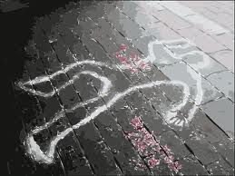
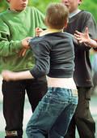
The rights of the child
Vote
Be treated in hospital
Have a child
Task 1: Write down which of these things every child should be allowed to have or do.
Challenge: Can you say why? Add sentences.
A mobile phone
Kill someone
Get married
Drinking water
A place to live
Hit someone

Slide 6
Different types of Bullying
Verbal bullying – name calling or making nasty comments or jokes based on sexuality, appearance, race, disability or religion.
Indirect bullying – being ignored, dirty or intimidating looks or gestures, giving people the evil eye, made to feel like an outsider or spreading rumours.

Slide 7
Different types of Bullying
Physical bullying – punching, being spat at, making people do things they don't want to do, having belongings damaged or stolen, making people feel uncomfortable or scared.
Cyber bullying - sending nasty or threatening texts or e-mails, making threatening phone calls, taking humiliating pictures or video clips and sharing them with others, or horrible comments or threats placed on Facebook.

